Slide 1
Statement of Cash Flows
Basic elements
included
In the various sections
Of the
Statement of Cash Flows
Operating, Investments and financing

Slide 2
Statement of Cash Flows
The Statement of Cash Flows is one of the four basic financial statements in addition to the income statement, statement of owner’s equity/statement of retained earnings and balance sheet
The Statement of Cash Flows has four sections
Operating
Investing
Financing
Disclosures of non-cash investing and financing transactions

Slide 3
Statement of Cash Flows
Provides a detail of how cash was obtained and spent by the company in operating its business (operating), investing in its infrastructure (investing), and financing its operations (financing).
The statement informs the reader if cash has been obtained through operating the company, through selling assets or by borrowing money or issuing stock.
Healthy companies primarily generate cash flow from operating activities not from selling off assets or issuing stock or incurring debt.

Slide 4
Operating Section
How much cash was generated and spent through conducting the business of the company. Starts with net income and will disclose gains and losses from asset sales and retirement of liabilities
Increases and decreases in the balances of current assets and current liabilities of business are shown in this section
Includes cash from
Customers on cash sales
Collections on credit sales
Borrowers on interest
Dividends received from investments in other companies
Lawsuit settlements
Includes cash spent on
Salaries and wages
Vendors for goods and services
Taxes and governmental fines
Interest paid to lenders

Slide 5
Investing Section
Long-Term Assets including
Purchase and sale of long-term assets
Investments in the securities of other corporations
Lending and collection money for notes receivable for non-sales transactions
If the note receivable is to a customer, then it is included in the operating section
If the note receivable is not related to sales, then collection of the principal is included in the investing section but collection of interest is included in the operating section
Easiest way to remember: Only the principal on notes for non-sales transactions are included in the Investing section

Slide 6
Investing Section
Cash from
Selling long-term assets
Selling investments in securities of other companies
Collection of principal on non-sales notes receivable
Cash paid to
Purchase long-term assets
Purchase investments in securities of other companies
Make loans on non-sales transactions

Slide 7
Financing Section
Long-Term Liabilities and Stockholders’ Equity
Include transactions related to company’s owners and creditors
Investments from owners and cash/dividends paid to owners
Transactions related to loans
Transactions related to bonds

Slide 8
Financing Section
Cash from
Issuing stock shares
Issuing short-term or long-term debt
Contributions from owners
Issuing bonds
Cash paid to
Owners for dividends
Owners as withdrawals
Purchase treasury shares
Repay principal on loans – Interest is always in the operating section

Slide 9
Non-Cash Investing and Financing
When important investing and financing activities do not affect cash receipts or payments, they are still disclosed at the bottom of the statement of cash flows or in a note to the statement because of their importance and the full-disclosure principle.
Examples:
Purchase of long-term assets using a long-term note payable (loan). This transaction involves both investing and financing activities but does not affect any cash inflow or outflow and is not reported in any of the three sections of the statement of cash flows.
Purchase of long-term assets by issuing shares of stock
Retirement of bonds by issuing shares of stock
Converting preferred stock to common stock

Slide 10
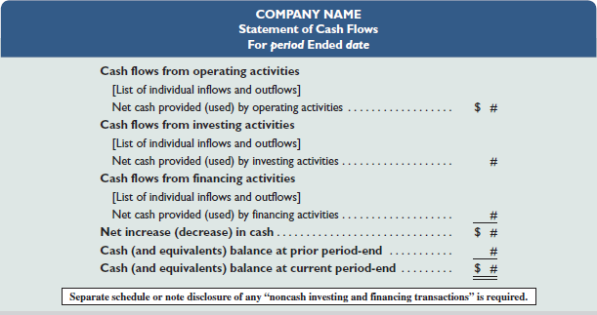
Statement of Cash Flows

