Slide 1
Essentials of Accounting for Governmental and Not-for-Profit Organizations
Chapter 5
Accounting for Other Government Fund Types
Capital Projects Fund
McGraw-Hill/Irwin
Copyright © 2016 by The McGraw-Hill Companies, Inc. All rights reserved.

Slide 2
Chapter 5 – Learning objectives
Apply the modified accrual basis of accounting in the recording of typical transactions of capital projects funds
Prepare the fund-basis financial statements for governmental funds

Slide 3
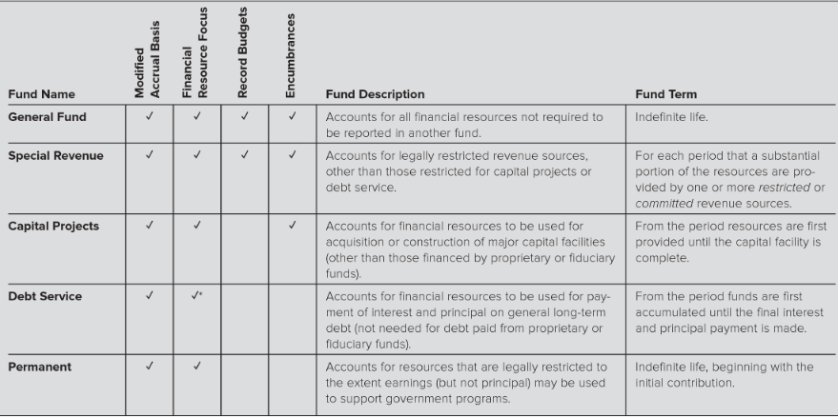
Governmental Fund Types – Review

Slide 4
Review of Capital Project Funds
Use Modified Accrual Basis and Current Financial Resources measurement focus
If an annual budget is used, may be recorded in the fund but is not required – not often used
If control of purchase orders is relevant to the fund, can use encumbrance accounting. Typically done with capital projects.
Generally do not report long-term assets or long-term liabilities on fund-basis balance sheet
Long-term asset purchases are treated as expenditures and no depreciation is recorded. Long-term debt proceeds are treated as other financing sources.

Slide 5
Fund Definitions Capital Projects Funds
Capital Projects Funds: Account for and report financial resources that are restricted, committed or assigned to expenditure for capital outlays.

Slide 6
Capital Project Funds
Used for construction or acquisition of major long-term assets such as buildings, bridges, etc. for government funds until project is complete
Proprietary type funds account for construction activities of proprietary activities. They do not require use of a capital project fund.
Sources: Accounts for issuance of bonds and receipt of other financing sources such as dedicated taxes
Accounts for construction or acquisition expenditures
Does not report the long-term asset in the capital project fund—Treated as expenditure in the fund
Long-term asset is listed in government-wide Statement of Net Position after reconciliation

Slide 7
Primary Sources of Funds for Capital Projects
Issuance of bonds
Recorded as bond proceeds not revenue and is found Other Financing Sources of the Statement of Revenue, etc.
Grants from other government units – Recorded as revenue
Dedicated taxes or other revenues raised specifically for a capital project – Recorded as revenue
Most often the resources are long-term debt issues, dedicated taxes, and grants.
Transfers from other funds such as Gen Fund – Recorded as Other Financing Source—Transfer In.
Other
Donations
Interest earned on funds held

Slide 8
Bond Issues
Long-term bonds are not fund liabilities in governmental type funds
Assume $12,000,000 of bonds are issued to fund a capital project:
Cash $12,000,000
Other financing sources: Bond Proceeds $12,000,000
However, recorded as long-term liability in govt-wide Fin Stmt after reconciliation
Bond proceeds are considered an Other Financing Source on the Statement of Revenues, Expenditures and Changes in Fund Balance
Bond proceeds is not a revenue per se, but is considered a current inflow on the activity statement

Slide 9
Bond Premium
Capital Projects Fund
A bond premium is recorded as:
Other Financial Sources – Premium on Bonds
Cannot be used for capital project expenditures
Debt Service Fund
These premiums must be used for Debt Service and are transferred from the capital projects fund to the debt service fund

Slide 10
Number of Capital Project Funds to Use
Some jurisdictions may require a separate fund for each building project
Otherwise, governments may account for all, or at least related construction projects, in a single fund using the ‘fund within a fund’ approach
In that case a government will use separate accounts for:
Expenditures - Project 1,
Expenditures - Project 2, etc.
General rule—make sure you can demonstrate the funds intended to be used on a specific project are traceable to the project

Slide 11
Capital Project Fund
Exists only for the duration of the project
Unused bond proceeds remaining in a capital projects fund would be transferred to a debt service fund. The capital projects fund would record Other Financing Use—Transfers Out and the debt service fund would record Other Financing Sources—Transfers In.
Expenditures are reported according to character outlay on the Stmt of Rev, Expenditures, and Changes in Fund Balance
Often uses encumbrance accounting but not necessarily budgetary accounting
Fund Balances
Net resources often classified as Restricted for voter approved funds and/or intergovernmental taxes and grants
Contractual outlays often classified as Committed
Remainder classified as Assigned
No unassigned for any fund except General

Slide 12
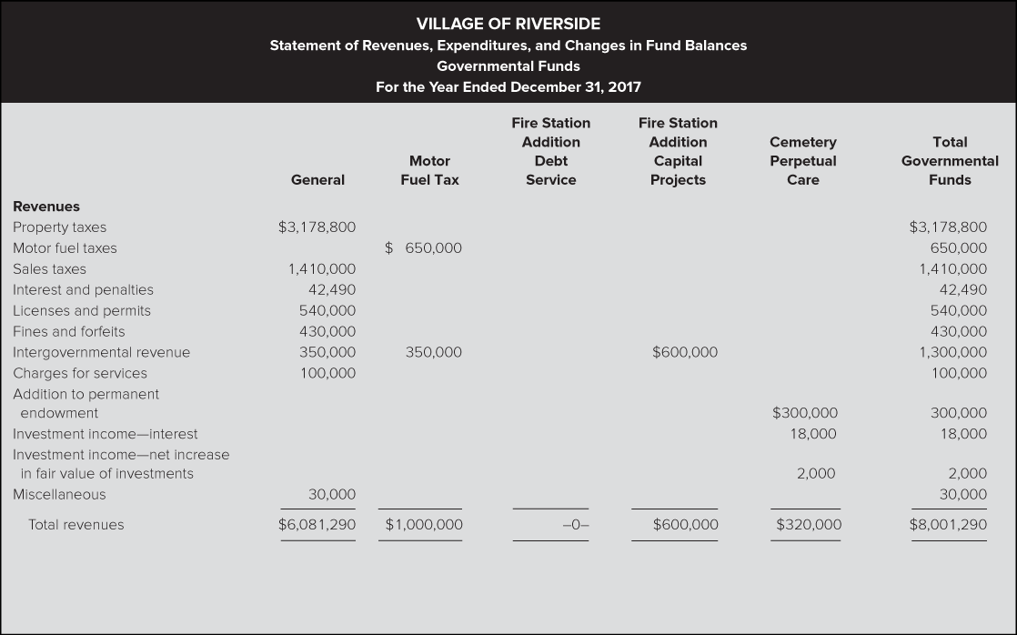

Slide 13
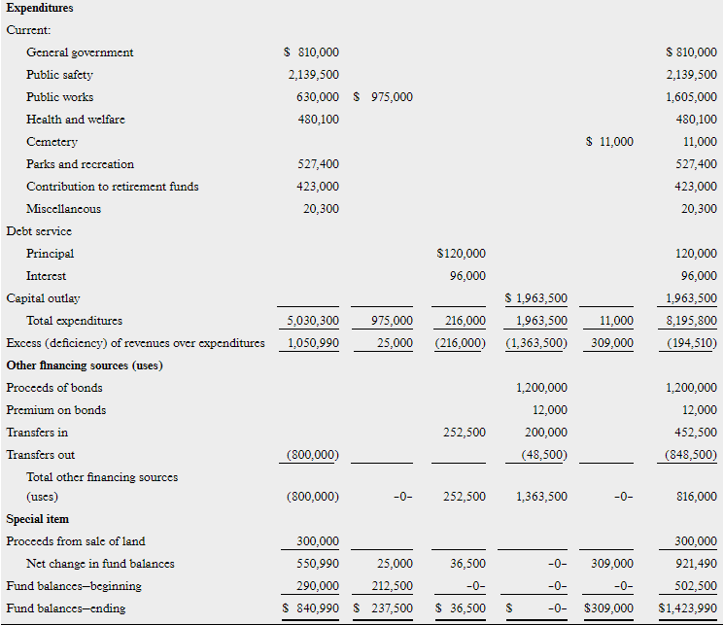

Slide 14
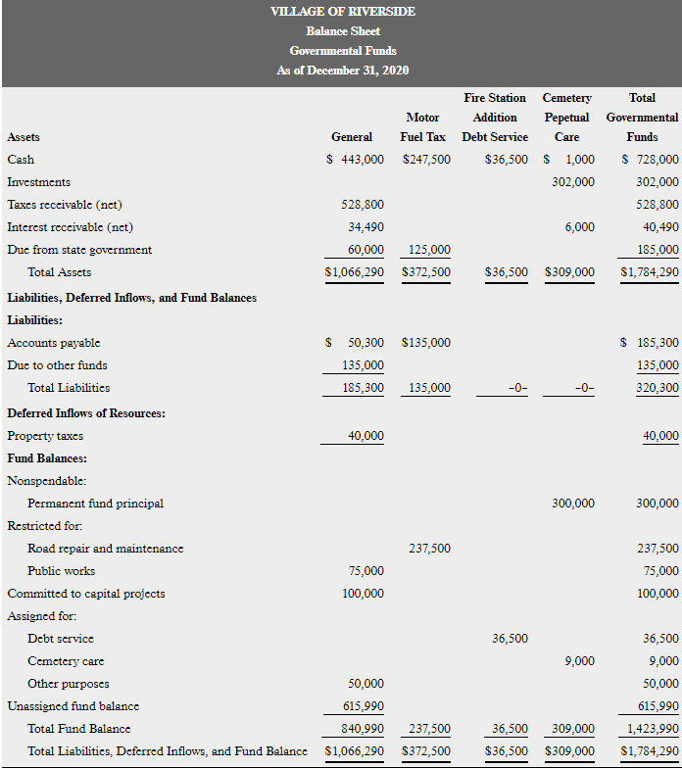

Slide 15
