Slide 1
Closing Entries
In-Class Assignments

Slide 2
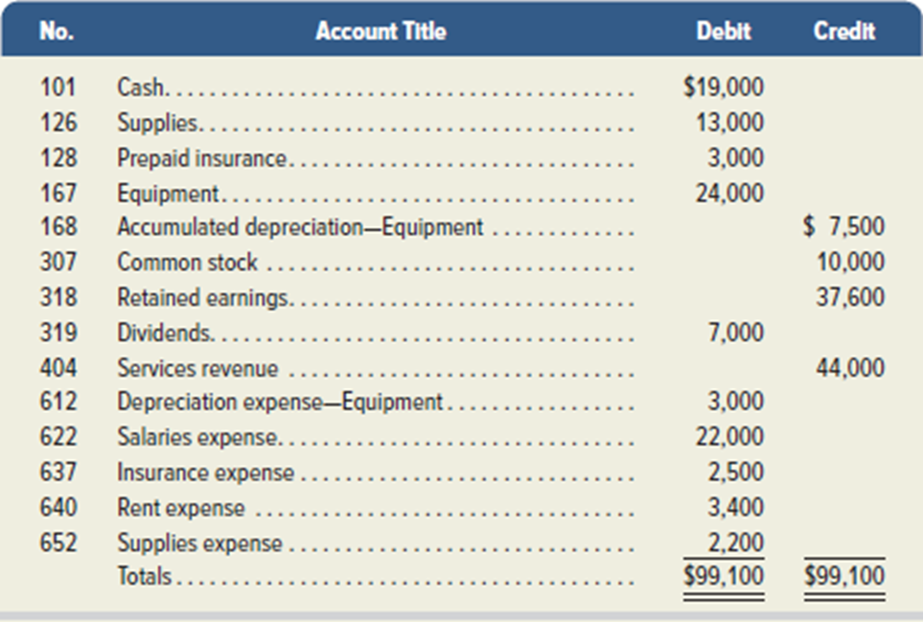
What is the first closing entry (CE#1)?

Slide 3
What is the first closing entry (CE#1)?
Step 1: Close Credit Balances in Revenue Accounts to Income Summary
The first closing entry transfers credit balances in revenue accounts to the Income Summary account.
We bring accounts with credit balances to zero by debiting them.
This leaves revenue accounts with zero balances, and they are now ready to record revenues for next period.

Slide 4
What is the second closing entry (CE#2)?

Slide 5
What is the second closing entry (CE#2)?
Step 2: Close Debit Balances in Expense Accounts to Income Summary
The second closing entry transfers debit balances in expense (and loss) accounts to the Income Summary account.
We bring expense accounts’ debit balances to zero by crediting them.
With a balance of zero, these accounts are ready to record expenses for next period.

Slide 6
What is the third closing entry (CE#3)?

Slide 7
What is the third closing entry (CE#3)?
Step 3: Close Income Summary to Retained Earnings
The third closing entry transfers the balance of the Income Summary account to the Retained Earnings account.
This entry closes the Income Summary account.
HINT: Use a T account for Income Summary to determine the balance after CE1 and CE2
If a net loss occurred because expenses exceeded revenues, the third entry would be: debit Retained Earnings and credit Income Summary.

Slide 8
What is the fourth closing entry (CE#4)?

Slide 9
What is the fourth closing entry (CE#4)?
Step 4: Close Dividends Account to Retained Earnings
The fourth closing entry transfers any debit balance in the Dividends account to the Retained Earnings account.
This entry gives the Dividends account a zero balance, and the account is now ready to record next period’s dividends.

Slide 10
What is the ending balance in Retained Earnings?
Hint: Use a T Account

Slide 11
What is the ending balance in Retained Earnings?
Hint: Use a T Account

Slide 12
What will be on the Post-Closing Trial Balance?
Hint: Use a T Account

Slide 13
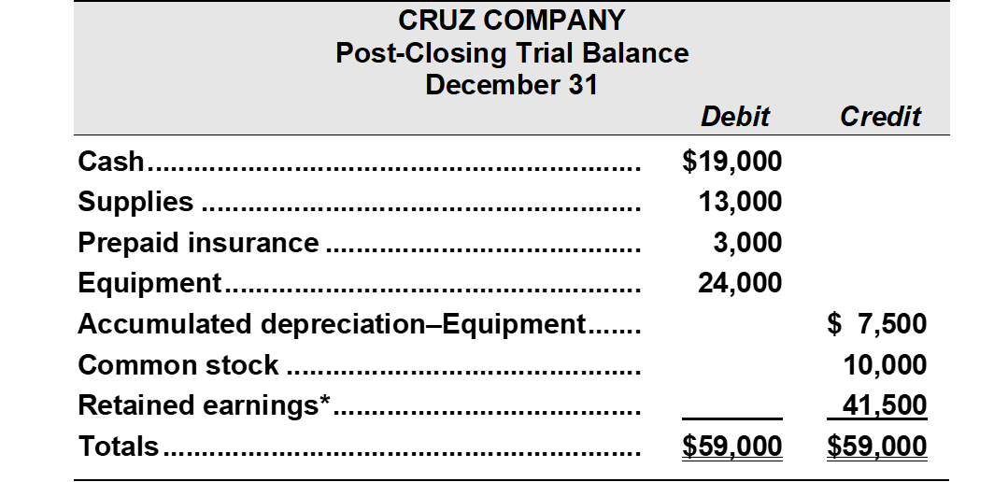
What accounts are included in the Post-Closing Trial Balance?
Hint: Use a T Account

Slide 14
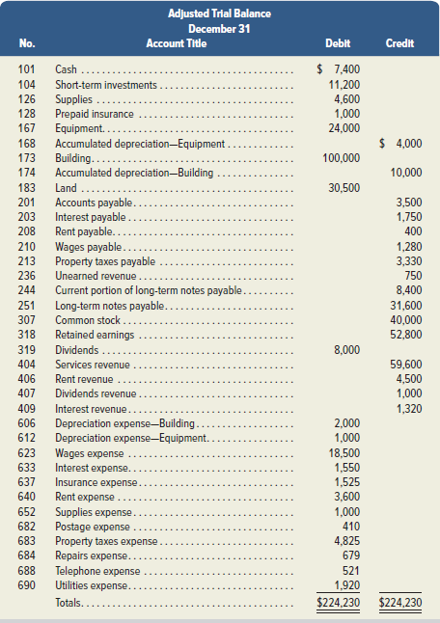
Prepare the closing entries.
What is the ending balance in Retained Earnings?

