Slide 1
Notes Receivable
Notes receivable are more formalized documents than trade receivables as they are written promises to pay and carry an interest provision. Typically, they are have more legal standing and are easier to enforce

Slide 2
Notes Receivable
Notes receivable (NR) will have a face value and typically the days outstanding are on the face of the document.
Often NR are for large amounts and are due over a long period of time. Many times, companies will require a customer with a long outstanding trade receivable to consummate a NR to ensure legal standing for the company during the collection process.
To calculate interest, a banker’s year is used which is comprised of 360 days.

Slide 3
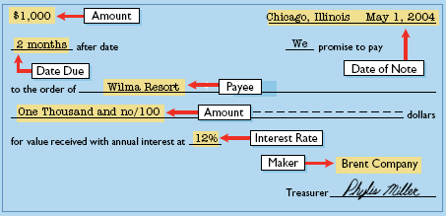
Typical Note Receivable

Slide 4
Computing NR Interest

Slide 5
Exchanging Trade AR for Note Receivable
When a trade AR is exchanged, the company will often require the customer to pay some cash at the time of the exchange
When paid, the JE is

Slide 6
Recognizing Interest Receivable – AJE – New Example
When the books are closed for a period, an AJE is required for interest earned but not yet paid on the financial statement date. This AJE will affect the JE when the note is paid

Slide 7
Calculating Note Maturity Dates
Due Date Expressed as Days
Due date Expressed as Months

