Slide 1
Merchandising Companies
Accounting for Sales and Purchases
Using various examples from a fictitious company,
we will walk through sales and purchases of merchandise

Slide 2
Merchandising Companies
This chapter is about a new type of company which sells merchandise and not services. We will learn about this type of company by looking at various transactions for a seller and purchaser of merchandise.
We will use a local company named “Candy Mart” which purchases from the large candy manufacturers and sells to local candy stores for Halloween baskets. The store’s clients are Happy Halloween, Scary Snacks, and Gruesome Goodies.

Slide 3
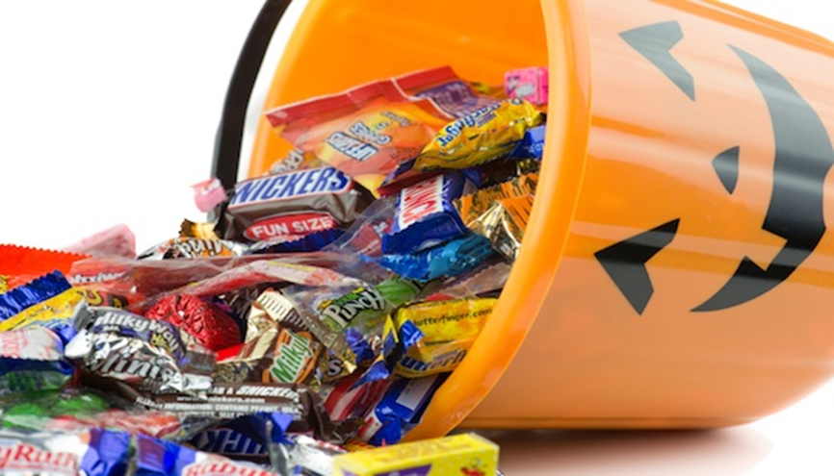
As a merchandiser, Candy Mart has this amount of candy at October 1, 20xx.

Slide 4
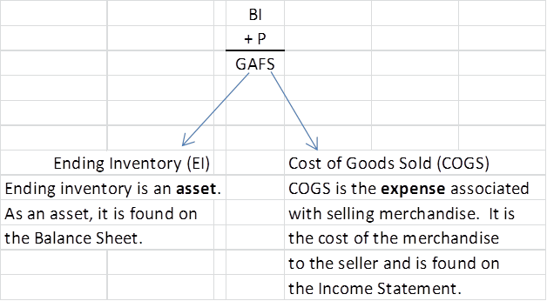
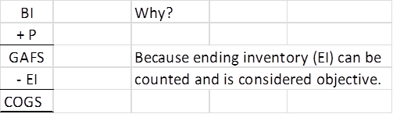
At the end of the month:
What can happen to Goods Available for Sale (GAFS) during the month?

Slide 8

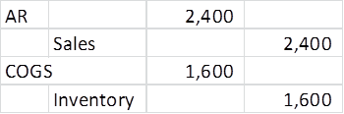

Slide 9



Slide 10

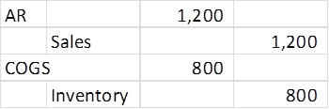
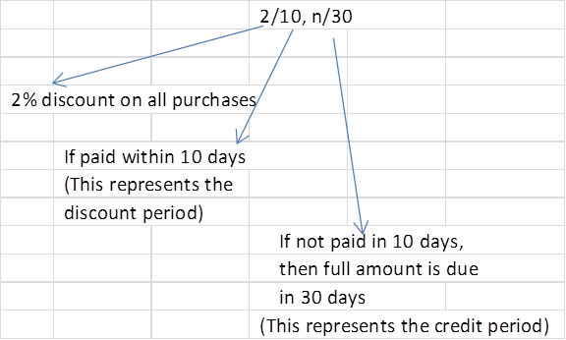

Slide 12



Slide 14
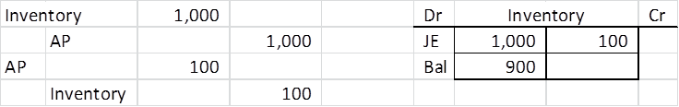

Slide 16
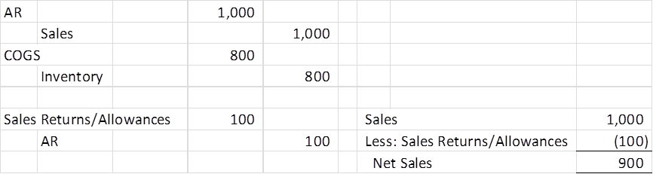

Slide 18
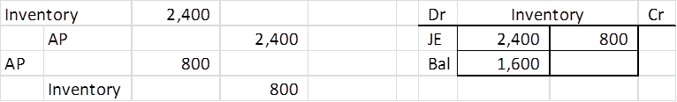

Slide 19
How do returns and allowances affect the purchase discount when the bill is ultimately paid?

Slide 20
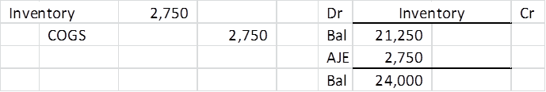
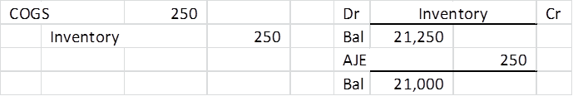

Slide 23
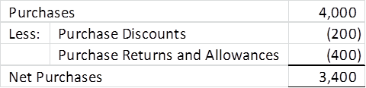
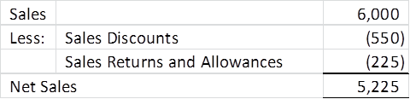

Slide 24
