Slide 1
Long Term Assets Property, Plant and Equipment
types
cost
Depreciation
Disposal

Slide 2
Characteristics
Plant assets are tangible assets used in a company's operations that have a useful life of more than one accounting period. Plant assets are also called fixed assets. For many companies, plant assets make up the single largest class of assets they own.
Plant assets are set apart from other assets by two important features.
First, plant assets are used in operations. This makes them different from, for instance, inventory that is held for sale and not used in operations. The distinctive feature here is use, not type of asset. A company that purchases a computer to resell it reports it on the balance sheet as inventory. If the same company purchases this computer to use in operations; it is a plant asset.
The second important feature is that plant assets have useful lives extending over more than one accounting period. This makes plant assets long term and not a current asset such as supplies that are normally consumed in a short time period after they are placed in use.
The accounting for plant assets reflects these two features.
Since plant assets are used in operations, companies match their costs against the revenues they generate in a systematic and rational manner by depreciating the asset called depreciation. Also, since their useful lives extend over more than one period, our matching of costs and revenues must extend over several periods.
Depreciation expense XX
Accumulated depreciation XX
Land An important exception is land; land cost is not allocated to expense. Land is expected to have an indefinite life.

Slide 3
Asset Types
Land
Land Improvements
Buildings
Machinery and Equipment

Slide 4
Important Concepts
There are three major issues in accounting for plant assets:
(1) computing the costs of plant assets
(2) allocating the costs of most plant assets (less any salvage amounts) against revenues for the periods they benefit—depreciation
(3) recording the disposal of plant assets.

Slide 5
Computing Costs
Plant assets are recorded at cost when acquired in accordance with the historical cost principle. Cost includes all normal and reasonable expenditures necessary to get the asset in place and ready for its intended use.
The cost of a machine, for instance, includes its invoice cost plus any required freight, unpacking, assembling, installing, and testing costs. Examples are the costs of building a base or foundation for a machine, providing electrical hookups, etc. To be recorded as part of the cost of a plant asset--an expenditure must be normal, reasonable, and necessary in preparing it for its intended use. Focus on this when trying to determine what costs should be added to an asset.
If an asset is damaged during installation, the repairs are not added to its cost. The repairs are charged to expense. Paying a fine for moving heavy machinery without a proper permit is not part of the machinery's cost, but payment for a proper permit is included in the cost of machinery. Charges are sometimes incurred to modify or customize a new plant asset. These charges are added to the asset's cost.

Slide 6
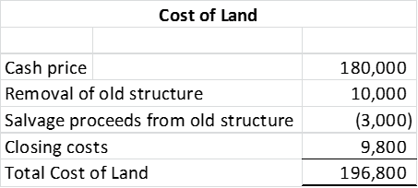
Land
When land is purchased for a building site, its cost includes the
total amount paid for the land, including any real estate commissions, title insurance fees, legal fees
any accrued property taxes paid by the purchaser
payments for surveying, clearing, grading, and draining
government assessments, whether incurred at the time of purchase or later, for items such as public roadways, sewers, and sidewalks. These assessments are included because they permanently add to the land's value.
Land purchased as a building site for a future building sometimes includes structures that must be removed. Add the cost of removal and subtract any salvage proceeds.
A company pays $180,000 cash to acquire land for a retail store.
This land had an old structure that was removed at a cost of $10,000
The company obtains salvage proceeds of $3,000 from selling components of the old structure
Closing costs total $9,800

Slide 7
Land Improvements
Land has an indefinite life and is not used up over time. However, Land improvements have a limited life. Land improvements include such items as
parking lot surfaces,
driveways,
fences,
shrubs,
lighting systems
The costs of these improvements increase the usefulness of the land, but they are recorded in the general ledger in a separate Land Improvement account so that their costs can be depreciated in accordance with the future periods they benefit. This expense is “matched” to the revenues earned during these periods as the assets were put in place to help the company earn revenue.

Slide 8
Buildings
A Building account is charged for the costs of purchasing or constructing a building that is used in operations.
When purchased, a building's costs usually include all the necessary and reasonable costs to procure the building.
purchase price,
brokerage fees,
title fees
attorney fees
all expenditures to ready it for its intended use, including any necessary repairs or renovations such as
wiring,
lighting,
flooring

Slide 9
Machinery and Equipment
The costs of machinery and equipment consist of all costs normal and necessary to purchase them and prepare them for their intended use. These include the
purchase price,
tariffs
transportation charges,
insurance while in transit
installing, assembling, and testing of the machinery and equipment.

Slide 10
Lump Sum Purchase
Plant assets sometimes are purchased as a group in a single transaction for a lump-sum price. The land, structure and land improvements already exist and are purchased together but need to be separately recorded in the general ledger for purposes of depreciation and to provide useful information on the financial statements.
In order to allocate the asset values in the general ledger when there is a single price, we follow these steps
Obtain the appraised tax value or market value of each type of asset
Add these values together
Calculate the percent of each asset class as portion of the total from Step 2
Multiple the single price by these percentages
Determine the apportioned cost to be recorded in the general ledger.

Slide 11
DEPRECIATION
Depreciation is the process of systematically and rationally allocating the cost of a plant asset to expense in the accounting periods benefiting from its use. The assets were placed into service in order to help the company generate revenue and their costs must be matched to the revenue they helped to generate.
Depreciation does not measure the decline in the asset's market value each period, nor does it measure the asset's physical deterioration.
Factors in Computing Depreciation
Factors that determine depreciation are (1) cost, (2) salvage value, and (3) useful life. NOTE: Salvage value and useful life are estimates.
Salvage value is an estimate of the asset's value at the end of its benefit period.
Useful Life is the length of time it is productively used in a company's operations.
For example, the productive life of a computer can be eight years or more. Some companies, however, trade in old computers for new ones every two years. In this case, these computers have a two-year useful life.

Slide 12
Depreciation Methods
Depreciation methods are used to allocate a plant asset's cost over the accounting periods in its useful life.
Straight Line Method The most frequently used method
Units of Production Method – Method when assets are infrequently in use.
Double Declining Balance – Method used for tax purposes.
We will use the following example to understand how to calculate depreciation for these three methods

Slide 13
Straight-Line Method Straight-line depreciation charges the same amount of expense to each period of the asset's useful life.
Example 1. If the machine was placed in service on Jan 1 and we are preparing financial statements as of Dec 31, then …
Example 2. If the machine was placed in service on Jul 1 and we are preparing financial statements as of Dec 31, then …
The $1,800 Depreciation Expense is reported on the income statement among operating expenses. The $1,800 Accumulated Depreciation is a contra asset account to the Machinery account in the balance sheet.
1. Determine depreciable base
2. Divide the depreciable base by number of months in the useful life and multiply this product by the number of months associated with the accounting period.

Slide 14
Net Book Value
Very important concept: The net balance sheet amount is the asset book value, or simply book value, and is computed as the asset's total cost less its accumulated depreciation. Do not confuse the calculation of book value with depreciable base—they do look similar

Slide 15
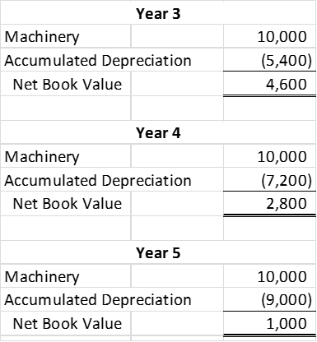
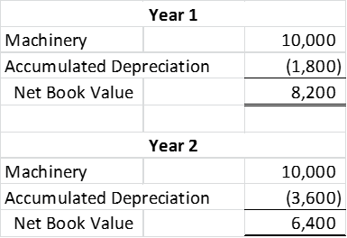
Continued Example of Book Value
At the end of year two, the book value is $6,400 and is reported in the balance sheet as follows:
The book value of this machine declines by $1,800 each year due to depreciation. Important to know the concept of book value and accumulated depreciation when we calculate the gain or loss on the disposal of property, plant and equipment.
Note: Ending book value is the salvage value.

Slide 16
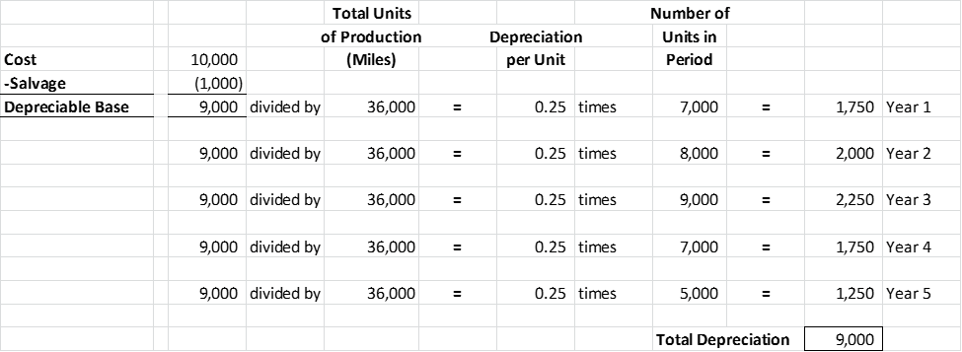
Units-of-Production Method
The use of some plant assets varies greatly from one period to the next based upon usage of a machine. It may be idle for a portion of the year. A builder, for instance, might use a piece of construction equipment for a month and then not use it again for several months. When equipment use varies from period to period, the units-of-production depreciation method can better match expenses with revenues.
Units-of-production depreciation charges a varying amount to expense for each period of an asset's useful life depending on its usage.

Slide 17
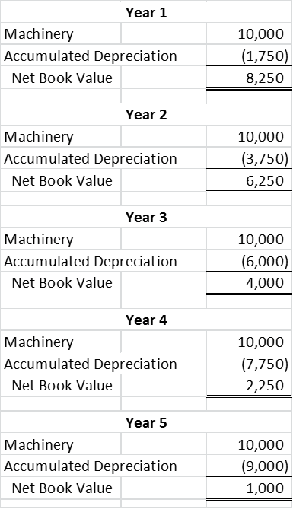
Units of Production Book Value
Note: Ending book value is the salvage value.

Slide 18
Declining-Balance Method An accelerated depreciation method yields larger depreciation expenses in the early years of an asset's life and less depreciation in later years. Chosen for tax purposes
The rate is calculated as 100% divided by the useful life in years. This result is multiplied by 2 to obtain the double declining balance rate.
The rate is then applied to book value for each year. In the first year, the book value equals the asset cost because accumulated depreciation is not yet recorded.

Slide 19
Change in Estimates for Depreciation
Depreciation is based on estimates of salvage value and useful life. During the useful life of an asset, these estimates can change. Use the new estimate to compute depreciation for current and future periods.
An Example. At the beginning of an asset's third year, its book value is $6,400, computed as $10,000 minus $3,600. Assume that at the beginning of its third year (or end of second year), the estimated number of years remaining in its useful life changes from three to four years and its estimate of salvage value changes from $1,000 to $400. Straight-line depreciation for each of the four remaining years is computed as:
Revising an estimate of the useful life or salvage value of a plant asset is referred to as a change in an accounting estimate and is reflected in current and future financial statements, not in prior statements.

Slide 20
Reporting Accumulated Depreciation
Both the cost and accumulated depreciation of plant assets are reported on the balance sheet or in its notes. Reporting both the cost and accumulated depreciation of plant assets helps users compare the assets of different companies.
For example, a company holding assets costing $50,000 and accumulated depreciation of $40,000 is likely in a situation different from a company with new assets costing $10,000. While the book value of $10,000 is the same in both cases, the first company is facing the need to replace older assets. These insights are not provided if the two balance sheets report only the $10,000 book values.

Slide 21
Disposal of Plant Assets Disposals of plant assets occur in one of three basic ways: discarding, sale, or exchange. We will cover discarding and sales.
Asset Discarding - Journal entry steps.
Credit the asset based on the general ledger amount.
Debit the accumulated depreciation based on the general ledger amount.
If the asset is not fully depreciated, record Loss on Disposal of Asset for the difference. NOTE: There can only be a loss when an asset is discarded.
Fully Depreciated Example:
A machine costing $9,000 with accumulated depreciation of $9,000 is discarded. When accumulated depreciation equals the asset's cost, it is said to be fully depreciated (zero book value). The entry to record the discarding of this asset is
Not Fully Depreciated Example:
How do we account for discarding an asset that is not fully depreciated or one whose depreciation is not up-to-date? Bring depreciation up-to-date.
Ex: Asset has a cost of $9,000 and accumulated depreciation of $6,500
NOTE: There can only be a loss when an asset is discarded and only if it is not fully depreciated.

Slide 22
Sale of Plant Asset – Sales of plant assets can yield gain or losses.
Journal entry steps.
Credit the asset based on the general ledger amount.
Debit the accumulated depreciation based on the general ledger amount.
Record the cash received.
If there is a difference, either debit Loss on Asset Disposal or credit Gain on Asset Disposal.
Make sure to bring depreciation up to date if necessary
Sale at Book Value
Note: Book value is cost minus accumulated depreciation.
Sale above book value
Sale below book value

