Slide 1
Flexible Budgets
Flexible budgets
Restate
the original budget calculations using
actual, current volumes.
This restatement is then used
to isolate
the reasons for the differences between
the original Budget and actual results

Slide 2
Purpose of Flexible Budgets
Rarely do budgeted volumes equal actual results.
Therefore restating the budget calculations in terms of the actual volume (Flexible Budget) can show what should have taken place based on actual results.
Comparing the Flexible budget to the original budget yields an activity variance which captures differences related to volume (or activity) changes.
Comparing the Flexible budget to actual results (the income statement) yields variances related to revenue and spending differences.

Slide 3
Original Budget

Slide 4
Budget Report – Comparing Budget to Actual (Inc Stmt) Results

Slide 5
Adding the Flexible Budget

Slide 6
Comparing the Flexible budget to original budget– What can be explained by the changes in volume?

Slide 7
Comparing the Flexible Budget to Actual (Inc Stmt) – What are the revenue and spending variances?

Slide 8
Favorable or Unfavorable Variance Analysis
The Flexible budget represents what “should have been” based upon the actual activity (number of clients).
Comparing Flexible Budget to Income Statement
When comparing the income statement to the flexible budget for revenues, look at what should have been to determine if the revenue/spending variance is favorable or unfavorable
When comparing the income statement to the flexible budget for expenses, look at what should have been to determine if the revenue/spending variance is favorable or unfavorable
Comparing Flexible Budget to Original Budget
When comparing the original budget to the flexible budget, look at the volumes originally predicted. If the actual activity level was less than originally planned, the revenue variance will be unfavorable and is explained by the change in volume. (The activity variance isolates the portion of the total variance associated with change in volume).
When comparing the original budget to the flexible budget, look at the volumes originally predicted. If the actual activity level was less than originally planned, the spending variance will be favorable and is explained by the change in volume. (The activity variance isolates the portion of the total variance associated with change in volume).
When comparing the original budget to the flexible budget, look at the volumes originally predicted. If the actual activity level was less than originally planned, the revenue variance will be unfavorable and is explained by the change in volume. (The activity variance isolates the portion of the total variance associated with change in volume).
When comparing the original budget to the flexible budget, look at the volumes originally predicted. If the actual activity level was less than originally planned, the spending variance will be favorable and is explained by the change in volume. (The activity variance isolates the portion of the total variance associated with change in volume).
The total variance between the original budget and income statement is explained by the activity variance and the revenue/spending variance. The Flex Budget is a useful tool to provide adequate measures of the variances.

Slide 9
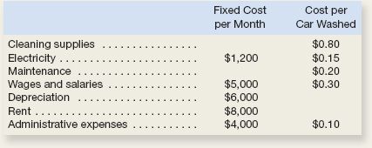
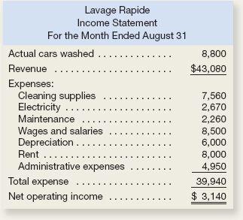
In Class Assignments
9–10 Flexible Budget
Lavage Rapide is a Canadian company that owns and operates a large automatic carwash facility near Montreal. The following table provides data concerning the company’s costs. The company expects to wash 9,000 cars per month at $4.90 per car. Prepare the budget
EXERCISE 9–14 Prepare a Flexible Budget Performance Report
Prepare a flexible budget performance report that shows the company’s revenue and spending variances and activity variances for August

Slide 50
The Foundational 15

