Slide 1
Essentials of Accounting for Governmental and Not-for-Profit Organizations
Chapter 3
Modified Accrual Accounting
Governmental Funds:
Including the Role of Fund Balances and Budgetary Accounting
McGraw-Hill/Irwin
Copyright © 2016 by The McGraw-Hill Companies, Inc. All rights reserved.

Slide 2
Chapter 3 – Learning objectives
Describe the basic accounts used by governmental funds
Identify the recognition criteria for revenues and expenditures under modified accrual basis
Apply fund balance classifications for governmental funds
Prepare journal entries for the expenditures cycle using both budgetary and activity accounts

Slide 3
Basic Accounts used by Governmental Funds

Slide 4
Modified Accrual Accounting
The modified accrual basis is a distinct system of accounting that contains financial statement elements that appear nowhere else.
Basis used by Governmental funds at the fund level
General
Capital Projects
Debt Service
Special Revenue
Permanent (only earnings not principal can be expended).
Among these are
Restricted Assets
Expenditures
Deferred inflows
Deferred outflows
Fund balances

Slide 5
Account Structure – Permanent Accounts
Accounts that are not closed at year end (Balance Sheet)
Assets: Cash and Cash Equivalents Investments Receivables: - Taxes Receivable Accounts Receivable Due from Other Governments Supplies Inventories Restricted Assets (typically cash) Deferred Outflows of Resources | Liabilities: Accounts Payable Accrued Liabilities Deferred Inflows of Resources Deferred Revenues Fund Balances: Nonspendable Restricted Committed Assigned Unassigned

Slide 6
Modified Accrual Accounting Permanent Accounts
Is not the cash basis of accounting
Recognizes receivables and revenues before collection.
Recognizes payables and accruals
However, long-term assets and liabilities are not recognized. The focus is on current financial resources (as budgeted).
Assets are cash and those items expected to be converted to cash in the near term.
Restricted cash: Examples: Port authority of a city – lessee deposits. Proceeds from a revenue bond must be used for their stated purpose such as improving roads, building a new high school, etc.
Liabilities recognized are settled with current financial resources.

Slide 7
Deferrals Deferred Inflows and Deferred Outflows

Slide 8
Deferrals refer to the timing of an economic event and in this context—a future period
The events have already taken place and will be recognized in the future as expenditures or revenues but until they legally can be, they are housed in deferred inflows/outflows – cash has been received or expended and must be housed somewhere.
The focus is on evaluating inter-period equity.
That is—Has the government raising sufficient resources each year to cover that year’s costs. If a government does not raise sufficient resources during the year, it either must consume surplus resources accumulated in prior years or push some costs off to the future.
Providing users with information to assess whether a government is achieving inter-period equity is an important objective of financial reporting by state and local governments.
To get a sense of whether inter-period equity has been achieved, any inflows or outflows that took place during the fiscal year, but which relate to future period, should not be included. Those inflows and outflows are kept out of the assessment of inter-period equity by being reported as deferred inflows and deferred outflows rather than recognized as revenues and expenses.

Slide 9
Deferred out flows of resources have a debit balance but are not assets.
Assets are a resource that a government controls at present that can be used to provide present services.
Deferred out flows are a consumption of assets by the government that is applicable to a future reporting period. For example, prepaid items, grants paid in advance when all eligibility requirements except timing have been met, etc. Rarely appear and are particularly defined by GASB.
The transaction has taken place in the current period (cash spent) but recognizing it is deferred to a future period to which the out flow is related.

Slide 10
Deferred in flows of resources have a credit balance but are not liabilities. Usually deferred taxes.
A liability is a requirement to give up resources the government cannot generally avoid.
Deferred in flow – the transaction has taken place (cash received) but recognizing it is deferred to a future period to which the inflow is related.
An example: Govt has a July to June tax year. Tax revenue would be recognized, therefore, in July but if tax bills are sent out early (before July) and citizens pay before July, these are deferred taxes. Not legally tax revenue yet; however, the receipt of the monies is recorded.
When July begins, the receipts would be reclassed to tax revenue and out of deferred in flow of resources

Slide 11
Modified Accrual Accounting Activity Accounts
Evolved from a demand for accountability over public monies and is closely tied to the budgetary function

Slide 12
Account Structure Nominal Accounts
Accounts that are closed at year end
Budgetary Accounts | Financial Statement Activity Accounts
Estimated Revenues Appropriations Estimated Other Financing Sources Estimated Other Financing Uses Encumbrances Budgetary Fund Balance – Reserve for Encumbrances | Revenues Tax Revenues Charges for Services Expenditures Current Capital Outlay Debt Service Other Financing Sources Transfers In Debt Proceeds Other Financing Uses Transfers Out

Slide 13
Modified Accrual Accounting Activity Accounts - Revenues
Revenues are recognized in the fiscal year they are measurable and available for expenditure
Measurable-when the govt can determine or reasonably estimate. Example tax rolls prepared or tax bills sent.
Available – govt will collect in current fiscal year or 60 days after. If collected after 60 days, it is a deferred inflow
Follow eligibility requirements
Defined entity (Public school as defined by state law)
Within the time requirement as imposed by law
If based on reimbursement, qualifying items must be purchased first
If contingency based, recognized when the contingency is met
Considered to be non exchange transactions
Property Taxes, special assessments, and fines and forfeits are considered to be imposed, non-exchange transactions.

Slide 14
Types of Nonexchange Transactions
Imposed nonexchange revenues
property tax, special assessments, fines/forfeits
Derived tax revenues
sales, income, motor fuel taxes
Government mandated transactions
federal government requires state, municipal, etc. expenditures
Voluntary nonexchange transactions
grants, donations

Slide 15
Classification and Sources of Inflows
Classified by source
Where the money came from: taxes, licenses and permits, charges for service, etc
May be subdivided further by type of tax
Sources of Inflows
Revenues are defined as inflows and include taxes, charges for services, and amounts provided by other entities such as the state or federal government.
Other Financing Sources include transfers in from other funds and the proceeds of long-term borrowing.

Slide 16
Modified Accrual Accounting Activity Accounts - Expenditures
Expenditures are recorded when the related liability is incurred.
Expenditures can be
Related to the current period
A capital outlay
Debt servicing of interest and/or principal.

Slide 17
Classification of Outflows - Informational
Expenditures and Encumbrances may be classified by
function, program, department, activity, character, or object
Character groupings are always: CURRENT, CAPITAL OUTLAY, and DEBT SERVICE
Current character groupings are typically classified by function:
General government, public safety, streets and highways
Public safety could be subdivided by department: Police and fire
Police could be subdivided further by activity: Traffic and drug enforcement
Activities in the traffic area could be divided into objects of expenditure: Policeman’s salary, gas for automobiles

Slide 18
Activity Accounts – Uses of funds
Transfers out of a fund to other funds are classified as Other Financing Uses.
Ex Transfer from Gen Fund to Debt Service Fund
The General fund would recognize the transaction as tax revenue and a transfer out
The debt service fund would recognize the expenditure and the transfer in
Thus, the fund that levied the tax records the tax and the fund that expended the funds would record the expenditure

Slide 19
Reporting Fund Balances

Slide 20
Fund Balance
The account category, Fund Balance, is unique to governmental funds.
Fund Balance serves a purpose similar to retained earnings, in that activity accounts (Revenue and Expenditures) are closed to this fund balance at the end of each accounting period.

Slide 21
Fund Balance - interpretation
Since only current financial resources and claims against those resources are recognized in these funds, the difference between assets and liabilities (fund balance) represents the net resources of the fund that are currently available for future spending.
However, even current financial resources vary in the extent to which government managers have discretion over their future use and this is reflected by assigning fund balance to five categories (nonspendable, restricted, committed, assigned and unassigned).

Slide 22
Reporting of Fund Balances
The objective of fund balance classification is to provide information regarding the availability of the net resources in the fund
Users such as bond investors and banks want to know whether the use of amounts reported in governmental funds is constrained and how binding those constraints are.

Slide 23
Fund Balances
Either
Non spendable or
Spendable

Slide 24
Fund Balances
Non spendable
The first step is to identify those fund resources that are non-spendable.
Inventories and prepaid items typically appear in governmental funds because they are current assets. However, these resources are non-spendable because they are used in operations rather than converted into cash.
The principal (corpus) of a permanent fund that may not be spent, but is required by its donor to be maintained, would also be classified as non-spendable.
One exception—Permanent funds are classified as non-spendable in the government fund balances but as restricted in the government-wide statements.

Slide 25
Fund Balances
Spendable
The remaining resources include cash and items expected to be converted into cash in the next period.
These “spendable” resources are further classified according to the nature of any constraints imposed on their use, using a hierarchy of constraints. The hierarchy ranges from “restricted” for the most constrained to “unassigned” for the least.

Slide 26
Spendable Fund Balances
Restricted
resources of a governmental fund that are subject to constraints imposed by external parties or law.
Restrictions arising from external parties include debt covenants (such as a requirement for a sinking fund) or constraints imposed by legislation or federal and state agencies on the use of intergovernmental revenues.
Restrictions can also result from legally enforceable requirements that resources be used only for specific purposes. For example, a voter approved referendum restricting the use of tax proceeds to a particular project. The unexpended resources derived from this tax would be displayed as restricted fund balance.

Slide 27
Spendable Fund Balances
Committed
Represent resources of a governmental fund that the governing body has specified for a particular use. (internal restriction)
To be classified as committed, the resources should have been designated through ordinance or resolution by the government’s highest level of authority.
Committed resources differ from restricted in that the constraint is imposed by a government upon itself.
Amounts representing contractual obligations of a government should also be classified as committed fund balance, provided that existing resources in the fund have been specifically committed for use in satisfying the contractual obligation.
For example, board approval of large contracts would typically represent commitment of the funds.

Slide 28
Spendable Fund Balances
Assigned
Represent resources of governmental funds that the government intends for a specific purpose.
Differ from committed in that the committed resources require a formal action by the governing body of the government.
Are more easily modified or removed.

Slide 29
Spendable Fund Balances
Assigned
Difference between General Fund and other fund types
For governmental funds other than the General Fund, this is the category for all remaining fund balance after allocating to the non-spendable, restricted, and committed categories.
The rationale is that the act of recording resources in special revenue, capital projects, debt service, or permanent funds is evidence of the government’s intent to use the resources for a specific purpose. Thus, everything is “assigned.”
Only the General Fund will report unassigned fund balance.
Resources in the General Fund may also be assigned to a specific purpose. For example, placing a purchase order for office equipment is a clear expression of the intent of the government. Until the resources are expended on capital assets, that portion of the General Fund’s net resources would be classified as assigned fund balance.

Slide 30
Spendable Fund Balances
Unassigned
Residual category for the General Fund only.
Negative fund balances could occur if expenditures for a specific purpose exceed the resources available in the fund.
Funds other than General - GASB does not generally permit the reporting of negative restricted, committed, or assigned fund balances. If this occurs, the government should reduce any assigned fund balances by the amount of the negative balance of the restricted or committed balances.
If a deficit remains once all assigned fund balances are zero, the remaining negative amount should be reported as unassigned fund balance in the general fund.
This is the only fund balance that can be negative.
Within the General Fund, if there is a negative unassigned fund balance related to the general fund, the assigned fund balances are reviewed, then modified or abandoned until the negative unassigned fund balance is resolved.

Slide 31
Spendable Fund Balances
Unassigned
Unassigned fund balance receives the most attention by citizens who may view unassigned resources as justification for tax relief or spending on favored projects. Government officials may wish to understate unassigned fund balance by temporarily classifying resources into one of the other categories. However, GASB standards make it difficult for governments to do this.
For example, GASB provides guidance on the classification of budget stabilization or rainy day funds. Rainy day funds are amounts set aside for future periods of economic downturn. Such stabilization amounts that meet certain criteria are classified as committed if imposed externally or by law.
GASB standards state that rainy day funds may be classified as committed only if they are created by a resolution or ordinance that identifies the specific circumstances under which the resources may be expended.

Slide 32
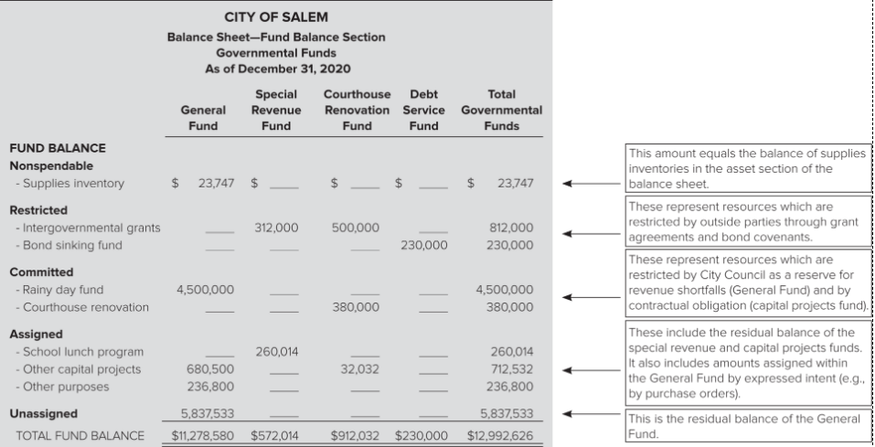

Slide 33
Fund Balances - Financial Statements
Fund balance appears only in the fund-basis statements of the Governmental Type funds
Does not affect reporting of Net Position by Proprietary or Fiduciary Funds
Does not affect reporting of Net Position of Governmental Activities in the government-wide statements.

Slide 34
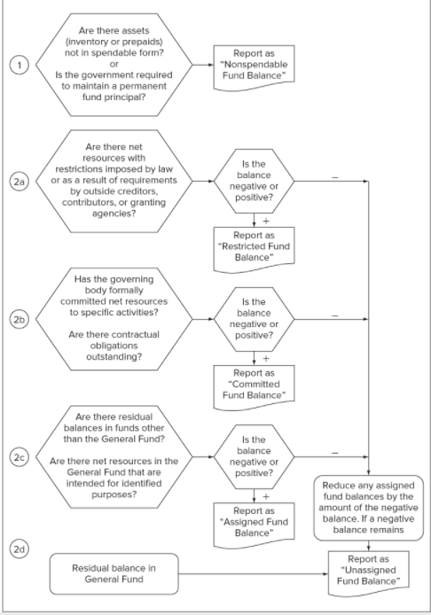

Slide 36
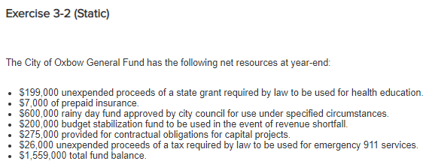

Slide 38
Budget stabilization
Rainy day or budget stabilitization amounts that are available “in emergencies” or in periods of “revenue shortfalls” would not be classified as committed unless the emergency or shortfall condition is specified and of a magnitude to distinguish it from events that occur routinely.

