Slide 1
Essentials of Accounting for Governmental and Not-for-Profit Organizations
Chapter 4
Accounting for the General and Special Revenue Funds
© McGraw-Hill Education. All rights reserved. Authorized only for instructor use in the classroom. No reproduction or further distribution permitted without the prior written consent of McGraw-Hill Education.

Slide 2
Learning Objectives
Apply the modified accrual basis of accounting in the recording of typical transactions of a General and special revenue fund
Prepare closing entries and classify fund balances
Prepare the fund-basis financial statements of a General and special revenue fund

Slide 3
Review: Fund Accounting
The purpose of fund accounting is to segregate those financial resources that have constraints/limitations on their use so that the government may demonstrate compliance with those limitations.
Every general-purpose government will have one, and only one, General Fund.
The General Fund is used to account for and report all financial resources not accounted for and reported in another fund. If there are no limitations and the monies do not require segregation, they are found in the General Fund.

Slide 4
GASB – Fund Definitions Special Revenue Funds
Account for and report the proceeds of specific revenue sources that are restricted or committed (does not include assigned) to expenditure for specified purpose other than debt service or capital projects.
Restricted – Limits imposed by external parties or the law
If reimbursement-based, eligibility requirements are satisfied when qualified expenditures are incurred
Committed – Limits imposed internally through ordinance or resolution by the govt’s highest level of authority

Slide 5
Special Revenue Funds Received Particular Guidance from GASB:
Although other resources may supplement a special revenue fund, assignment of resources is not sufficient for the establishment of a special revenue fund.
Further, if the government expects that a substantial portion of the resources supporting a special revenue fund’s activities will no longer be derived from restricted and committed revenue sources, the government should discontinue the use of a special revenue fund and report the fund’s remaining resources in the General Fund.

Slide 6
Review: Modified Accrual versus Accrual (1 of 2)
Accrual
Recognize revenues when earned
Match expenses against the revenues when resources or services are used.
Modified Accrual
Recognize revenues when measurable and available
Measurable – Able to determine or reasonably estimate the amount.
Available – Able to collect within the current period or within 60 days of year end.
(available to pay this year’s bills— for example, property taxes received within 60 days of year end)

Slide 7
Review: Modified Accrual versus Accrual (2 of 2)
Recognize expenditures when the liability is incurred — no attempt to match to revenues, match to period of occurrence only
Expenditures are recorded and fund liabilities are recognized when goods and services are received, regardless of whether resources are available in the fund. As a result, many expenditures are accrued, even in governmental funds.
Exception — recognize interest and principal payments as expenditures when DUE and are not accrued.

Slide 8
Modified Accrual Revenue Cycle
Assume
Yr 1 Property tax levied $1,000,000
Yr 1 $800,000 is collected
Yr 2 $120,000 collected in January and February (within 60 days)
Yr 2 $80,000 collected in March and April (after 60 days)

Slide 10
Uncollectible Amounts
An allowance for uncollectible taxes is recorded at the time of a tax levy.
Since uncollectible amounts will not be available to finance current expenditures, revenues are effectively reduced by the amount of the estimate
Record levy:

Slide 11
Write-offs of Uncollectible Amounts
The write-off of an uncollectible account does not affect revenues or expenditures.
Allowance and receivables are both “balance sheet” type accounts
Revenue and expenditures are both “income statement” type accounts

Slide 12
Modified Accrual Expenditure Cycle (1 of 2)
Supplies are ordered at an estimated cost of $3,500
Supplies are received with an actual cost of $3,000 plus shipping of $250
Invoice is paid

Slide 13
Modified Accrual Expenditure Cycle (2 of 2)
Receive Goods
Payment

Slide 14
Short-term Borrowing
Since governmental funds recognize obligations requiring current financial resources to settle, current borrowings are recorded as notes payable.
e.g. Short-term Tax anticipation notes
Taken out when there are timing differences between expenditures and tax collection and secured by the government’s power to tax

Slide 15
Repayment of Short-term Borrowing
Repayment of principal of short-term obligations is not an expenditure, but the associated interest is recorded as an expenditure
e.g. Short-term Tax anticipation notes

Slide 16
Interfund Transactions
Transactions between funds are of particular interest to financial statement preparers and users since failure to properly report these transactions results in two funds involved in the interfund transaction being misstated.
Additionally, since most of these transactions are eliminated in the government-wide statements, it is particularly important that they be identified in the accounts of the affected funds.

Slide 17
Interfund Transactions - Types
Classified as either Reciprocal or Nonreciprocal
Reciprocal
Exchange transactions (each party independent and seeking its own self-interest)
Interfund Loans and Interfund Services
Loans will be repaid = receivables/payables
Services are purchases of services of one fund by another = revenue/expenditures
Nonreciproal
Reimubursements
Another fund must reimburse fund which initially paid for an item
Transfers
No expectation of repayment.

Slide 18
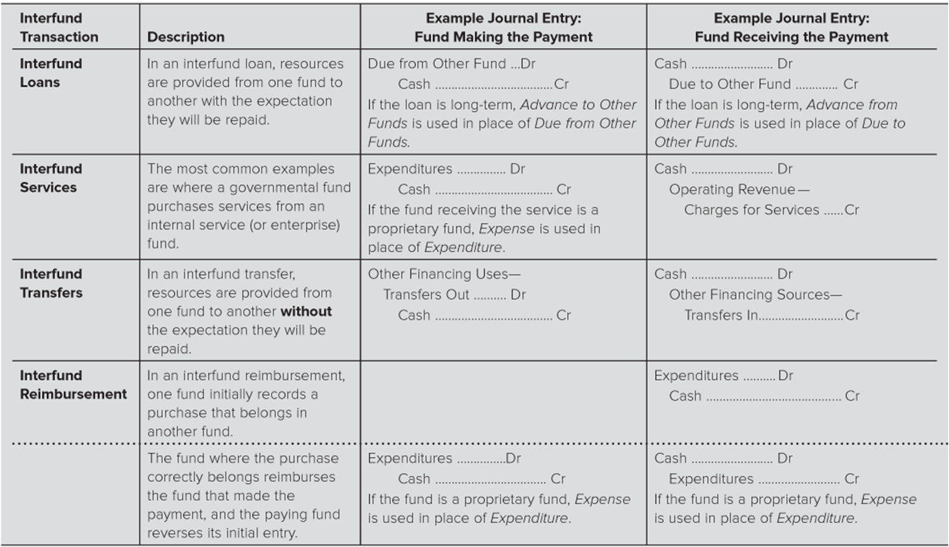

Slide 19
Transfers
Any assignment of resources from one fund to another where there is no expectation that the amounts will be repaid.
Transfers Into a Fund are considered Other Financing Sources
Transfers Out are considered Other Financing Uses
Recurring Transfers (such as for debt service) are commonly built into the General Fund budget

Slide 20
Special Items
Special items are significant transactions that are either unusual or infrequent but within the control of management.
Example: sale of a capital asset
The proceeds of capital assets are designated as special items:

Slide 21
The Closing Process
Closing process for government type funds needs to accomplish the following:
Close budgetary accounts
Close Revenues, expenditures, encumbrances, and related other financing sources or uses to Fund Balance
Special attention should be paid to encumbrance balances when they are closed in order to classify the commitment in determining fund balance classifications
Typically start with a pre-closing trial balance

Slide 22
Closing the Budget
The budgetary accounts (considering any budget revisions) are closed to budgetary fund balance

Slide 23
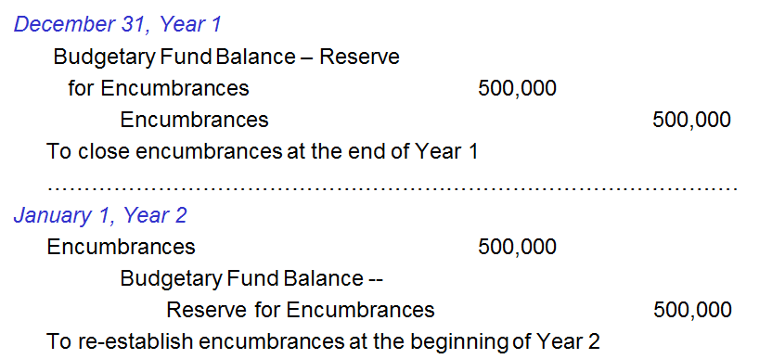
Closing Encumbrance Accounts
Encumbrance accounts are closed at year end and re-established in the next year if it is the govt’s policy to do so. If not carried forward, the encumbrance “lapses.”

Slide 24
Closing Activity Accounts
Activity accounts are closed to fund balance
Fund balance acts like “retained earnings.”
No income summary step
The remaining Fund Balance represents the net resources of the Gen Fund available for future appropriations if unrestricted

Slide 25
Fund balance - Presentation
Fund Balance is presented within the five categories of fund balance:
Nonspendable
Restricted
Committed
Assigned
Unassigned (General Fund residual)

