Slide 1
Statement of Cash Flows
The Statement of Cash flows
Provides managers
and
external readers of the financial statements
With information to determine
What has caused cash to increase or decrease

Slide 2
Cash and Cash Equivalents
Cash on the balance sheet includes both cash and cash equivalents
Cash equivalents are short-term, highly liquid investment instruments which can be:
Readily converted to a known amount of cash and
Are sufficiently close to their due date (maturity) so its market value will not change (are unaffected by any changes in interest rates). Usually investments within three (3) months of their due date meet these criteria.
Examples: US T Bills and money market funds

Slide 3
What caused cash to increase or decrease?
Cash is important to any healthy business and demonstrates an ability for the company to meet obligations, expand, and invest
There are three sections to the Statement of Cash Flows (SCF)
The operating section (cash from or used by the company’s business)
The investing section (cash from or used by the company’s investments in long-term assets or investments in long-term equity or debt [stocks and bonds] of other companies)
The financing section (cash from or used by borrowing or from issuing of shares)
If a company is generating cash from operations, it is more desirable than if it is generating the lion’s share of its cash from selling off investments, borrowing from banks or issuing shares of its stock. Although selling property, plant and equipment, borrowing, or issuing stock are great ways to raise cash for expansion, the company must be able to meet its day-to-day obligations from its operations.

Slide 4
Information from the Income Statement and Comparative Balance Sheet Are Used to Prepare the SCF as well as other GL information provided
Operating Section – Uses information from the income statement and current asset and liability section of the balance sheet
Investing Section – Uses information from the long-term asset section of the balance sheet
Property Plant and Equipment
Long-Term Investments in debt and equity instruments of other companies
Financing Section – Uses information from the long-term liabilities and equity section of the balance sheet
Bank Loans
Issuing shares of the company’s stock
Payment of dividends

Slide 5
SCF Categories
Operations – (Income statement and Current Assets/Liabilities from Balance Sheet as well as all interest)
Receipt of cash from customers
Payment of cash for wages and salaries
Paid cash to purchase inventories
Receipt of cash interest on outstanding note
Paid cash interest on outstanding note
Paid cash for property taxes
Paid cash on accounts payable
Paid cash for prepaid assets
Changes in current assets such as prepaids, accounts receivable, inventory
Changes in current liabilities such as accounts payable, wage/salaries payable, income taxes payable
Investing (Long-Term Assets only)
Sold stock investments for cash
Receipt of cash from sale of plant assets and/or land
Paid cash to acquire a patent
Financing (Long-Term Liabilities and Equity as well as any borrowings other than Accts Payable)
Sold stock for cash
Paid cash dividends
Paid cash to settle long-term note payable
Paid cash to acquire treasury stock
Borrowed money from bank for a short or long-term period

Slide 6
NonCash Transactions
Companies can buy a long-term asset with a long-term note payable. This transaction does not affect cash and is considered a non-cash transaction.
Other types of noncash transactions are:
Retiring debt with stock
Conversion of preferred stock to common stock
Exchange of noncash assets for other noncash assets
Purchase of other noncash assets using equity or debt
These transactions are either reported at the bottom of the Statement of Cash Flows or in a note to the Statement perhaps with a schedule

Slide 7
The Statement of Cash Flows

Slide 8
An Example. Both the Income Statement and a Comparative Balance Sheet are needed to prepare the SCF

Slide 9
The Operating Section – Indirect Method

Slide 10
Operating Section and the Income Statement

Slide 11
Operating Section and the Income Statement

Slide 12
Operating Section and the Income Statement

Slide 13
Operating Section and the Income Statement

Slide 14
Operating Section and the Balance Sheet

Slide 15
Operating Section and the Balance Sheet

Slide 16
Operating Section and the Balance Sheet

Slide 17
Operating Section and the Balance Sheet

Slide 18
Operating Section and the Balance Sheet

Slide 19
Operating Section and the Balance Sheet

Slide 20
Investing Section and Long-Term Asset Section of Balance Sheet

Slide 21
Investing Section and Long-Term Asset Section of Balance Sheet

Slide 22
Investing Section and Long-Term Asset Section of Balance Sheet

Slide 23
Investing Section and Long-Term Asset Section of Balance Sheet

Slide 24
Financing Section and the Balance Sheet

Slide 25
Financing Section and the Balance Sheet

Slide 26
Financing Section and the Balance Sheet

Slide 27
Financing Section and the Balance Sheet

Slide 28
Financing Section and the Balance Sheet

Slide 29
Statement of Cash Flows

Slide 30
Statement of Cash Flows

Slide 31
Statement of Cash Flows

Slide 32
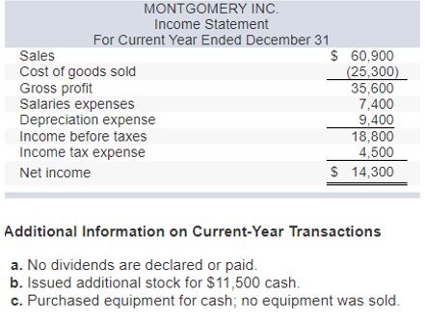

Slide 33
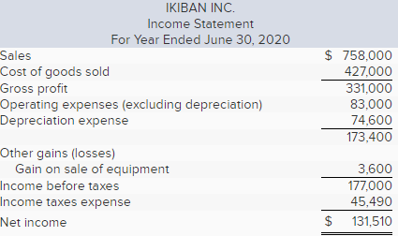
What if there were Paid in Capital in Excess of Common Stock? How does that affect cash from stock sales?
To calculate the cash from the equipment sale, calculate the change in accumulated depreciation after considering the current year’s deprecation expense. Also consider the gain on the equipment sale.
To calculate dividends, construct a Statement of Retained Earnings

