Slide 1
Essentials of Accounting for Governmental and Not-for-Profit Organizations
Chapter 12
Accounting for Hospitals and Other Health Care Providers
Copyright ©2020 McGraw-Hill Education. All rights reserved. No reproduction or distribution without the prior written consent of McGraw-Hill Education.

Slide 2
What Types of Organizations?
Clinics
Medical groups
Individual practitioners
Emergency care
Laboratories
Surgery care centers
Continuing care
HMOs
Home health agencies
Hospitals
Nursing homes
Rehabilitation centers
Copyright ©2020 McGraw-Hill Education. All rights reserved. No reproduction or distribution without the prior written consent of McGraw-Hill Education.

Slide 3
Ownership Types
Investor Owned: HUMANA | Humana Inc. stock is widely-held and the company is listed on the New York Stock Exchange.
Private Not-For-Profit: SAINT JOSEPH’S | The Hospital is owned by the (Catholic) Archdiocese of Atlanta.
Government Owned: NEW YORK CITY HEALTH AND HOSPITALS CORPORATION | The NY City Health and Hospital Corporation was created by the NY state legislature.
Copyright ©2020 McGraw-Hill Education. All rights reserved. No reproduction or distribution without the prior written consent of McGraw-Hill Education.

Slide 4
Ownership Types – Standard Setter
Investor Owned: HUMANA | FASB – except standards specifically for not-for-profits
Private Not-For-Profit: SAINT JOSEPH’S | FASB – particularly standards for not-for-profits such as those governing the format of financial statements and recognizing contribution revenue
Government Owned: NEW YORK CITY HEALTH AND HOSPITALS CORPORATION | GASB – Special-purpose entity engaged in business-type activities
Copyright ©2020 McGraw-Hill Education. All rights reserved. No reproduction or distribution without the prior written consent of McGraw-Hill Education.

Slide 5
Standard Setting Authority
Additional guidance is provided by the AICPA Audit Guide for Health Care Organizations and applies to all types of entities and excludes the type of organization designed as a Not for Profit such as a Voluntary Health and Welfare Organization (Chapter 10).
If an entity receives revenue mainly from patient services, it is a health care organization
If an entity receives revenue mainly from voluntary contributions, it is a voluntary health and welfare organization.
Copyright ©2020 McGraw-Hill Education. All rights reserved. No reproduction or distribution without the prior written consent of McGraw-Hill Education.

Slide 6
Revenue recognition
Health care organizations derive most of their revenues from services provided to customers. These are considered exchange transactions.
Copyright ©2020 McGraw-Hill Education. All rights reserved. No reproduction or distribution without the prior written consent of McGraw-Hill Education.

Slide 7
Revenue recognition
FASB establishes a five-step model for recognizing revenue:
1. Identify the contract with the customer. (Challenge for Hosp)
2. Identify the performance obligations in the contract. (Challenge for commercial enterprises)
3. Determine the transaction price. (Challenge for Hosp)
4. Allocate the transaction price to the performance obligations. (Challenge for commercial enterprises)
5. Recognize revenue when (or as) the entity satisfies a performance obligation. (Challenge for commercial enterprises)
Copyright ©2020 McGraw-Hill Education. All rights reserved. No reproduction or distribution without the prior written consent of McGraw-Hill Education.

Slide 8
Revenue recognition
A performance obligation is a good or service promised to a customer as part of a sales contract.
This is frequently a challenge for commercial businesses that bundle products and services in a single contract but is typically not a reporting issue for health care.
For health care organizations, the more challenging issues that require significant judgement are:
Is there a contract?
What is the contract price?
Copyright ©2020 McGraw-Hill Education. All rights reserved. No reproduction or distribution without the prior written consent of McGraw-Hill Education.

Slide 9
Revenue recognition
Step 1: Identify the contract with the customer.
Patients in need of immediate medical treatment could arrive at an emergency room and be unconscious or otherwise lack the capacity to enter a binding contract. Further, the emergency room may be required by law or their own policies to provide service without regard to whether the patient is insured or has the ability to pay.
In the case of trauma care, the health care organization may have to delay recording revenue until it can be determined whether the patient has the ability to pay or should be classified as charity care.
For a contract to exist, there must be an expectation of (some) payment.
Copyright ©2020 McGraw-Hill Education. All rights reserved. No reproduction or distribution without the prior written consent of McGraw-Hill Education.

Slide 10
Charity Care
Charity care is the term used in the health care industry to describe a situation in which services are provided to a patient without the expectation of receiving payment.
FASB characterizes charity care patients as those with a demonstrated inability to pay at the time of treatment. For a contract to exist, there must be an expectation of (some) payment.
The result is there is no contract in a charity care situation and no revenue is recognized. However, related expenses are included in other expenses.
Copyright ©2020 McGraw-Hill Education. All rights reserved. No reproduction or distribution without the prior written consent of McGraw-Hill Education.

Slide 11
Revenue recognition
Step 3: The third step in revenue recognition (determine the transaction price) also presents challenges for health care organizations.
The amount of revenue recognized at the time of service should not exceed the amount the health care organization actually expects to receive in payment.
Determining the amount of expected cash receipts is complicated by the existence of:
Discounts (such as prompt pay discounts)
Explicit contractual adjustments with 3rd party payors
Implicit price concessions.
All of these must be estimated at the time of service.
Copyright ©2020 McGraw-Hill Education. All rights reserved. No reproduction or distribution without the prior written consent of McGraw-Hill Education.

Slide 12
Contractual Adjustments
Health care entities commonly agree to accept payment on behalf of patients from third party payors such as insurance companies or government programs (e.g. Medicare and Medicaid).
Typically, these third parties do not pay the standard rate (i.e. list price) for services provided to patients. The difference between the standard rate and the reimbursement rate is termed contractual adjustment (or explicit price-concession).
Contractual adjustments for amounts billed to third party payors are treated as contra-revenue accounts. Page 357
Patient service revenues are reported net of these contractual adjustments.
Copyright ©2020 McGraw-Hill Education. All rights reserved. No reproduction or distribution without the prior written consent of McGraw-Hill Education.

Slide 13
Implicit Price Concessions
Implicit price concessions exist when an entity has a customary business practice of accepting less than the stated charges for medical treatment.
Implicit price concession may be estimated based on historical collection experience from similar patients.
In determining historical collection experience, the hospital may group patients into categories such as uninsured self-pay, high deductible insured, or elective versus non-elective procedures, and calculate expected collections based on group averages.
Patient service revenues are reported net of implicit price concessions.
Copyright ©2020 McGraw-Hill Education. All rights reserved. No reproduction or distribution without the prior written consent of McGraw-Hill Education.

Slide 14
Reporting patient service revenue
The hospital would report the following in its Statement of Operations:
Gross patient service revenue $ 980,000,000
Less: Contractual Adjustments (120,000,000)
Less: Implicit price concessions (22,300,000)
Net patient service revenue $ 837,700,000
Copyright ©2020 McGraw-Hill Education. All rights reserved. No reproduction or distribution without the prior written consent of McGraw-Hill Education.

Slide 15
Contributed Services Not for Profit Hospitals, etc.
Not for profit guidelines apply for contributed services such as professionals donating time or constructed/improving an asset

Slide 16
Hospital Financial Statements
Balance Sheet (most use classified balance sheet)
Instead of Statement of Activities
Statement of Operations
Including a schedule of Functional Expenses if private not-for-profit
Statement of Changes in Net Assets (or “Changes in Equity” if investor owned. If investor owned, then the financial statements would have paid in capital and retained earnings.)
Statement of Cash Flows Statement
Notes
Copyright ©2020 McGraw-Hill Education. All rights reserved. No reproduction or distribution without the prior written consent of McGraw-Hill Education.

Slide 17
Comparison of Financial Statements
Two statements take the place of the Statement of Activities:
Statement of Operations:
This is only for unrestricted (i.e. without donor restrictions) items.
Private sector entities must disclose expenses by functional category if not provided in the Statement of Operations
Statement of Changes in Net Assets:
Not-for-profits must show details of changes for both net asset categories (either without or with donor restrictions).
Copyright ©2020 McGraw-Hill Education. All rights reserved. No reproduction or distribution without the prior written consent of McGraw-Hill Education.

Slide 18
Display Issues – Statement of Operations continued
Operating revenues are often classified as
Net patient service revenues,
Premium revenue (from capitation agreements—agreements whereby the entity is to provide service to a group or individual for a fixed fee), and
Other Revenue (parking lot, gift shop, cafeteria, and tuition).
Unrestricted gifts may be treated as Operating or Nonoperating depending on policy.
Copyright ©2020 McGraw-Hill Education. All rights reserved. No reproduction or distribution without the prior written consent of McGraw-Hill Education.

Slide 19
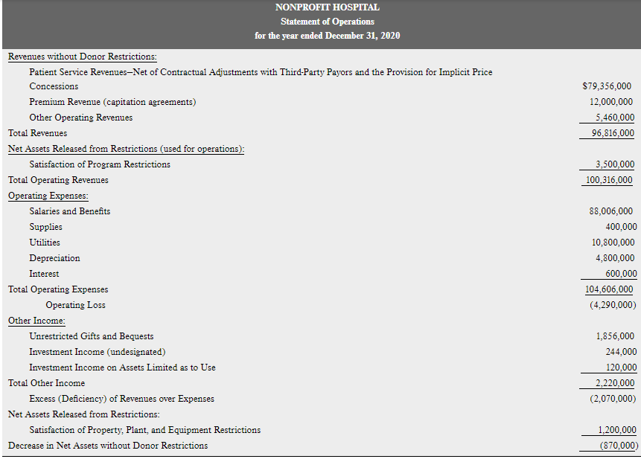

Slide 20
Display Issues – Statement of Operations
Private not-for-profits and government-related entities must provide a Performance Indicator.
This a measure of income which excludes:
Equity transfers,
Restricted Contributions,
Contributions of LT assets,
Most unrealized gains and losses,
Restricted investment returns, and
Extraordinary items.
Copyright ©2020 McGraw-Hill Education. All rights reserved. No reproduction or distribution without the prior written consent of McGraw-Hill Education.

Slide 22
Display Issues – Balance Sheet
FASB vs. GASB equity accounts:
FASB: Business: paid-in capital and retained earnings
FASB: Not for Profit: net assets without or with donor restrictions
Assets limited as to use is used to indicate board or bond covenant restrictions which are not donor restricted
GASB: net investment in capital assets, restricted net position, and unrestricted net position.
Copyright ©2020 McGraw-Hill Education. All rights reserved. No reproduction or distribution without the prior written consent of McGraw-Hill Education.

Slide 23
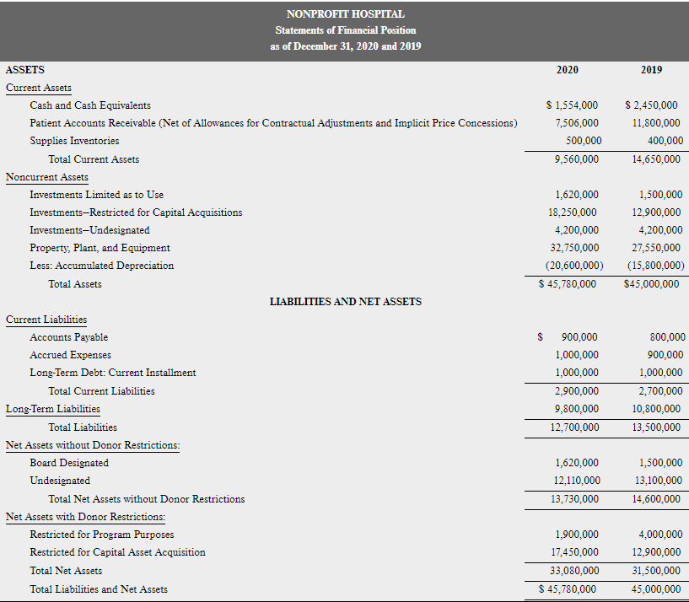

Slide 24
Comparison of Financial Statements continued
Statement of Cash Flows:
Business and not-for-profits use the FASB format (3 sections); governments use the GASB format (4 sections)
Copyright ©2020 McGraw-Hill Education. All rights reserved. No reproduction or distribution without the prior written consent of McGraw-Hill Education.

