Slide 1
Managerial Accounting and Cost Concepts
Defining Cost as a Concept in a Variety of Scenarios

Slide 2
The term “cost” is used in a variety of ways
Typically, cost refers to future projection of expenditures. Expenses typically refer to past expenditures.
There are many types of costs, and these costs are classified differently according to the immediate needs of management.
For example, managers may want cost data to predict costs, prepare planning budgets, or to make decisions.
Each different use of cost data demands a different classification and definition of costs.
This notion of different costs for different purposes is a critically important aspect of managerial accounting. We will find the same costs grouped in different manners depending upon our audience.

Slide 3
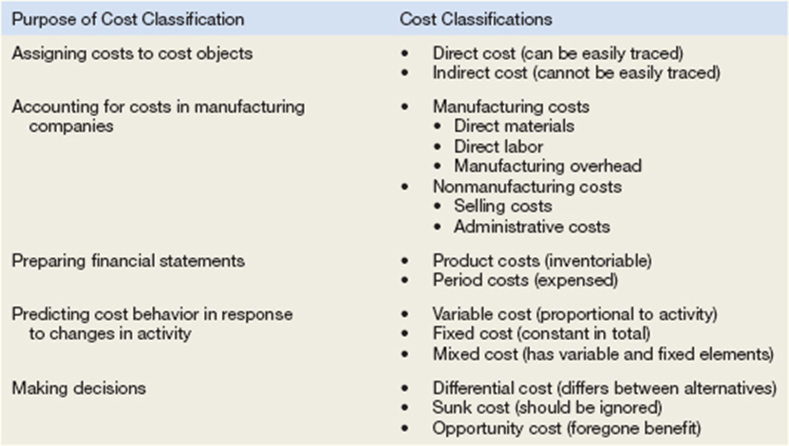
Cost Classifications

Slide 4
Assigning Costs to Cost Objects
Costs are assigned to cost objects for a variety of purposes including pricing, preparing profitability studies, and controlling spending. A cost object is anything for which cost data are desired—including products, customers, jobs, and organizational subunits.
For purposes of assigning costs to cost objects, costs are classified as either direct or indirect.
Direct Cost
A direct cost is a cost that can be easily and conveniently traced to a specified cost object.
If Nike is assigning costs to its various regional and national sales offices, then the salary of the sales manager in its Tokyo office would be a direct cost of that office.
If a printing company made 10,000 brochures for a specific customer, then the cost of the paper used to make the brochures would be a direct cost of that customer.
The caveat is “But for this cost object, would the cost exist?
Indirect Cost
An indirect cost is a cost that cannot be easily and conveniently traced to a specified cost object.
Providing a chapel area in a hospital could not be traced to any one hospital unit. It would a “common cost.” A common cost is incurred to support many cost objects but cannot be traced to any one cost object.
Costs can move between direct and indirect depending upon the cost object.
A manager of a factory would be a direct cost of the factory but would be an indirect cost of induvial product produced in the factory.

Slide 5
Identifying Direct and Indirect Costs Northwest Hospital is a full-service hospital that provides everything from major surgery and emergency room care to outpatient clinics.
For each cost incurred at Northwest Hospital, indicate whether it would most likely be a direct cost or an indirect cost of the specified cost object by placing an X in the appropriate column.

Slide 6
Manufacturing costs
Manufacturers have two categories of costs
Manufacturing – called “product” costs on financial stmts
Direct Materials – tangible items large enough and expensive enough to be traced to the product (inventory manufactured by the company)
Direct Labor – personnel who “touch” the product during manufacturing
Manufacturing Overhead – anything factory-related which is not direct materials or direct labor
Non-Manufacturing – called “period” costs on financial stmts
Selling costs – costs incurred between factory and delivery to consumer
Admin costs – costs incurred to oversee both manufacturing and selling

Slide 7
The PC Works assembles custom computers from components supplied by various manufacturers. The company is very small and its assembly shop, administrative offices, and retail sales store are housed in a single facility in a Redmond, Washington, industrial park.
For each cost, indicate whether it would most likely be classified as direct labor, direct materials, manufacturing overhead, selling, or an administrative cost.
The cost of a hard drive installed in a computer.
The cost of advertising in the Puget Sound Computer User newspaper.
The wages of employees who assemble computers from components.
Sales commissions paid to the company’s salespeople.
The wages of the assembly shop’s supervisor.
The wages of the company’s accountant.
Depreciation on equipment used to test assembled computers before release to customers.
Rent on the facility in the industrial park.

Slide 8
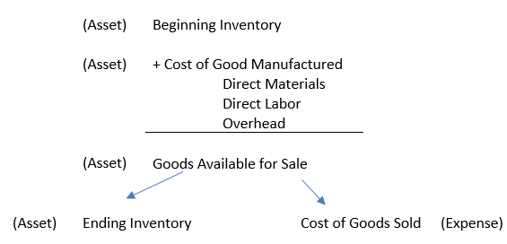
Cost Classifications for Preparing Financial Statements
Product Costs
For financial accounting purposes, product costs include all costs involved in acquiring or making a product. In the case of manufactured goods, these costs consist of direct materials, direct labor, and manufacturing overhead. Product costs “attach” to units of product as the goods are purchased or manufactured, and they remain attached as the goods go into inventory awaiting sale. Product costs are initially assigned to an inventory account on the balance sheet. When the goods are sold, the costs are released from inventory as expenses (typically called cost of goods sold) and matched against sales revenue on the income statement.
The matching principle is based on the accrual concept that costs incurred to generate a particular revenue should be recognized as expenses in the same period that the revenue is recognized. This means that if a cost is incurred to acquire or make something that will eventually be sold (inventory), then the cost should be recognized as an expense only when the sale takes place—that is, when the benefit occurs.

Slide 9
Cost Classifications for Preparing Financial Statements
Period Costs
All costs that are not product costs. All selling and administrative expenses are treated as period costs.
For example, sales commissions, advertising, executive salaries, public relations, and the rental costs of administrative offices are all period costs.
Period costs are not included as part of the cost of either purchased or manufactured goods; instead, period costs are expensed on the income statement in the period in which they are incurred using the usual rules of accrual accounting.
Keep in mind that the period in which a cost is incurred is not necessarily the period in which cash changes hands. For example, costs of prepaid liability insurance are spread across the periods that benefit from the insurance—regardless of the period in which the insurance premium is paid.

Slide 10
Other manufacturing cost groupings
Prime Costs
The two direct costs of manufacturing
Consist of
Direct materials
Direct labor
Conversion Costs
The two costs that convert inert direct materials into a product
Consist of
Direct Labor
Manufacturing overhead

Slide 11
A company has reported the following costs and expenses for the most recent month.
What are the product costs?
What are the period costs?
What are the manufacturing costs?
What are the non-manufacturing costs?
What are the prime costs?
What are the conversion costs?

Slide 12
Classification of Costs
Suppose that you have been given a summer job as an intern at Issac Aircams, a company that manufactures sophisticated spy cameras for remote-controlled military reconnaissance aircraft. The company, which is privately owned, has approached a bank for a loan to help it finance its growth.
The bank requires financial statements before approving such a loan. You have been asked to help prepare the financial statements and were given a list of costs.
Classify the above costs as either product costs or period costs for the purpose of preparing the financial statements for the bank.
Depreciation on salespersons’ cars.
Rent on equipment used in the factory.
Lubricants used for machine maintenance.
Salaries of personnel who work in the finished goods warehouse.
Soap and paper towels used by factory workers at the end of a shift.
Factory supervisors’ salaries.
Heat, water, and power consumed in the factory.
Materials used for boxing products for shipment overseas. (Units are not normally boxed.)
Advertising costs.
Workers’ compensation insurance for factory employees.
Depreciation on chairs and tables in the factory lunchroom.
The wages of the receptionist in the administrative offices.
Cost of leasing the corporate jet used by the company’s executives.
The cost of renting rooms at a Florida resort for the annual sales conference.
The cost of packaging the company’s product.

Slide 13
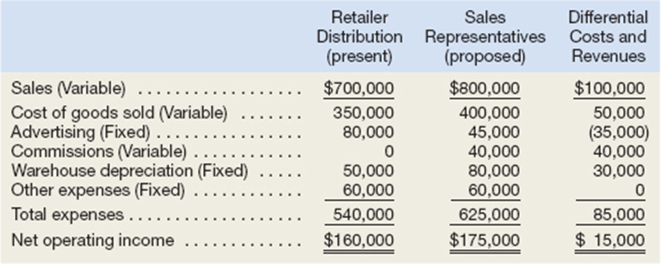
Cost Classifications for Decision Making
Costs are an important feature of many business decisions. In making decisions, it is essential to have a firm grasp of the concepts differential cost, opportunity cost, and sunk cost.
Differential Cost and Revenue
Decisions involve choosing between alternatives. In business decisions, each alternative will have costs and benefits that must be compared to the costs and benefits of the other available alternatives. A difference in costs between any two alternatives is known as a differential cost. A difference in revenues between any two alternatives is known as differential revenue. (If they are not different, then it is not a differential cost).
In general, only the differential revenue/costs are the focus of a decision as well as cash versus non-cash items.
Assume that Natural Cosmetics, Inc., is thinking about changing its marketing method from distribution through retailers to distribution by a network of neighborhood sales representatives.
Present costs and revenues are compared to projected costs and revenues in the following table:

Slide 14
Opportunity Cost and Sunk Cost
Opportunity cost
It is the potential benefit that is given up when one alternative is selected over another.
For example, assume that you have a part-time job while attending college that pays $800 per week.
If you spend one week at the beach during spring break without pay, then the $800 in lost wages would be an opportunity cost of taking the week off to be at the beach.
Opportunity costs are not usually found in accounting records, but they are costs that must be explicitly considered in every decision a manager makes.
Virtually every alternative involves an opportunity cost.
Sunk Cost
A sunk cost is a cost that has already been incurred and that cannot be changed by any decision made now or in the future.
Because sunk costs cannot be changed by any decision, they are not differential costs.
To illustrate a sunk cost, assume that a company paid $50,000 several years ago for a special-purpose machine. The machine was used to make a product that is now obsolete and is no longer being sold.
Past purchases of long-term, tangible assets are considered sunk costs. Nothing in the future can change the past decision to purchase buildings, equipment, etc.
For a cost to be a sunk cost, it occurred in the past and does not continue in the future. For example, wages to current employees are not sunk costs.

Slide 15
Northwest Hospital is a full-service hospital that provides everything from major surgery and emergency room care to outpatient clinics. The hospital’s Radiology Department is considering replacing an old inefficient X-ray machine with a state-of-the-art digital X-ray machine. The new machine would provide higher quality X-rays in less time and at a lower cost per X-ray. It would also require less power and would use a color laser printer to produce easily readable X-ray images. Instead of investing the funds in the new X-ray machine, the Laboratory Department is lobbying the hospital’s management to buy a new DNA analyzer.
For each of the items below, indicate by placing an X in the appropriate column whether it should be considered a differential cost, an opportunity cost, or a sunk cost in the decision to replace the old X-ray machine with a new machine. If none of the categories apply for a particular item, leave all columns blank.

Slide 16
Cost Classifications for Predicting Cost Behavior Cost classifications used to predict cost behavior: variable costs, fixed costs, and mixed costs.
It is often necessary to predict how a certain cost will behave in response to a change in activity to budget and to make decisions. For planning purposes and decision making, a manager must be able to anticipate what will change and by how much.
Cost behavior refers to how a cost reacts to changes in the level of activity. As the activity level rises and falls, a particular cost may rise and fall as well—or it may remain constant.
If the cost rises and falls with activity, then it is a variable cost because it varies with a change in activity.
If the cost remains constant no matter the level of activity, it is a fixed cost.
For a cost object, it may not be practical to separate variable from fixed costs, the object will have costs components that are variable and fixed or mixed.
The relative proportion of each type of cost in an organization is known as its cost structure. For example, an organization might have many fixed costs but few variable or mixed costs. Alternatively, it might have many variable costs but few fixed or mixed costs.

Slide 17
Variable Cost
A variable cost varies in direct proportion to changes in the level of activity. Common examples of variable costs include cost of goods sold for a merchandising company, direct materials, direct labor, variable elements of manufacturing overhead, such as indirect materials, supplies, and power. For selling and administrative expenses, there are variable costs such as commissions and shipping costs.
For a cost to be variable, it must vary in relation to something. That “something” is its activity base. The activity base of selling commissions would be sales, as they increase sales increase. The activity base causes the variable costs to increase and has to be measurable. The activity base is often referred to as a cost driver—it drives the costs to either increase or decrease.
Examples of activity bases (cost drivers) include the number of miles driven by salespersons, the number of pounds of laundry cleaned by a hotel, the number of calls handled by technical support staff at a software company, and the number of beds occupied in a hospital.

Slide 18
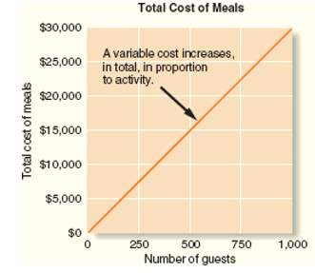
To provide an example of a variable cost, consider Nooksack Expeditions, a small company that provides daylong whitewater rafting excursions on rivers and serves gourmet meals to its guests from a caterer for $30 a person. The behavior of this variable cost, on both a per unit and a total basis, is shown below:
While total variable costs change as the activity level changes, it is important to note that a variable cost is constant if expressed on a per unit basis.
For example, the per unit cost of the meals remains constant at $30 even though the total cost of the meals increases and decreases with activity. The graph illustrates that the total variable cost rises and falls as the activity level rises and falls.

Slide 19
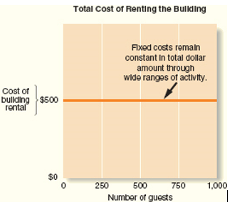
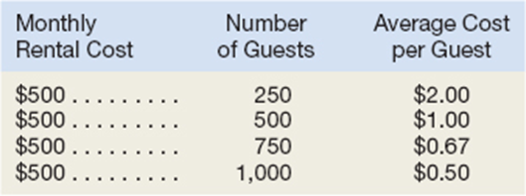
Fixed Cost
A fixed cost is a cost that remains constant, in total, regardless of changes in the level of activity.
Examples of fixed costs include straight-line depreciation, insurance, property taxes, rent, supervisory salaries, administrative salaries, and advertising.
Unlike variable costs, fixed costs are not affected by changes in activity. Consequently, as the activity level rises and falls, total fixed costs remain constant unless influenced by some outside force—usually expansion.
To continue the Nooksack Expeditions example, assume the company rents a building for $500 per month to store its equipment. The total amount of rent paid is the same regardless of the number of guests the company takes on its expeditions during any given month.
Because total fixed costs remain constant for large variations in the level of activity, the average fixed cost per unit becomes progressively smaller as the level of activity increases.
.
As a general rule, fixed costs are not expressed on an average per unit basis in internal reports because it creates the false impression that fixed costs are like variable costs and change as the level of activity changes.
Instead, internal reports express fixed costs in total.

Slide 20
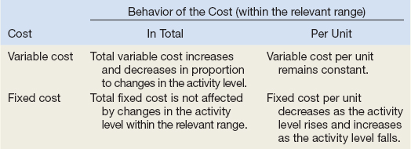

Slide 21
Illustration of why fixed costs should not be expressed as an average. Espresso Express operates a number of espresso coffee stands in busy suburban malls. The fixed weekly expense of a coffee stand is $1,200 and the variable cost per cup of coffee served is $0.22.
Fill in the following table with your estimates of total costs and cost per cup of coffee at the indicated levels of activity for a coffee stand. Round off the cost of a cup of coffee to the nearest tenth of a cent.
Does the average cost per cup of coffee served increase, decrease, or remain the same as the number of cups of coffee served in a week increases? Explain.

Slide 22
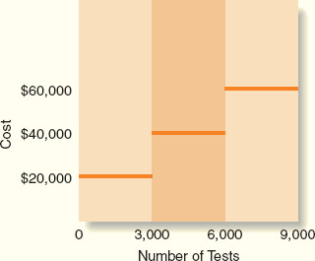
A cautionary tale - Fixed Costs - The Linearity Assumption and the Relevant Range
For example, suppose the Mayo Clinic rents a machine for $20,000 per month that tests blood samples for the presence of leukemia cells, and the capacity of the leukemia diagnostic machine is 3,000 tests per month.
The assumption that the rent for the diagnostic machine is $20,000 per month is only valid within the relevant range of 0 to 3,000 tests per month.
If the Mayo Clinic decides to test 5,000 blood samples per month, then it would need to rent another machine for an additional $20,000 per month.
Management accountants ordinarily assume that costs are strictly linear; that is, the relation between cost on the one hand and activity on the other can be represented by a straight line.
Costs can be approximated within a narrow band of activity known as the relevant range by a straight line. The relevant range is the range of activity within which the assumption that cost behavior is strictly linear is reasonably valid. (Typically a period of time over which observations of the cost have been made).
Outside of the relevant range, a fixed cost may no longer be strictly fixed. Managers should always keep in mind that assumptions made about cost behavior may be invalid if activity falls outside of the relevant range.

Slide 23
Budgeting Fixed Costs
Committed fixed costs
Committed fixed costs represent organizational investments with a multiyear planning horizon that can’t be significantly reduced even for short periods of time without making fundamental changes.
Examples include investments in facilities and equipment, as well as real estate taxes, insurance expenses, and salaries of top management.
Even if operations are interrupted or cut back, committed fixed costs remain largely unchanged in the short term because the costs of restoring them later are likely to be far greater than any short-run savings that might be realized.
Discretionary fixed costs
Discretionary fixed costs (often referred to as managed fixed costs) usually arise from annual decisions by management to spend on certain fixed cost items.
Examples of discretionary fixed costs include advertising, research, public relations, management development programs, and internships for students.
Discretionary fixed costs can be cut for short periods of time with minimal damage to the long-run goals of the organization.

Slide 24
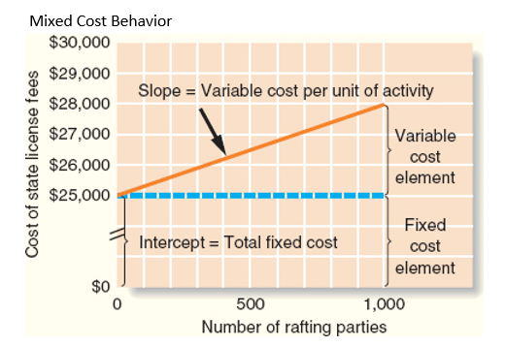
Mixed Costs
A mixed cost contains both variable and fixed cost elements.
To continue the Nooksack Expeditions example, the company incurs a mixed cost called fees paid to the state.
It includes a license fee of $25,000 per year plus $3 per rafting party paid to the state’s Department of Natural Resources.
If the company runs 1,000 rafting parties this year, then the total fees paid to the state would be $28,000, made up of $25,000 in fixed cost plus $3,000 in variable cost.

Slide 25
Methods of Analyzing Mixed Costs
Mixed Costs are very common
For example, the overall cost of providing X-ray services to patients at the Harvard Medical School Hospital is a mixed cost. The costs of equipment depreciation and radiologists’ and technicians’ salaries are fixed, but the costs of X-ray film, power, and supplies are variable.
Most electricity is a mixed cost.
The fixed portion of a mixed cost represents the minimum cost of having a service ready and available for use.
The variable portion represents the cost incurred for actual consumption of the service. Thus it varies in proportion to the amount of service actually consumed.
Managers can use a variety of methods to estimate the fixed and variable components of a mixed cost such as account analysis of amounts posted in the general ledger, the high-low method, and least-squares regression analysis. We will focus on the high-low method and least-squares regression analysis
The high-low and least-squares regression methods estimate the fixed and variable elements of a mixed cost by analyzing past records of cost and activity data.

Slide 26
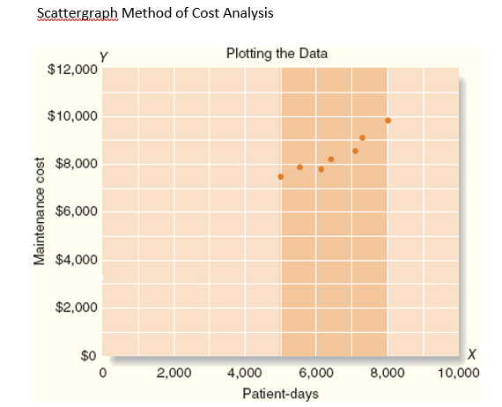
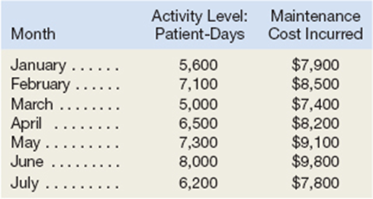
We will use an example from Brentline Hospital to illustrate the high-low method calculations and to compare the resulting high-low method cost estimates to those obtained using least-squares regression.
Brentline Hospital is interested in predicting future monthly maintenance costs for budgeting purposes.
The senior management team believes that maintenance cost is a mixed cost and that the variable portion of this cost is driven by the number of patient-days.
The hospital’s chief financial officer gathered the following data for the most recent seven-month period:
Usually, the first step is a scatterplot in Excel to determine if there is a relationship. If there is none, then steps are taken to find the cost driver.

Slide 27
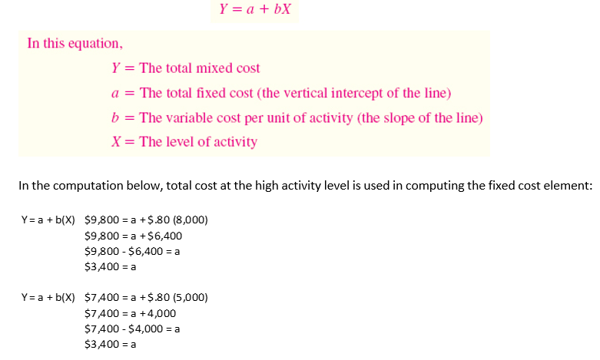
The High-Low Method
If the relation between cost and activity can be represented by a straight line, then use the following steps to identify the variable cost portion of the mixed cost:
Identify the period with the lowest level and highest level of activity.
Identify the costs associated with the lowest level and highest level of activity.
In the numerator (top) subtract the lowest cost from the highest cost
In the denominator (bottom) subtract the lowest level of activity from the highest.

Slide 28
Steps for Hi Lo
Determine variable costs per unit
Identify the period with the lowest level and highest level of activity.
Identify the costs associated with the lowest level and highest level of activity.
In the numerator (top) subtract the lowest level activity cost from the highest activity level cost
In the denominator (bottom) subtract the lowest level of activity from the highest.
Take either the highest or lowest level total cost and subtract the product of the variable cost per unit times the activity level at the high point
The remainder will be the fixed portion of the mixed cost.
The formula can then be restated as Total cost = fixed + variable cost per unit (x volume) for future planning or decision making.

Slide 29
Using the Hi-Lo Method: The Cheyenne Hotel in Big Sky, Montana, has accumulated records of the total electrical costs of the hotel and the number of occupancy-days over the last year. An occupancy-day represents a room rented out for one day. The hotel’s business is highly seasonal, with peaks occurring during the ski season and in the summer.

Slide 30
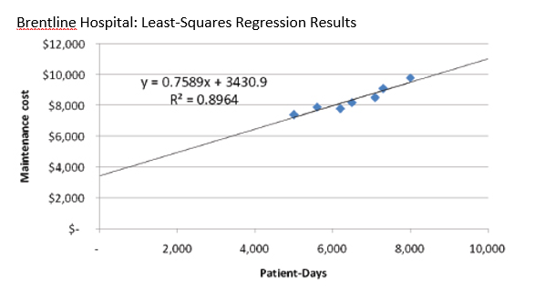
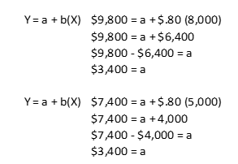
The Least-Squares Regression Method
The high-low method is very simple to apply, but it suffers from a major (and sometimes critical) defect—it utilizes only two data points.
Generally, two data points are not enough to produce accurate results. Additionally, the periods with the highest and lowest activity tend to be unusual. A cost formula that is estimated solely using data from these unusual periods may misrepresent the true cost behavior during normal periods.
The least-squares regression method, unlike the high-low method, uses all of the data to separate a mixed cost into its fixed and variable components. A regression line of the form Y = a + bX is fitted to the data.
Note there is a statistic ( R²) which is a measure of “goodness of fit.” The R² varies from 0% to 100%, and the higher the percentage, the better.
You should always plot the data in a scattergraph, but it is particularly important to check the data visually when the R² is low. A quick look at the scattergraph can reveal that there is little relation between the cost and the activity or that the relation is something other than a simple straight line. In such cases, additional analysis would be required.
Traditional and Contribution Format Income Statements
Traditional and Contribution Format Income Statements
Hi-Lo Results

Slide 31
How can we use cost behavior to better analyze a company?
The Traditional Format Income Statement
The Contribution Format Income Statement
Traditional income statements are prepared primarily for external reporting purposes.
Although the traditional income statement is useful for external reporting purposes, it has serious limitations when used for internal purposes. It does not distinguish between fixed and variable costs.
Internally, managers need cost data organized by cost behavior to aid in planning, controlling, and decision making. The contribution format income statement has been developed in response to these needs.
The crucial distinction between fixed and variable costs is at the heart of the contribution approach to constructing income statements.
The unique thing about the contribution approach is that it provides managers with an income statement that clearly distinguishes between fixed and variable costs and therefore aids planning, controlling, and decision making.

Slide 32
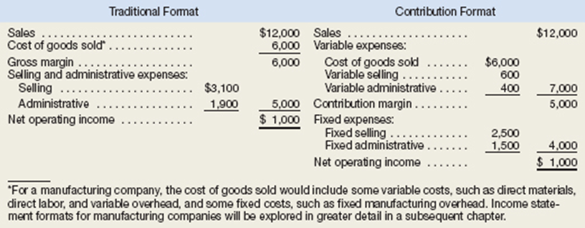
The Traditional Format Income Statement
The Contribution Format Income Statement

Slide 33
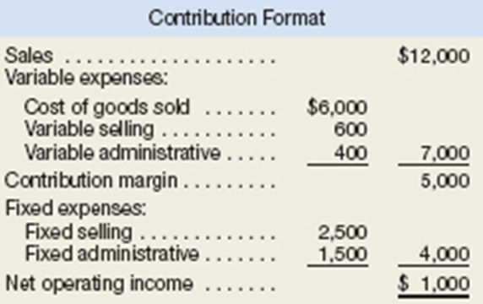
The contribution approach separates costs into fixed and variable categories, first deducting variable expenses from sales to obtain the contribution margin.
For a merchandising company, cost of goods sold is a variable cost that gets included in the “Variable expenses” portion of the contribution format income statement. The contribution margin is the amount remaining from sales revenues after variable expenses have been deducted. This amount contributes toward covering fixed expenses and then toward profits for the period.
The contribution format income statement is used as an internal planning and decision-making tool. Its emphasis on cost behavior aids cost-volume-profit analysis, management performance appraisals, and budgeting. Moreover, the contribution approach helps managers organize data pertinent to numerous decisions such as segment analysis, pricing, and pricing special orders.

Slide 34
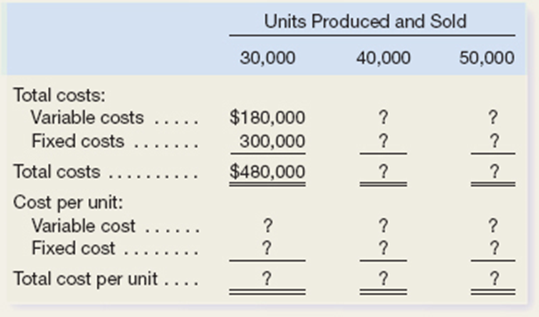
Harris Company manufactures and sells a single product. A partially completed schedule of the company’s total and per unit costs over the relevant range of 30,000 to 50,000 units produced and sold annually is given below:
Assume that the company produces and sells 45,000 units during the year at a selling price of $16 per unit. Prepare a contribution format income statement for the year.

