Slide 1
Cost, Volume, Profit Dynamics
Using cost behavior, we will analyze how cost, volume, and profit is affected.

Slide 2
Using a very simple example, we will examine cost behavior using cost, volume, profit

Slide 3
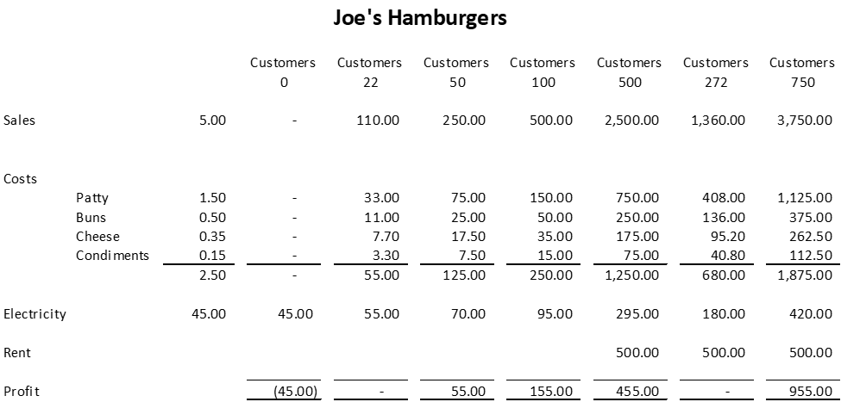
We can see from this very simple example when there are no customers, the company still pays its mixed cost for electricity—the fixed portion is $45 and 50 cents a customer thereafter.
Once customers are served, variable costs are incurred to serve each customer and the mixed cost of electricity increases by 50 cents for each customer.
When Joe decides to expand, the company incurs a fixed cost of rent which does not change despite the number of customers served.

Slide 4
How can we use cost behavior to better analyze a company?
The Traditional Format Income Statement
The Contribution Format Income Statement
Traditional income statements are prepared primarily for external reporting purposes.
Although the traditional income statement is useful for external reporting purposes, it has serious limitations when used for internal purposes. It does not distinguish between fixed and variable costs.
Internally, managers need cost data organized by cost behavior to aid in planning, controlling, and decision making. The contribution format income statement has been developed in response to these needs.
The crucial distinction between fixed and variable costs is at the heart of the contribution approach to constructing income statements.
The unique thing about the contribution approach is that it provides managers with an income statement that clearly distinguishes between fixed and variable costs and therefore aids planning, controlling, and decision making.

Slide 5
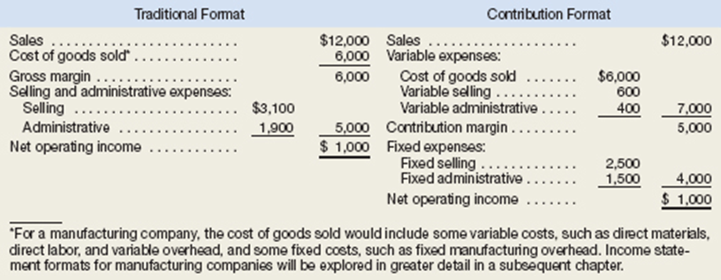
The Traditional Format Income Statement
The Contribution Format Income Statement

Slide 6
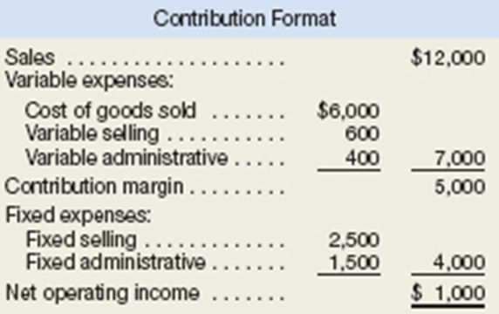
The contribution approach separates costs into fixed and variable categories, first deducting variable expenses from sales to obtain the contribution margin.
For a merchandising company, cost of goods sold is a variable cost that gets included in the “Variable expenses” portion of the contribution format income statement. The contribution margin is the amount remaining from sales revenues after variable expenses have been deducted. This amount contributes toward covering fixed expenses and then toward profits for the period.
The contribution format income statement is used as an internal planning and decision-making tool. Its emphasis on cost behavior aids cost-volume-profit analysis, management performance appraisals, and budgeting. Moreover, the contribution approach helps managers organize data pertinent to numerous decisions such as segment analysis, pricing, and pricing special orders.

Slide 7
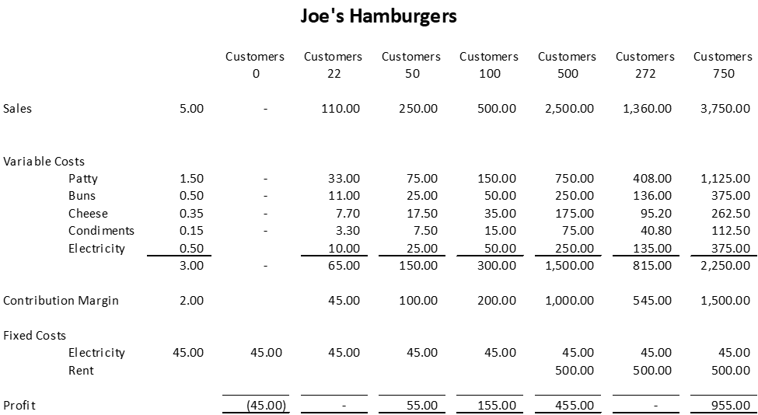

Slide 8
Cost-Volume-Profit Relationships
Cost-volume-profit (CVP) analysis helps managers make many important decisions such as what products and services to offer, what prices to charge, what marketing strategy to use, and what cost structure to maintain. Its primary purpose is to estimate how profits are affected by the following factors:
Sales volume.
Unit variable costs.
Total fixed costs.
To simplify CVP calculations for this class, we will adopt the following assumptions with respect to these factors:
Selling price is constant. The price of a product or service will not change as volume changes.
Costs are linear and can be accurately divided into variable and fixed elements. The variable element is constant per unit. The fixed element is constant in total over the entire relevant range.

Slide 9
The Basics of Cost-Volume-Profit (CVP) Analysis
CVP begins with the contribution income statement. The contribution income statement emphasizes the behavior of costs and therefore is extremely helpful to managers in judging the impact on profits of changes in selling price, cost, or volume.
Notice that sales, variable expenses and contribution margin are expressed on a per unit and ratio basis as well as in total on this contribution income statement.
Per unit and ratio figures will be very helpful to in some of our calculations. The contribution income statement is prepared for management’s use inside the company and would not ordinarily be made available to those outside the company.

Slide 10
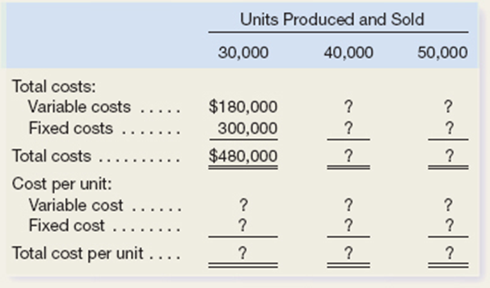
Harris Company manufactures and sells a single product. A partially completed schedule of the company’s total and per unit costs over the relevant range of 30,000 to 50,000 units produced and sold annually is given below:
Assume that the company produces and sells 45,000 units during the year at a selling price of $16 per unit. Prepare a contribution format income statement for the year.

Slide 11
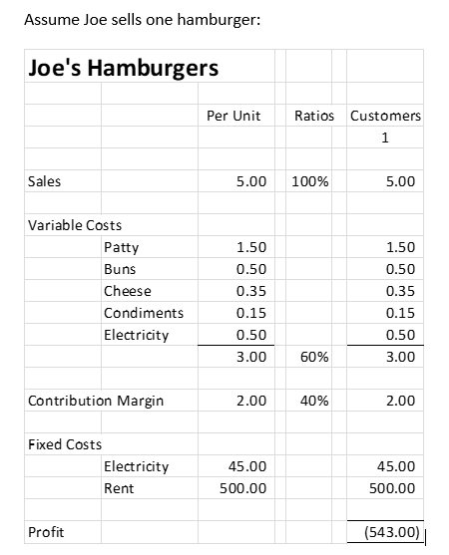
Contribution Margin
Contribution margin is the amount remaining from sales revenue after variable expenses have been deducted. Thus, it is the amount available to cover fixed expenses and then to provide profits for the period. Notice the sequence here—contribution margin is used first to cover the fixed expenses, and then whatever remains goes toward profits. If the contribution margin is not sufficient to cover the fixed expenses, then a loss occurs for the period or the company breaks even.

Slide 12
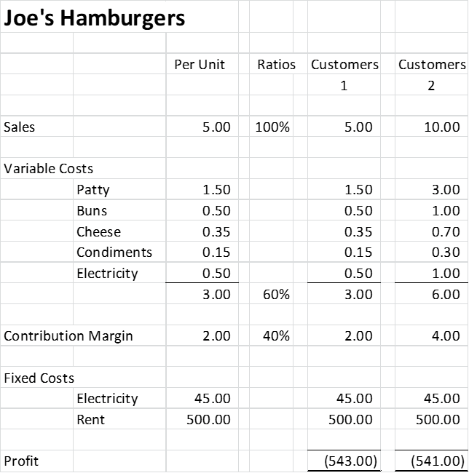
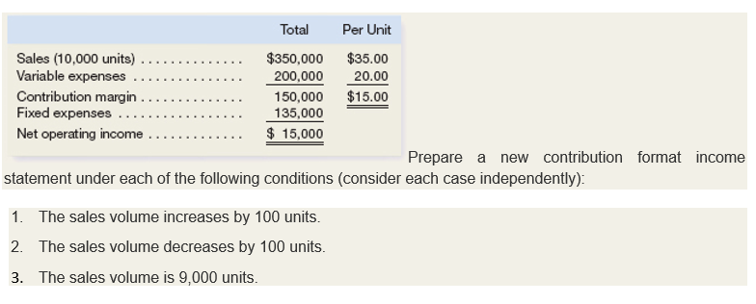
For each additional hamburger he sells during the month, $2 more in contribution margin becomes available to help cover the fixed expenses. If a second is sold, for example, then the total contribution margin will increase by $2 (to a total of $4) and the company’s loss will decrease by $2, to $541:
Exercise:

Slide 13
Break-Even Analysis
If Joe’s Hamburgers can sell enough to generate $545 in contribution margin, then all the fixed expenses will be covered and he will break even for the month—that is, it will show neither profit nor loss but just cover all costs.
How can you calculate the break-even point in unit sold or dollars sales? Managers can use either of two approaches, the equation method or the formula method. We will use the formula method.

Slide 14
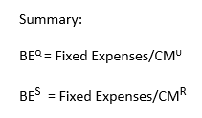
The Formula Method
Breakeven Quantities In a single product situation, the formula to break even is BE^{Q} = Fixed Expenses/CM^{U} or Breakeven Quantities = Fixed expenses divided by contribution margin per unit
For Joe’s – Fixed expenses divided by contribution margin per unit ($545/$2) equals 273 hamburgers.
The formula for breakeven sales is BE^{S} = Fixed Expenses/CM^{R} which is Break even sales are equal to Fixed Expenses divided by the Contribution Margin Ratio. $545/.4 or approximately $1,365 in sales.

Slide 15
Break-Even
Mauro Products distributes a single product, a woven basket whose selling price is $15 per unit and whose variable expense is $12 per unit. The company’s monthly fixed expense is $4,200.
Required:
Calculate the company’s break-even point in units (quantities) sales.
Calculate the company’s break-even point in dollar sales.

Slide 16
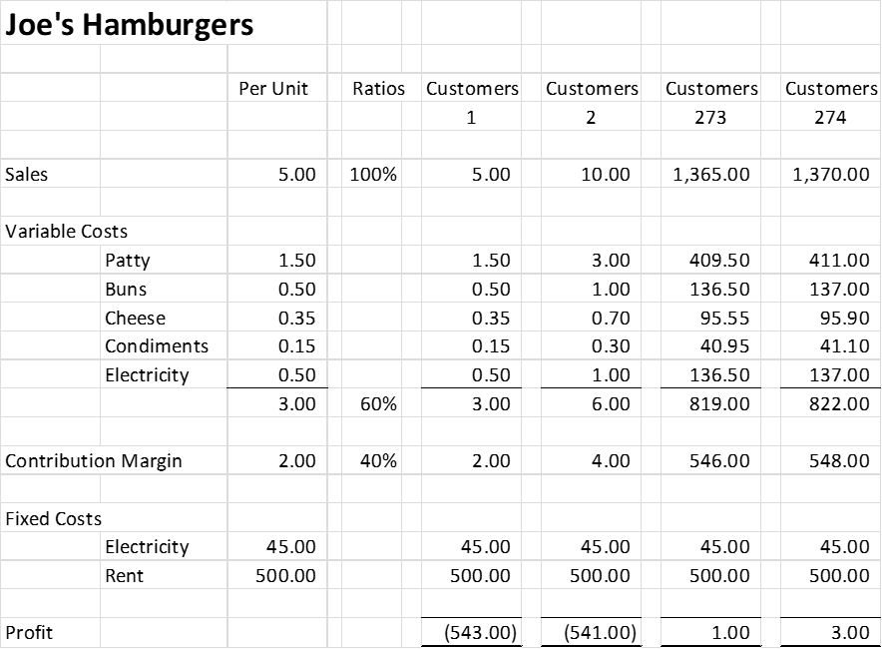
Once the break-even point has been reached, net operating income will increase by the amount of the unit contribution margin for each additional unit sold. For example, if 274 hamburgers are sold in a month, then the net operating income for the month will be increased by $2 ($3 in total) because the company will have sold one hamburger more than the number needed to break even

Slide 17
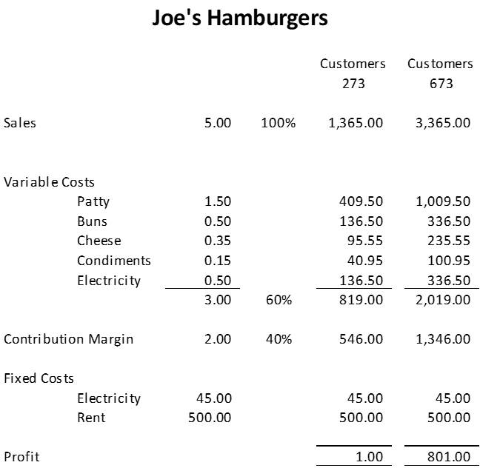
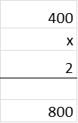
How to Quickly Calculate Profit once breakeven has been met
Units Sold
To estimate the profit at any sales volume above the break-even point, multiply the number of units sold in excess of the break-even point by the unit contribution margin. The result represents the anticipated profits for the period. So, if our breakeven quantities for Joe’s are 273, if he sells 400 more (673 in total) the profit will be …

Slide 18
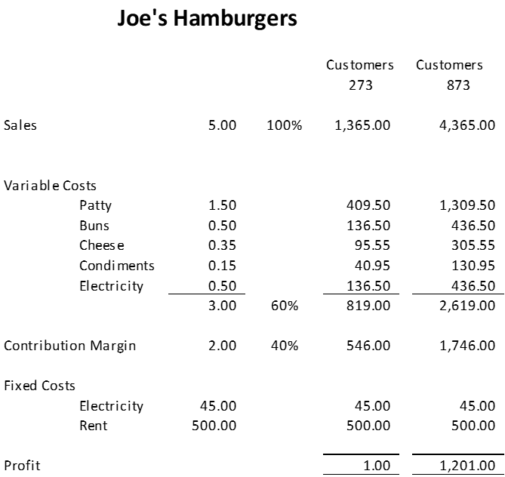
How to Quickly Calculate Profit once breakeven has been met
Dollar Sales Changes
The CM ratio shows how the contribution margin will be affected by a change in total sales. A CM ratio of 40% means that for each dollar increase in sales, total contribution margin will increase by 40 cents ($1 sales × CM ratio of 40%). Net operating income will also increase by 40 cents, assuming that fixed costs are not affected by the increase in sales. Generally, the effect of a change in sales on the contribution margin is expressed in equation form as
Dollar sales increase times contribution margin ratio
As this illustration suggests, the impact on net operating income of any given dollar change in total sales can be computed by applying the CM ratio to the dollar change.
For example, if Joe plans a $3,000 increase in sales, the net operating income should increase to $1,200 ($3,000 increase in sales × CM ratio of 40%).

Slide 19
Computing and Using the CM Ratio
Last month when Holiday Creations, Inc., sold 50,000 units, total sales were $200,000, total variable expenses were $120,000, and fixed expenses were $65,000.
What is the company’s contribution margin (CM) ratio?
Estimate the change in the company’s net operating income if it were to increase its total sales by $1,000

Slide 20
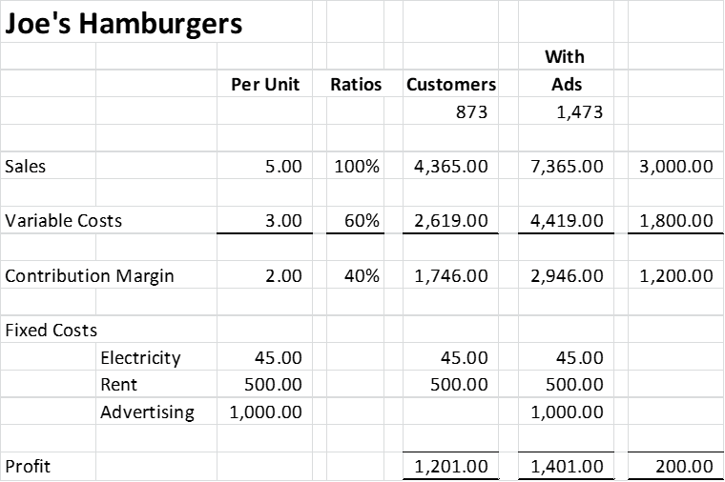
Change in Fixed Costs
Joe is currently selling 873 hamburgers per month at $5 per hamburger for total monthly sales of $4,365.
The restaurant manager feels that a $1,000 monthly advertising budget would increase monthly sales by $3,000 to a total of 1,473 hamburgers.
Should Joe add advertising?
Sales increase times CM ratio less additional fixed costs
$3,000 x 40% minus 1,000 (or $1,200 minus $1,000) equals $200
Sales were increased by $1,200 but it cost Joe $1,000 to obtain the additional sales. As a practical matter, advertising is expected to build momentum if the product is good. The sales increases should continue.

Slide 21
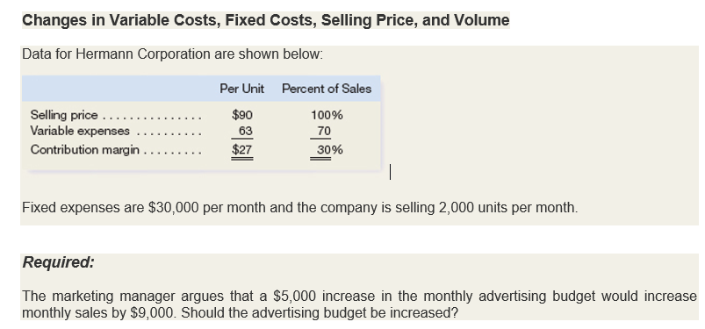

Slide 22
Determine the level of sales needed to achieve a desired target profit.
Target profit analysis is one of the key uses of CVP analysis. In target profit analysis, we estimate what sales volume is needed to achieve a specific target profit. For example, suppose Joe wants to obtain a profit of $2,000 per month. To determine the unit sales and dollar sales needed to achieve a target profit, we can rely on the formula method.
Target Profit Quantities
T¶^{Q} = (Target Profit + Fixed Expenses) divided by Contribution Margin per Unit
T¶^{Q} = (T¶ + F)/ CM^{U}
Target profit quantities = (2,000 + 545)/2 = 1,273
Target Profit Sales
T¶^{s} = (T¶ + F) divided by Contribution Margin Ratio
T¶^{s} = (T¶ + F)/CM^{R}
Target profit Sales = (2,000 + 545)/.4 = $6,365

Slide 24
