Slide 1
Survey of Accounting
Second Edition
Kimmel ● Weygandt
Chapter 2
A Further Look at the Balance Sheet
Prepared by
Coby Harmon
University of California, Santa Barbara
Westmont College
This slide deck contains animations. Please disable animations if they cause issues with your device.
Copyright ©2020 John Wiley & Sons, Inc.

Slide 2
Learning Objective 1
Identify the Sections of a Classified Balance Sheet
L O 1

Slide 3
The Classified Balance Sheet
Presents a snapshot at a point in time.
To improve understanding, companies group similar assets and similar liabilities together.
Standard Classifications
Assets | Liabilities and Stockholders’ Equity
Current assets | Current liabilities
Long-term investments | Long-term liabilities
Property, plant, and equipment | Stockholders’ equity
Intangible assets
L O 1

Slide 4
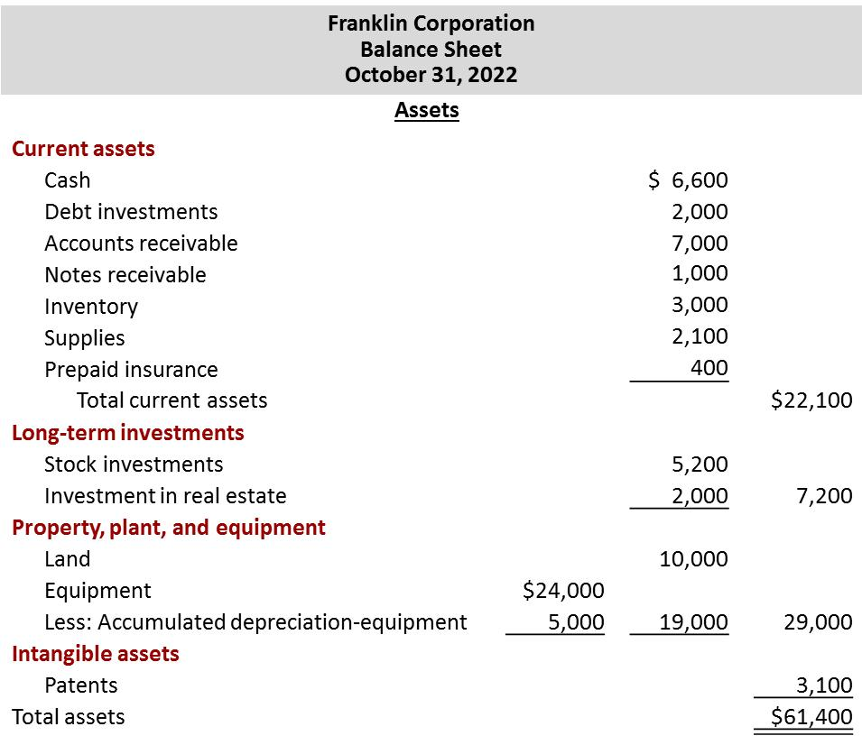
The Classified Balance Sheet (partial)
Assets
L O 1

Slide 5
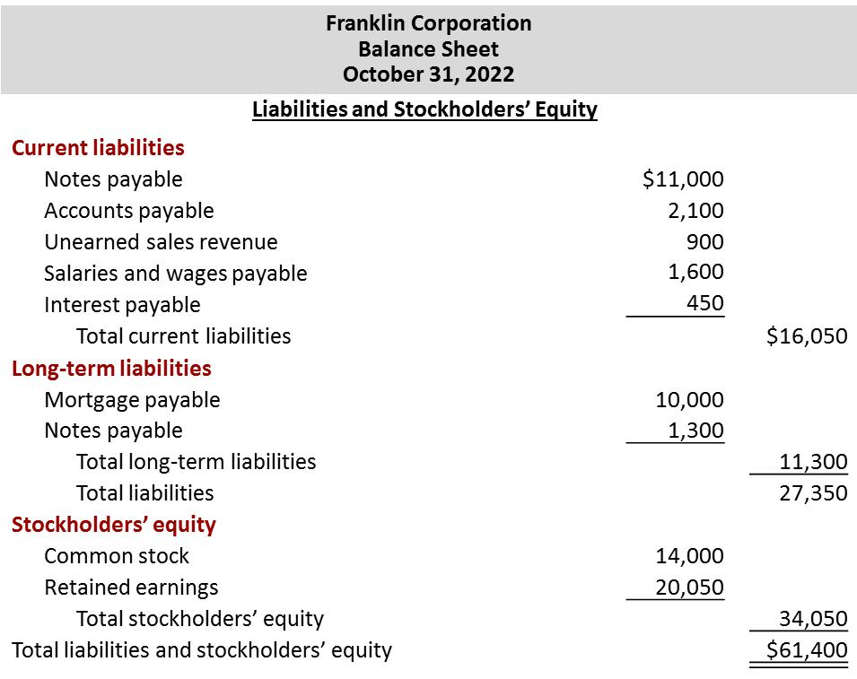
The Classified Balance Sheet (partial)
Liabilities and Stockholders’ Equity
L O 1

Slide 6
The Classified Balance Sheet
Current Assets
Assets a company expects to convert to cash or use up within one year or the operating cycle, whichever is longer.
Operating cycle is the average time it takes from purchase of inventory, to sale of goods, and then to collection of cash from customers.
Common types include cash, investments, receivables, inventories, and prepaid expenses.
L O 1

Slide 7
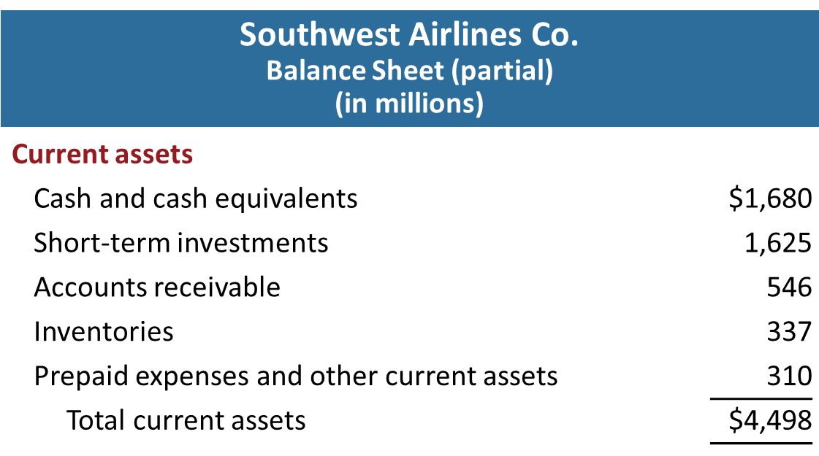
Current Assets Presentation
Companies list current asset accounts in the order they expect to convert them into cash.
L O 1

Slide 8
The Classified Balance Sheet
Long-Term Investments
Investments in stocks and bonds of other corporations that are held for more than one year.
Long-term assets such as land or buildings that a company is not currently using in its operating activities.
Long-term notes receivable.
L O 1

Slide 9
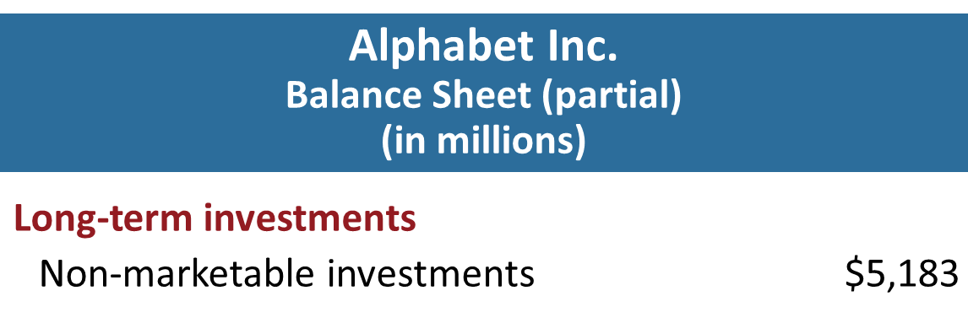
The Classified Balance Sheet
Long-Term Investments Example
L O 1

Slide 10
The Classified Balance Sheet
Property, Plant, and Equipment
  Long useful lives.
  Currently used in operations.
  Includes land, buildings, equipment, delivery vehicles, and furniture.
  Depreciation - allocating the cost of assets to a number of years.
  Accumulated depreciation - total amount of depreciation expensed thus far in the asset’s life.
L O 1

Slide 11
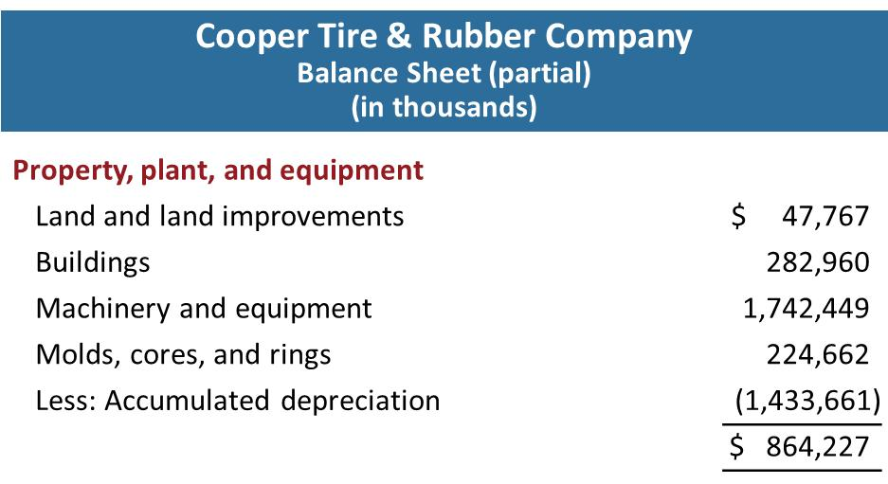
The Classified Balance Sheet
Property, Plant, and Equipment Example
L O 1

Slide 12
The Classified Balance Sheet
Intangible Assets
  Assets that do not have physical substance.
  Includes goodwill, patents, copyrights, and trademarks or trade names.
  Helpful Hint
  Sometimes intangible assets are reported under a broader heading called “Other assets.”
L O 1

Slide 13
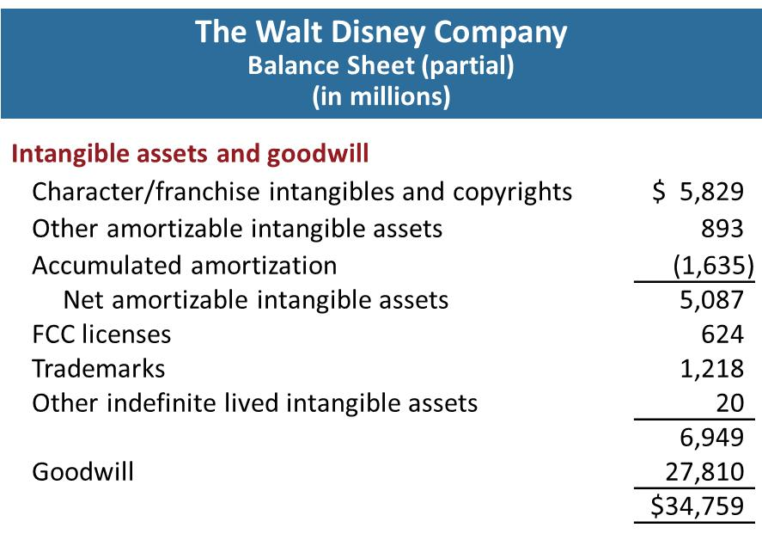
The Classified Balance Sheet
Intangible Assets Example
L O 1

Slide 14
The Classified Balance Sheet
Current Liabilities
  Obligations the company is to pay within the next year or operating cycle, whichever is longer.
  Common examples are accounts payable, salaries and wages payable, notes payable, unearned revenue, interest payable, and income taxes payable.
  Also included are current maturities of long-term obligations—payments to be made within the next year on long-term obligations.
L O 1

Slide 15
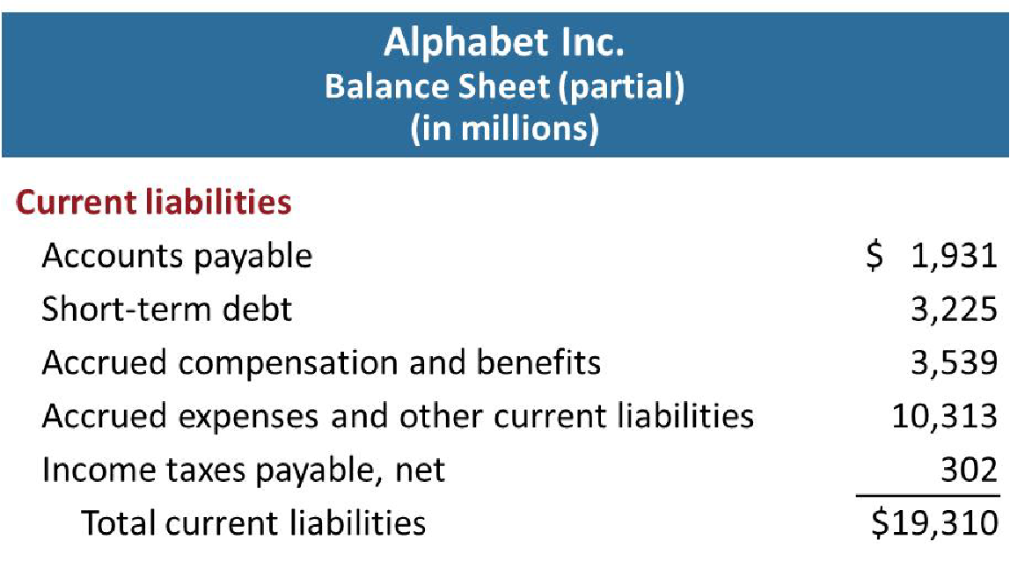
The Classified Balance Sheet
Current Liabilities Example
L O 1

Slide 16
The Classified Balance Sheet
Long-Term Liabilities
  Obligations a company expects to pay after one year.
  Include bonds payable, mortgages payable, long-term notes payable, lease liabilities, and pension liabilities.
L O 1

Slide 17
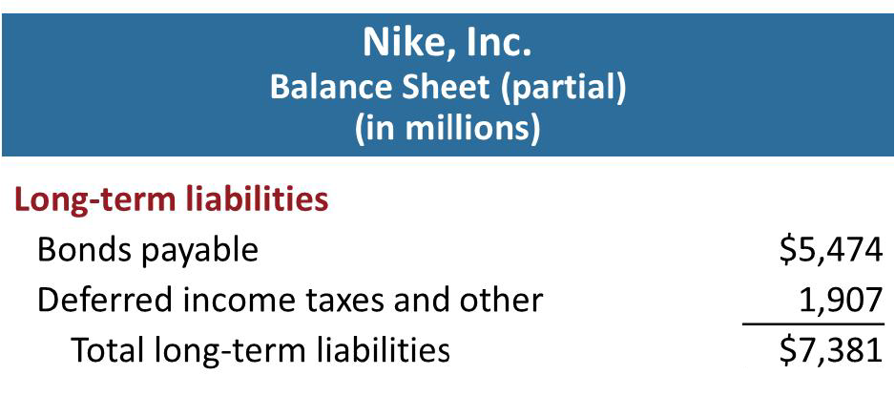
The Classified Balance Sheet
Long-Term Liabilities Example
L O 1

Slide 18
The Classified Balance Sheet
Stockholders’ Equity
  Common stock - investments of assets into the business by the stockholders.
  Retained earnings - income retained for use in the business.
L O 1

Slide 19
Learning Objective 2
Use Ratios to Evaluate a Company's Balance Sheet
L O 2

Slide 20
Analyzing the Balance Sheet Using Ratios
  Ratio Analysis
  Ratio analysis expresses the relationship among selected items of financial statement data.
  A ratio expresses the mathematical relationship between one quantity and another.
  A single ratio by itself is not very meaningful.
L O 2

Slide 21
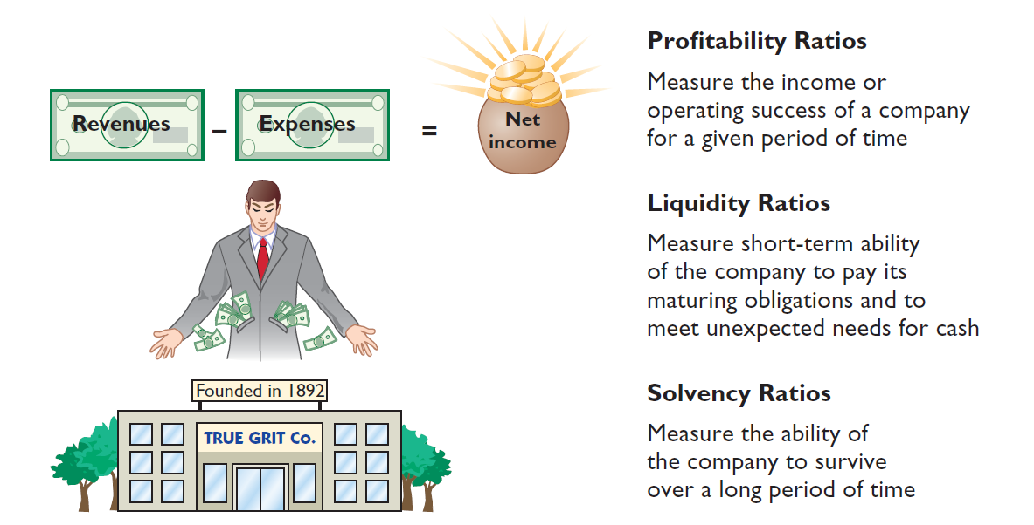
Ratio Analysis
L O 2

Slide 22
Using a Classified Balance Sheet
L O 2

Slide 23
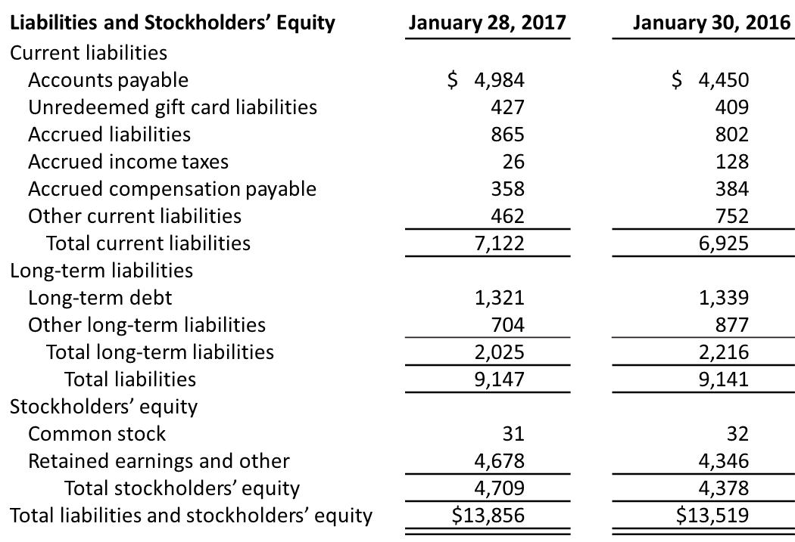
Using a Classified Balance Sheet (continued)
L O 2

Slide 24
Using a Classified Balance Sheet
Liquidity
The ability to pay obligations expected to become due within the next year or operating cycle.
One measure of liquidity is working capital, which is the difference between the amounts of current assets and current liabilities.
Working Capital = Current Assets – Current Liabilities
Best Buy had working capital in 2017 of $3,394 million ($10,516 million − $7,122 million).
L O 2

Slide 25
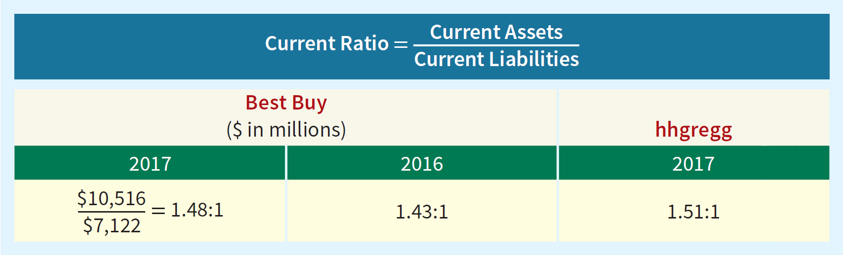
Using a Classified Balance Sheet
Liquidity Ratios
Liquidity ratios measure short-term ability to pay maturing obligations and meet unexpected needs for cash. The current ratio is a more dependable indicator of liquidity than working capital.
In 2017, for every dollar of current liabilities, Best Buy has $1.48 of current assets.
L O 2

Slide 26
Using a Classified Balance Sheet
Solvency
The ability to pay interest as it comes due and to repay the balance of a debt due at its maturity.
Solvency ratios measure the ability of the company to survive over a long period of time.
Helpful Hint - Some users evaluate solvency using a ratio of liabilities divided by stockholders’ equity. The higher this “debt to equity” ratio, the lower is a company’s solvency.
L O 2

Slide 27
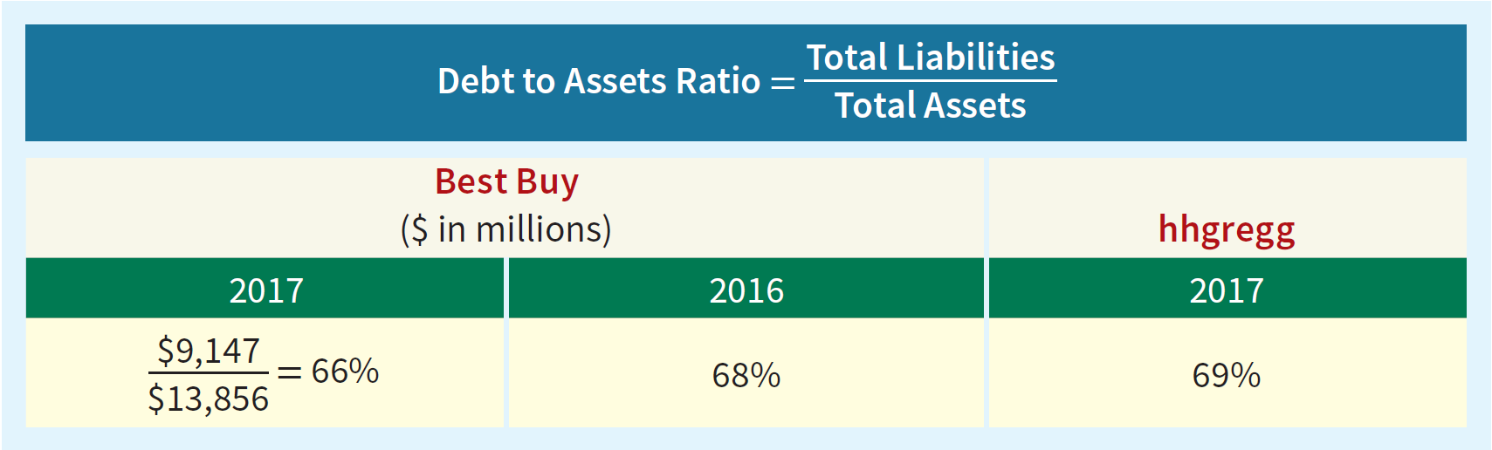
Using a Classified Balance Sheet
Debt to Assets Ratio
Debt to assets ratio measures the percentage of total financing provided by creditors rather than stockholders.
The 2017 ratio means that every dollar of assets was financed by 66 cents of debt.
L O 2

