Slide 1
Essentials of Accounting for Governmental and Not-for-Profit Organizations
Chapter 7
Pension Funds
McGraw-Hill/Irwin
Copyright © 2016 by The McGraw-Hill Companies, Inc. All rights reserved.

Slide 2
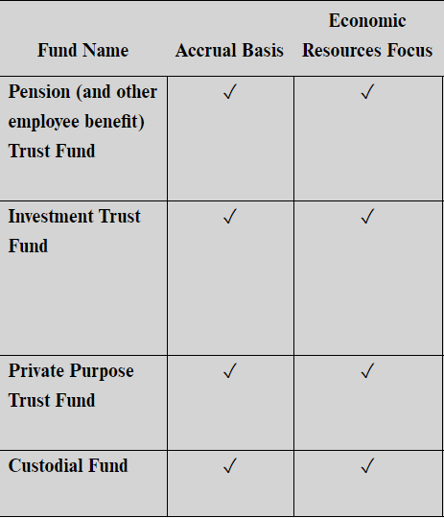
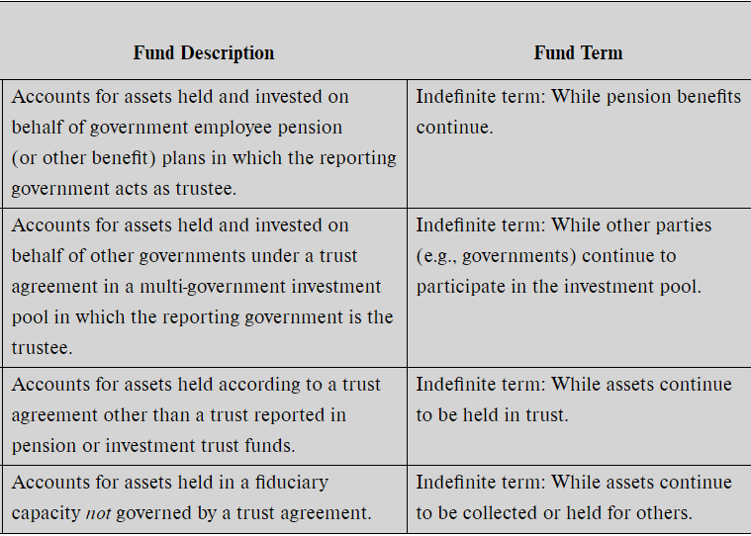
Summary of Fiduciary-Type Funds

Slide 3
Financial Reporting Process:
Two levels of reporting:
- Government-wide
- Fund basis

Slide 4
Pensions: Types of Pension Plans
Plans can be contributory v noncontributory
Contributory vs. noncontributory funds -- refers to whether the employee is required to contribute
Defined benefit plans:
The employer must pay a guaranteed level of benefit, computed using a formula despite amount in fund
Actuaries are used to determine funding
Will have unfunded actuarial liabilities
The risk of additional future liability is on the employer.
Defined contribution plans:
Provide retirement benefits for each participating employee
No obligation exists beyond what has accumulated in the person’s account
The employer pays based on assets accumulated with investment earnings
The risk of insufficient retirement pay is on the employee, not the employer.

Slide 5
Public Employee Retirement Systems
Most full-time public sector employees have retirement benefits
Pension plans for governments are called “Public Employee Retirement Systems”
Some large cities may have their own plan, but most local governments participate in the plans administered by state govt
Includes teachers, police, fire, public sector employees, legislators, etc.
If the statewide plan is a multiple-employer defined benefit plan, each entity is responsible to fund their individual plans and keep contributions up to date
If the statewide plan is a cost-sharing multiple-employer defined benefit plan, each entity shares proportionally in the resources and obligations and are equally over-funded or under-funded.
Some large cities may have their own plan, if so they will only include that plan in their reporting

Slide 6
Pensions have two categories of reporting
Reporting for the Plan (Ch 7)
Applies only to governments acting as trustees
As a result of the trust nature of the plan, they are considered a fiduciary fund and included in CAFR
The Statement of Fiduciary Net Position reports the excess of currently available resources over benefits currently payable to retired employees
The Statement does not report a liability for amounts expected to be paid to current employees when they retire in the future.
Employer reporting (Ch 9)
Applies whether a government manages its own plan or participates in a plan administered by another government
Accrual basis and economic resources
The central issues of employer reporting are the measurement and presentation of the net pension liability in statements displaying financial position and the related recognition of pension expenditure or expense.

Slide 7
Variables
Contributions “Additions” are invested to earn a return
There is an assumption the govt will set aside money while the employee is working to fund retirement
Benefits are paid out related to salary at retirement and years of service
Govt must determine how much to invest to adequately fund
Actuarial information needed to determine how long to pay benefits
Also unknown is investment income growth
If the govt has not contributed or investment earnings are not sufficient to pay future benefits, the pension is said to be underfunded

Slide 8
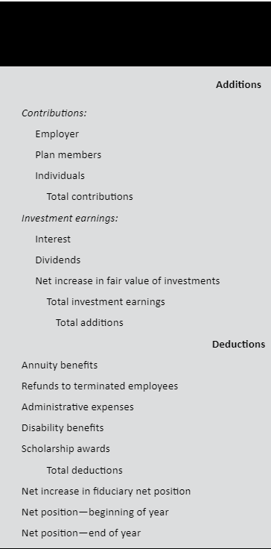
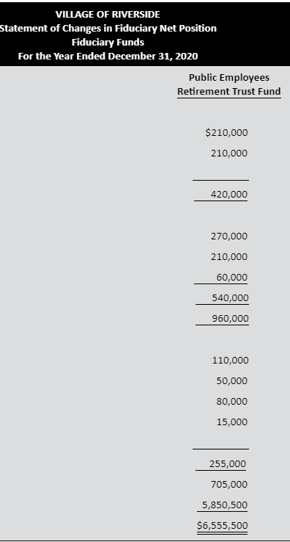
Plan Reporting: Pension Trust Financial Statements Accrual Basis
Statement of Changes in Fiduciary Net Position
Use of the terms Additions and Deductions instead of Revenues and Expenses

Slide 9
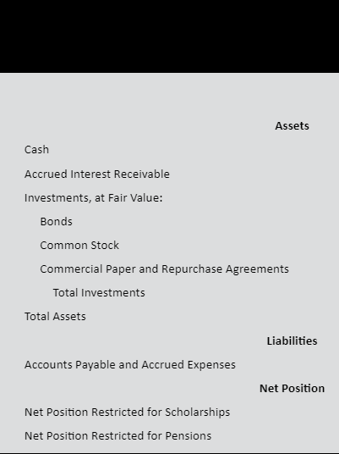
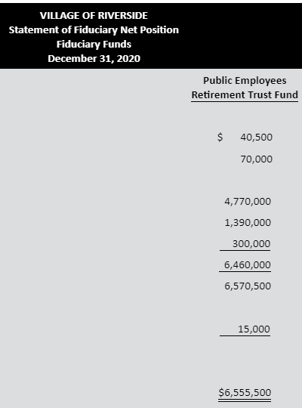
Plan Reporting: Pension Trust Financial Statements Accrual Basis
Statement of Fiduciary Net Position
Assets less short term accrued liabilities = Net Position Restricted for Pensions
Investments reported at fair value
Liabilities are what is currently due
No liability is shown for any unfunded pension obligation
A reader of the statement will not be able to tell if the plan is underfunded

Slide 10
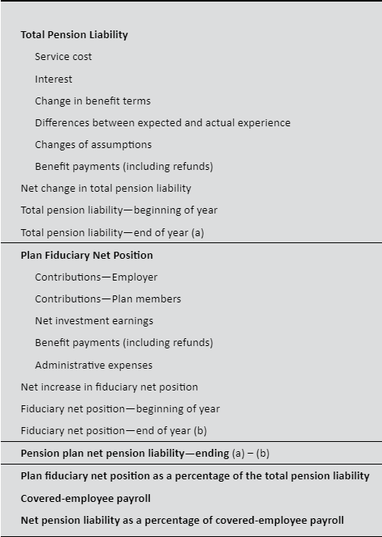
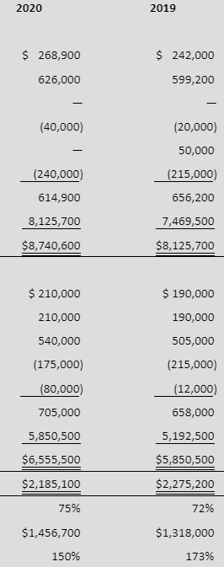
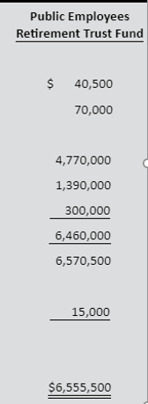
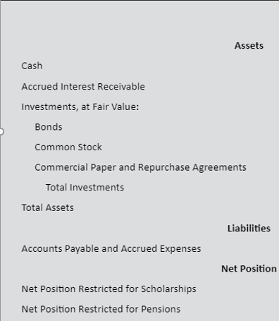

Slide 11
Pension Funds – Additional issues
To determine if a plan is underfunded, a ten-year supplemental schedule is provided which shows the Net Pension Liability and related ratios
The Net Pension liability is the difference between the Net Position Restricted for Pensions as reported on the Statement of Fiduciary Net Position and the Total Pension Liability
The Total Pension Liability is the future obligations of the plan – measured at present value
Two factors affect the liability each year
Service cost – The employee works another year adding to liability
Interest cost component – Passage of time between present value of future liability and future costs when the employee does retire
Required supplementary schedules:
Ten year schedule of changes in net pension liability and related ratios
The Net Pension Liability

Slide 12
Pension Funds
Actuarial methods are prescribed by GASB as well as frequency of evaluations, and appropriate discount rates
Additional required supplementary schedules:
Ratios for disclosing the magnitude of any underfunding
Ten year schedule of employer contributions and
Ten year schedule of investment returns.

Slide 13
Other post-retirement benefits Health care, life ins, disability/long-term care
Rights to these benefits arise during employee service
Costs occur after retirement
Measuring future costs involves actuaries – assumptions and estimates
Future costs are hard to calculate
Less well funded than pensions
Has two categories of reporting
Plan reporting of liability and expense
Reporting by the plan itself

Slide 14
IRS 457 Deferred Compensation Plans
Usually, an entity outside of the govt administers. If so, govt reports amounts withheld and distributed
If administered by the govt or participates in investment decisions, resources are held in trust and accounted for like pensions.
Example of IRS 457 plan: Manager earns $50,000 but has $5,000 withheld and contributed to a 457 plan …. The manager will not be taxed on the $5,000 until he draws it out at retirement.

Slide 15
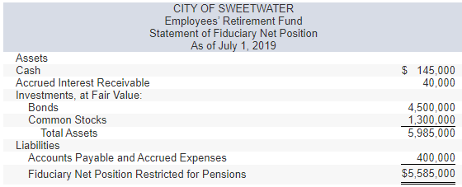
The City of Sweetwater maintains an Employees’ Retirement Fund, a single-employer defined benefit plan that provides annuity and disability benefits.
The fund is financed by actuarially determined contributions from the city’s General Fund and by contributions from employees.
Administration of the retirement fund is handled by General Fund employees, and the retirement fund does not bear any administrative expenses.

Slide 16
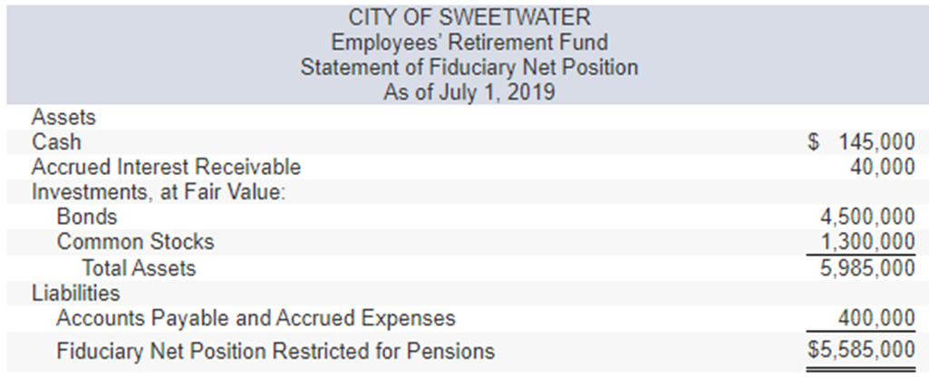
The fund is financed by actuarially determined contributions from the city’s General Fund and by contributions from employees.
Administration of the retirement fund is handled by General Fund employees, and the retirement fund does not bear any administrative expenses.
The interest receivable on investments was collected in cash.

Slide 17
The fund is financed by actuarially determined contributions from the city’s General Fund and by contributions from employees.
Administration of the retirement fund is handled by General Fund employees, and the retirement fund does not bear any administrative expenses.
2. Member contributions in the amount of $260,000 were received in cash. The city’s General Fund also contributed $830,000 in cash.

Slide 18
The fund is financed by actuarially determined contributions from the city’s General Fund and by contributions from employees.
Administration of the retirement fund is handled by General Fund employees, and the retirement fund does not bear any administrative expenses.
3. Annuity benefits of $740,000 and disability benefits of $172,000 were recorded as liabilities.

Slide 19
The fund is financed by actuarially determined contributions from the city’s General Fund and by contributions from employees.
Administration of the retirement fund is handled by General Fund employees, and the retirement fund does not bear any administrative expenses.
4. Accounts payable and accrued expenses in the amount of $990,000 were paid in cash.

Slide 20
The fund is financed by actuarially determined contributions from the city’s General Fund and by contributions from employees.
Administration of the retirement fund is handled by General Fund employees, and the retirement fund does not bear any administrative expenses.
5. Interest income of $235,000 and dividends in the amount of $40,000 were received in cash. In addition, bond interest income of $45,000 was accrued at year-end.

Slide 21
The fund is financed by actuarially determined contributions from the city’s General Fund and by contributions from employees.
Administration of the retirement fund is handled by General Fund employees, and the retirement fund does not bear any administrative expenses.
6. Refunds of $68,000 were made in cash to terminated, nonvested participants.

Slide 22
The fund is financed by actuarially determined contributions from the city’s General Fund and by contributions from employees.
Administration of the retirement fund is handled by General Fund employees, and the retirement fund does not bear any administrative expenses.
7. Common stocks, carried at a fair value of $500,000, were sold for $475,000. That $475,000, plus an additional $305,000, was invested in stocks.

Slide 23
The fund is financed by actuarially determined contributions from the city’s General Fund and by contributions from employees.
Administration of the retirement fund is handled by General Fund employees, and the retirement fund does not bear any administrative expenses.
8. At year-end, it was determined that the fair value of stocks held by the pension plan had decreased by $42,000; the fair value of bonds had increased by $33,000.

Slide 24
9. Nominal accounts for the year were closed.

