Slide 1
Ch 6 Proprietary Funds
In-Class Assignments

Slide 2
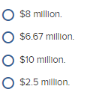
TB MC Qu. 06-84
Montgomery County operates a landfill as an enterprise fund. The closure and post-closure care costs are estimated to be $40 million. It is estimated that the capacity of the landfill is 16 million tons of waste and that waste will be accepted for 6 years. During 2020, 4 million tons of waste was accepted. The charge for closure and post-closure care costs for 2020 would be:

Slide 3
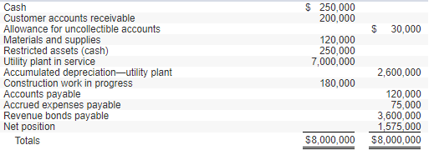
Ex 6-6 The Town of Weston has a Water Utility Fund with the following trial balance as of July 1, 2019, the first day of the fiscal year:
During the year ended June 30, 2020, the following transactions and events occurred in the Town of Weston Water Utility Fund:
1. Accrued expenses at July 1 were paid in cash.
2. Billings to nongovernmental customers for water usage for the year amounted to $1,380,000; billings to the General Fund amounted to $96,000.
3. Liabilities for the following were recorded during the year:
Materials and supplies $ 185,000
Costs of sales and services 345,000
Administrative expenses 202,000
Construction work in progress 220,000
4. Materials and supplies were used in the amount of $275,000, all for costs of sales and services.
5. After collection efforts were unsuccessful, $9,000 of old accounts receivable were written off.
6. Accounts receivable collections totaled $1,459,000 from nongovernmental customers and $48,400 from the General Fund.
7. $1,035,000 of accounts payable were paid in cash.
8. One year’s interest in the amount of $175,000 was paid.
9. Construction was completed on plant assets costing $250,000; that amount was transferred to Utility Plant in Service.
10. Depreciation was recorded in the amount of $260,000.
11. The Allowance for Uncollectible Accounts was increased by $9,900.
12. As required by the loan agreement, cash in the amount of $100,000 was transferred to Restricted Assets for eventual redemption of the bonds.
13. Accrued expenses, all related to costs of sales and services, amounted to $83,000.
14. Nominal accounts for the year were closed.

Slide 4
Ex 6-6 The Town of Weston has a Water Utility Fund with the following trial balance as of July 1, 2019, the first day of the fiscal year:
During the year ended June 30, 2020, the following transactions and events occurred in the Town of Weston Water Utility Fund:
1. Accrued expenses at July 1 were paid in cash.

Slide 5
Ex 6-6 The Town of Weston has a Water Utility Fund with the following trial balance as of July 1, 2019, the first day of the fiscal year:
During the year ended June 30, 2020, the following transactions and events occurred in the Town of Weston Water Utility Fund:
2. Billings to nongovernmental customers for water usage for the year amounted to $1,380,000; billings to the General Fund amounted to $96,000.

Slide 6
Ex 6-6 The Town of Weston has a Water Utility Fund with the following trial balance as of July 1, 2019, the first day of the fiscal year:
During the year ended June 30, 2020, the following transactions and events occurred in the Town of Weston Water Utility Fund:
3. Liabilities for the following were recorded during the year:
Materials and supplies $ 185,000
Costs of sales and services 345,000
Administrative expenses 202,000
Construction work in progress 220,000

Slide 7
Ex 6-6 The Town of Weston has a Water Utility Fund with the following trial balance as of July 1, 2019, the first day of the fiscal year:
During the year ended June 30, 2020, the following transactions and events occurred in the Town of Weston Water Utility Fund:
4. Materials and supplies were used in the amount of $275,000, all for costs of sales and services.

Slide 8
Ex 6-6 The Town of Weston has a Water Utility Fund with the following trial balance as of July 1, 2019, the first day of the fiscal year:
During the year ended June 30, 2020, the following transactions and events occurred in the Town of Weston Water Utility Fund:
5. After collection efforts were unsuccessful, $9,000 of old accounts receivable were written off.

Slide 9
Ex 6-6 The Town of Weston has a Water Utility Fund with the following trial balance as of July 1, 2019, the first day of the fiscal year:
During the year ended June 30, 2020, the following transactions and events occurred in the Town of Weston Water Utility Fund:
6. Accounts receivable collections totaled $1,459,000 from nongovernmental customers and $48,400 from the General Fund.

Slide 10
Ex 6-6 The Town of Weston has a Water Utility Fund with the following trial balance as of July 1, 2019, the first day of the fiscal year:
During the year ended June 30, 2020, the following transactions and events occurred in the Town of Weston Water Utility Fund:
7. $1,035,000 of accounts payable were paid in cash.

Slide 11
Ex 6-6 The Town of Weston has a Water Utility Fund with the following trial balance as of July 1, 2019, the first day of the fiscal year:
During the year ended June 30, 2020, the following transactions and events occurred in the Town of Weston Water Utility Fund:
8. One year’s interest in the amount of $175,000 was paid.

Slide 12
Ex 6-6 The Town of Weston has a Water Utility Fund with the following trial balance as of July 1, 2019, the first day of the fiscal year:
During the year ended June 30, 2020, the following transactions and events occurred in the Town of Weston Water Utility Fund:
9. Construction was completed on plant assets costing $250,000; that amount was transferred to Utility Plant in Service.

Slide 13
Ex 6-6 The Town of Weston has a Water Utility Fund with the following trial balance as of July 1, 2019, the first day of the fiscal year:
During the year ended June 30, 2020, the following transactions and events occurred in the Town of Weston Water Utility Fund:
10. Depreciation was recorded in the amount of $260,000.

Slide 14
Ex 6-6 The Town of Weston has a Water Utility Fund with the following trial balance as of July 1, 2019, the first day of the fiscal year:
During the year ended June 30, 2020, the following transactions and events occurred in the Town of Weston Water Utility Fund:
11. The Allowance for Uncollectible Accounts was increased by $9,900.

Slide 15
Ex 6-6 The Town of Weston has a Water Utility Fund with the following trial balance as of July 1, 2019, the first day of the fiscal year:
During the year ended June 30, 2020, the following transactions and events occurred in the Town of Weston Water Utility Fund:
12. As required by the loan agreement, cash in the amount of $100,000 was transferred to Restricted Assets for eventual redemption of the bonds.

Slide 16
Ex 6-6 The Town of Weston has a Water Utility Fund with the following trial balance as of July 1, 2019, the first day of the fiscal year:
During the year ended June 30, 2020, the following transactions and events occurred in the Town of Weston Water Utility Fund:
13. Accrued expenses, all related to costs of sales and services, amounted to $83,000.

Slide 17
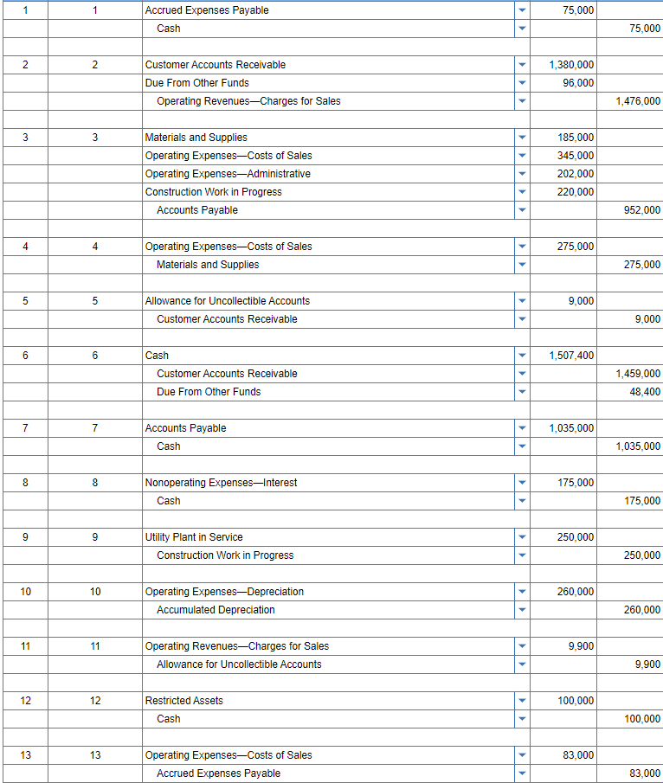
14. Nominal accounts for the year were closed.

Slide 18
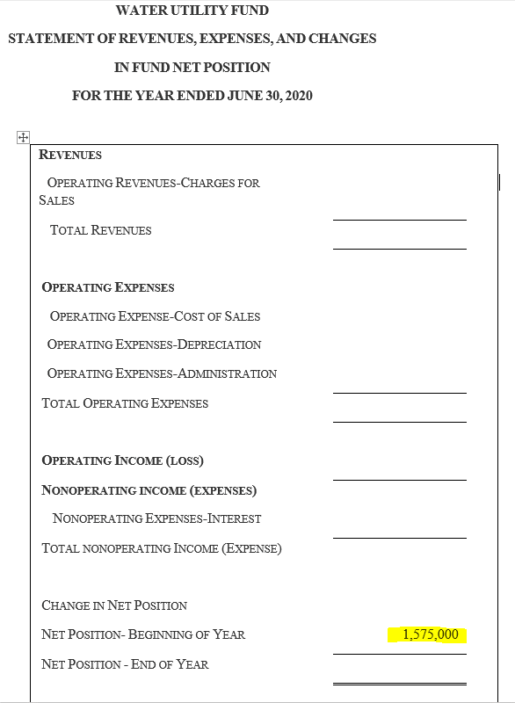

Slide 19
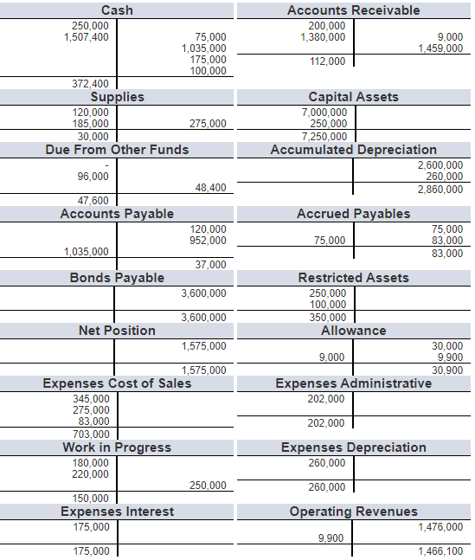

Slide 20
