Slide 1
Ch 6 Proprietary Funds
In-Class Assignments

Slide 2
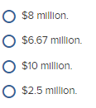
TB MC Qu. 06-84
Montgomery County operates a landfill as an enterprise fund. The closure and post-closure care costs are estimated to be $40 million. It is estimated that the capacity of the landfill is 16 million tons of waste and that waste will be accepted for 6 years. During 2020, 4 million tons of waste was accepted. The charge for closure and post-closure care costs for 2020 would be:

Slide 3
TB MC Qu. 06-84
Montgomery County operates a landfill as an enterprise fund. The closure and post-closure care costs are estimated to be $40 million. It is estimated that the capacity of the landfill is 16 million tons of waste and that waste will be accepted for 6 years. During 2020, 4 million tons of waste was accepted. The charge for closure and post-closure care costs for 2020 would be:
$40,000,000 estimated costs/16,000,000 tons = $2.50 per ton. $2.50 per ton × 4,000,000 tons = $10,000,000

Slide 4
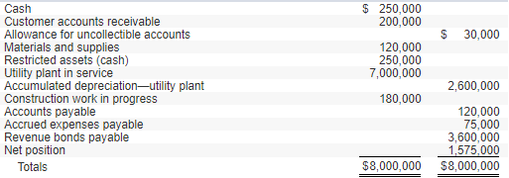
Ex 6-6
The Town of Weston has a Water Utility Fund with the following trial balance as of July 1, 2019, the first day of the fiscal year:
During the year ended June 30, 2020, the following transactions and events occurred in the Town of Weston Water Utility Fund:
1. Accrued expenses at July 1 were paid in cash.
2. Billings to nongovernmental customers for water usage for the year amounted to $1,380,000; billings to the General Fund amounted to $96,000.
3. Liabilities for the following were recorded during the year:
Materials and supplies $ 185,000
Costs of sales and services 345,000
Administrative expenses 202,000
Construction work in progress 220,000
4. Materials and supplies were used in the amount of $275,000, all for costs of sales and services.
5. After collection efforts were unsuccessful, $9,000 of old accounts receivable were written off.
6. Accounts receivable collections totaled $1,459,000 from nongovernmental customers and $48,400 from the General Fund.
7. $1,035,000 of accounts payable were paid in cash.
8. One year’s interest in the amount of $175,000 was paid.
9. Construction was completed on plant assets costing $250,000; that amount was transferred to Utility Plant in Service.
10. Depreciation was recorded in the amount of $260,000.
11. The Allowance for Uncollectible Accounts was increased by $9,900.
12. As required by the loan agreement, cash in the amount of $100,000 was transferred to Restricted Assets for eventual redemption of the bonds.
13. Accrued expenses, all related to costs of sales and services, amounted to $83,000.
14. Nominal accounts for the year were closed.

Slide 5
Ex 6-6
The Town of Weston has a Water Utility Fund with the following trial balance as of July 1, 2019, the first day of the fiscal year:
During the year ended June 30, 2020, the following transactions and events occurred in the Town of Weston Water Utility Fund:
1. Accrued expenses at July 1 were paid in cash.

Slide 6
Ex 6-6
The Town of Weston has a Water Utility Fund with the following trial balance as of July 1, 2019, the first day of the fiscal year:
During the year ended June 30, 2020, the following transactions and events occurred in the Town of Weston Water Utility Fund:
1. Accrued expenses at July 1 were paid in cash.

Slide 7
Ex 6-6
The Town of Weston has a Water Utility Fund with the following trial balance as of July 1, 2019, the first day of the fiscal year:
During the year ended June 30, 2020, the following transactions and events occurred in the Town of Weston Water Utility Fund:
2. Billings to nongovernmental customers for water usage for the year amounted to $1,380,000; billings to the General Fund amounted to $96,000.

Slide 8
Ex 6-6
The Town of Weston has a Water Utility Fund with the following trial balance as of July 1, 2019, the first day of the fiscal year:
During the year ended June 30, 2020, the following transactions and events occurred in the Town of Weston Water Utility Fund:
2. Billings to nongovernmental customers for water usage for the year amounted to $1,380,000; billings to the General Fund amounted to $96,000.

Slide 9
Ex 6-6
The Town of Weston has a Water Utility Fund with the following trial balance as of July 1, 2019, the first day of the fiscal year:
During the year ended June 30, 2020, the following transactions and events occurred in the Town of Weston Water Utility Fund:
3. Liabilities for the following were recorded during the year:
Materials and supplies $ 185,000
Costs of sales and services 345,000
Administrative expenses 202,000
Construction work in progress 220,000

Slide 10
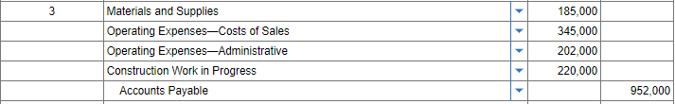
Ex 6-6
The Town of Weston has a Water Utility Fund with the following trial balance as of July 1, 2019, the first day of the fiscal year:
During the year ended June 30, 2020, the following transactions and events occurred in the Town of Weston Water Utility Fund:
3. Liabilities for the following were recorded during the year:
Materials and supplies $ 185,000
Costs of sales and services 345,000
Administrative expenses 202,000
Construction work in progress 220,000

Slide 11
Ex 6-6
The Town of Weston has a Water Utility Fund with the following trial balance as of July 1, 2019, the first day of the fiscal year:
During the year ended June 30, 2020, the following transactions and events occurred in the Town of Weston Water Utility Fund:
4. Materials and supplies were used in the amount of $275,000, all for costs of sales and services.

Slide 12
Ex 6-6
The Town of Weston has a Water Utility Fund with the following trial balance as of July 1, 2019, the first day of the fiscal year:
During the year ended June 30, 2020, the following transactions and events occurred in the Town of Weston Water Utility Fund:
4. Materials and supplies were used in the amount of $275,000, all for costs of sales and services.

Slide 13
Ex 6-6
The Town of Weston has a Water Utility Fund with the following trial balance as of July 1, 2019, the first day of the fiscal year:
During the year ended June 30, 2020, the following transactions and events occurred in the Town of Weston Water Utility Fund:
5. After collection efforts were unsuccessful, $9,000 of old accounts receivable were written off.

Slide 14
Ex 6-6
The Town of Weston has a Water Utility Fund with the following trial balance as of July 1, 2019, the first day of the fiscal year:
During the year ended June 30, 2020, the following transactions and events occurred in the Town of Weston Water Utility Fund:
5. After collection efforts were unsuccessful, $9,000 of old accounts receivable were written off.

Slide 15
Ex 6-6
The Town of Weston has a Water Utility Fund with the following trial balance as of July 1, 2019, the first day of the fiscal year:
During the year ended June 30, 2020, the following transactions and events occurred in the Town of Weston Water Utility Fund:
6. Accounts receivable collections totaled $1,459,000 from nongovernmental customers and $48,400 from the General Fund.

Slide 16
Ex 6-6
The Town of Weston has a Water Utility Fund with the following trial balance as of July 1, 2019, the first day of the fiscal year:
During the year ended June 30, 2020, the following transactions and events occurred in the Town of Weston Water Utility Fund:
6. Accounts receivable collections totaled $1,459,000 from nongovernmental customers and $48,400 from the General Fund.

Slide 17
Ex 6-6
The Town of Weston has a Water Utility Fund with the following trial balance as of July 1, 2019, the first day of the fiscal year:
During the year ended June 30, 2020, the following transactions and events occurred in the Town of Weston Water Utility Fund:
7. $1,035,000 of accounts payable were paid in cash.

Slide 18
Ex 6-6
The Town of Weston has a Water Utility Fund with the following trial balance as of July 1, 2019, the first day of the fiscal year:
During the year ended June 30, 2020, the following transactions and events occurred in the Town of Weston Water Utility Fund:
7. $1,035,000 of accounts payable were paid in cash.

Slide 19
Ex 6-6
The Town of Weston has a Water Utility Fund with the following trial balance as of July 1, 2019, the first day of the fiscal year:
During the year ended June 30, 2020, the following transactions and events occurred in the Town of Weston Water Utility Fund:
8. One year’s interest in the amount of $175,000 was paid.

Slide 20
Ex 6-6
The Town of Weston has a Water Utility Fund with the following trial balance as of July 1, 2019, the first day of the fiscal year:
During the year ended June 30, 2020, the following transactions and events occurred in the Town of Weston Water Utility Fund:
8. One year’s interest in the amount of $175,000 was paid.

Slide 21
Ex 6-6
The Town of Weston has a Water Utility Fund with the following trial balance as of July 1, 2019, the first day of the fiscal year:
During the year ended June 30, 2020, the following transactions and events occurred in the Town of Weston Water Utility Fund:
9. Construction was completed on plant assets costing $250,000; that amount was transferred to Utility Plant in Service.

Slide 22
Ex 6-6
The Town of Weston has a Water Utility Fund with the following trial balance as of July 1, 2019, the first day of the fiscal year:
During the year ended June 30, 2020, the following transactions and events occurred in the Town of Weston Water Utility Fund:
9. Construction was completed on plant assets costing $250,000; that amount was transferred to Utility Plant in Service.

Slide 23
Ex 6-6
The Town of Weston has a Water Utility Fund with the following trial balance as of July 1, 2019, the first day of the fiscal year:
During the year ended June 30, 2020, the following transactions and events occurred in the Town of Weston Water Utility Fund:
10. Depreciation was recorded in the amount of $260,000.

Slide 24
Ex 6-6
The Town of Weston has a Water Utility Fund with the following trial balance as of July 1, 2019, the first day of the fiscal year:
During the year ended June 30, 2020, the following transactions and events occurred in the Town of Weston Water Utility Fund:
10. Depreciation was recorded in the amount of $260,000.

Slide 25
Ex 6-6
The Town of Weston has a Water Utility Fund with the following trial balance as of July 1, 2019, the first day of the fiscal year:
During the year ended June 30, 2020, the following transactions and events occurred in the Town of Weston Water Utility Fund:
11. The Allowance for Uncollectible Accounts was increased by $9,900.

Slide 26
Ex 6-6
The Town of Weston has a Water Utility Fund with the following trial balance as of July 1, 2019, the first day of the fiscal year:
During the year ended June 30, 2020, the following transactions and events occurred in the Town of Weston Water Utility Fund:
11. The Allowance for Uncollectible Accounts was increased by $9,900.

Slide 27
Ex 6-6
The Town of Weston has a Water Utility Fund with the following trial balance as of July 1, 2019, the first day of the fiscal year:
During the year ended June 30, 2020, the following transactions and events occurred in the Town of Weston Water Utility Fund:
12. As required by the loan agreement, cash in the amount of $100,000 was transferred to Restricted Assets for eventual redemption of the bonds.

Slide 28
Ex 6-6
The Town of Weston has a Water Utility Fund with the following trial balance as of July 1, 2019, the first day of the fiscal year:
During the year ended June 30, 2020, the following transactions and events occurred in the Town of Weston Water Utility Fund:
12. As required by the loan agreement, cash in the amount of $100,000 was transferred to Restricted Assets for eventual redemption of the bonds.

Slide 29
Ex 6-6
The Town of Weston has a Water Utility Fund with the following trial balance as of July 1, 2019, the first day of the fiscal year:
During the year ended June 30, 2020, the following transactions and events occurred in the Town of Weston Water Utility Fund:
13. Accrued expenses, all related to costs of sales and services, amounted to $83,000.

Slide 30
Ex 6-6
The Town of Weston has a Water Utility Fund with the following trial balance as of July 1, 2019, the first day of the fiscal year:
During the year ended June 30, 2020, the following transactions and events occurred in the Town of Weston Water Utility Fund:
13. Accrued expenses, all related to costs of sales and services, amounted to $83,000.

Slide 31
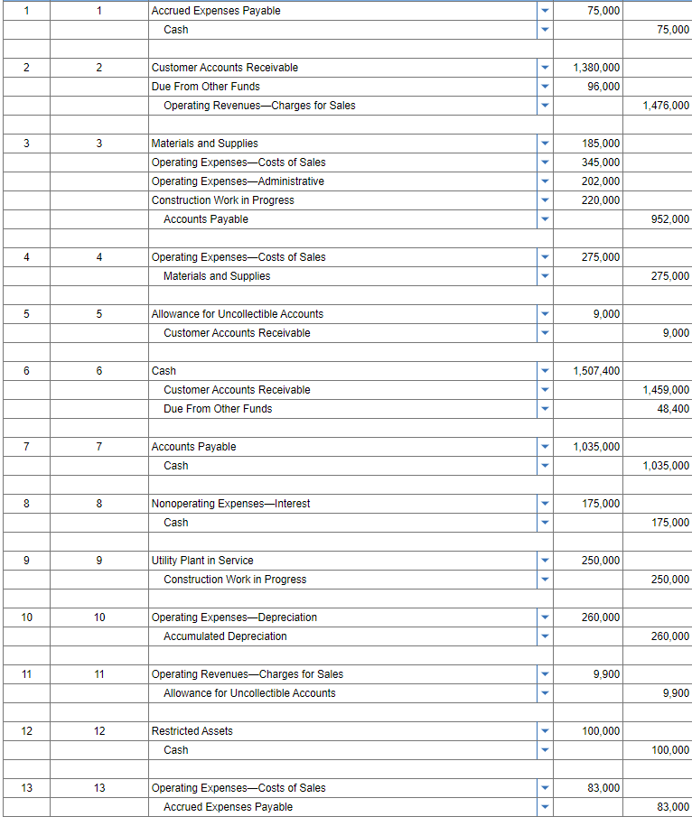
14. Nominal accounts for the year were closed.

Slide 32
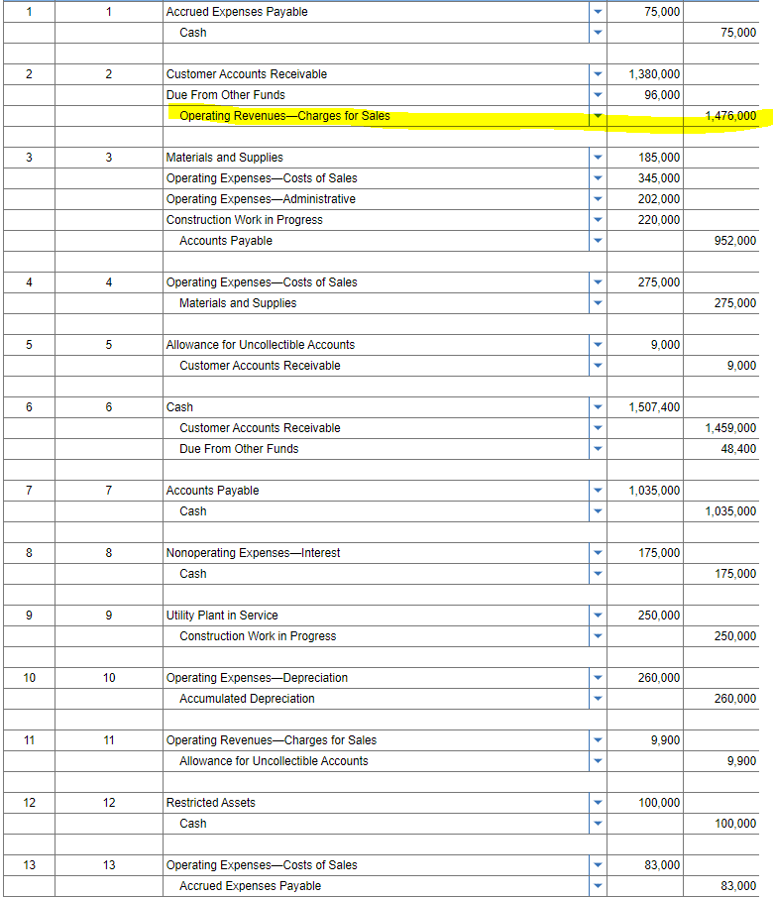
14. Nominal accounts for the year were closed.

Slide 33
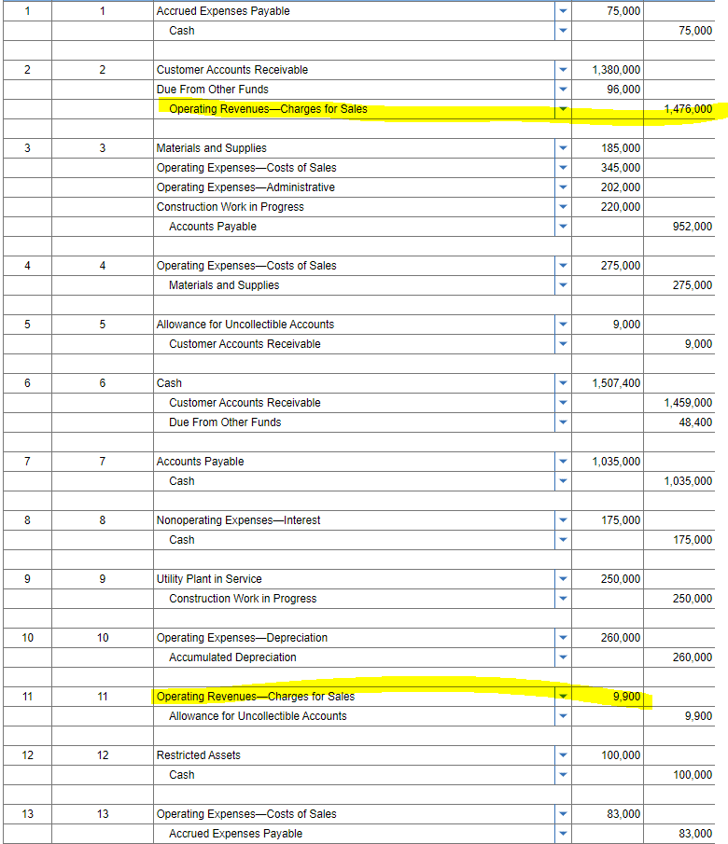
14. Nominal accounts for the year were closed.

Slide 34
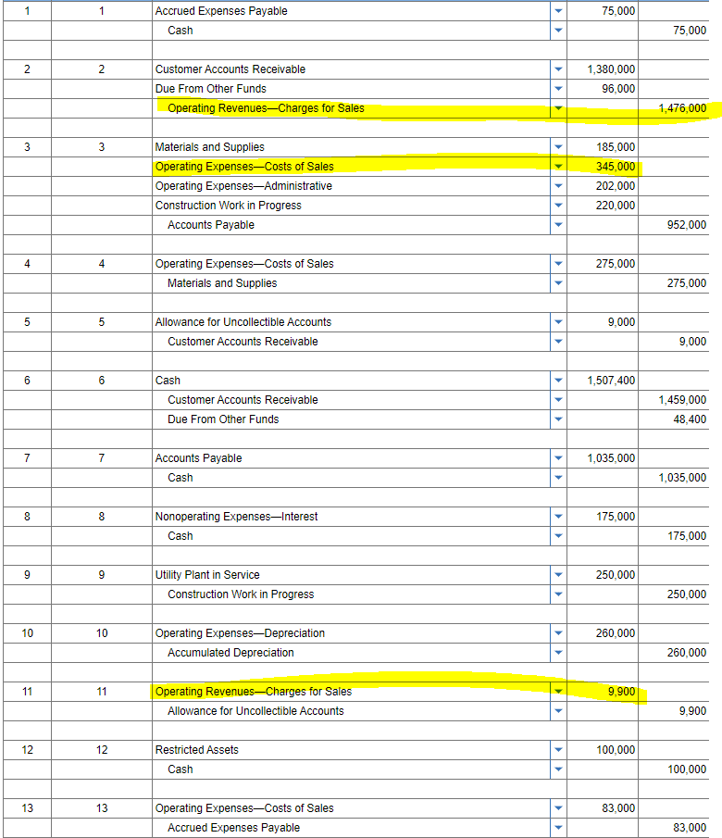
14. Nominal accounts for the year were closed.

Slide 35
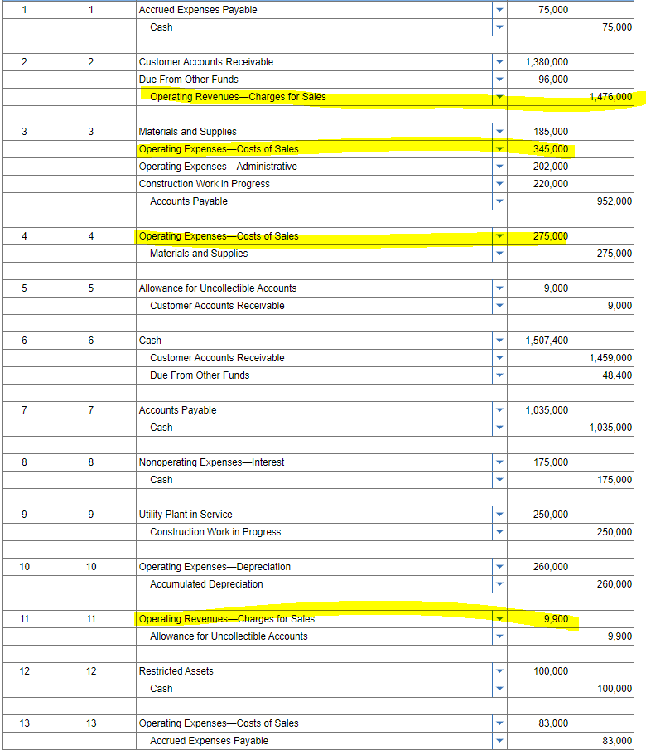
14. Nominal accounts for the year were closed.

Slide 36
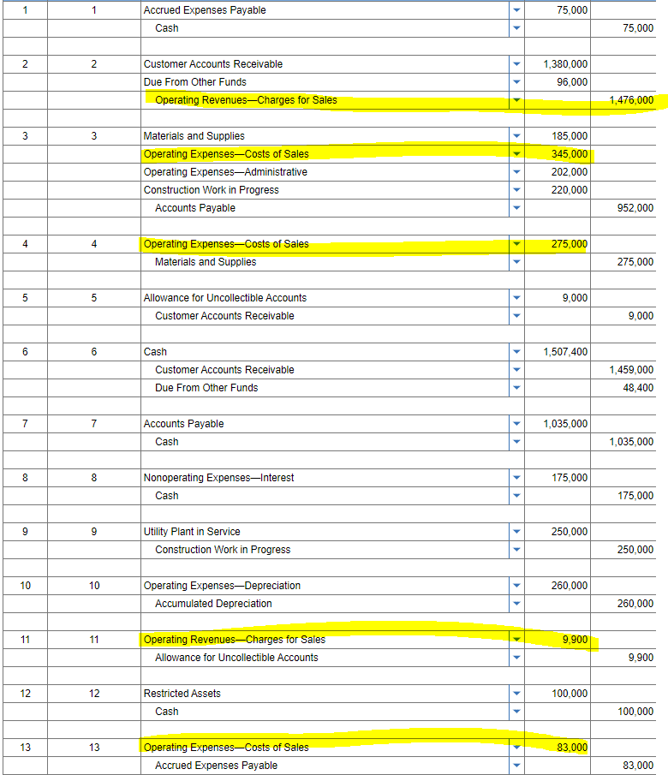
14. Nominal accounts for the year were closed.

Slide 37
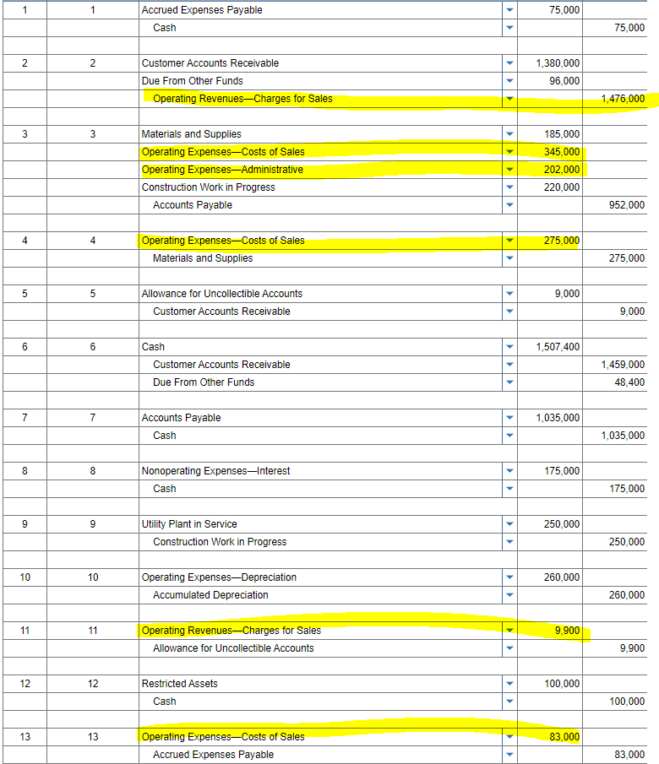
14. Nominal accounts for the year were closed.

Slide 38
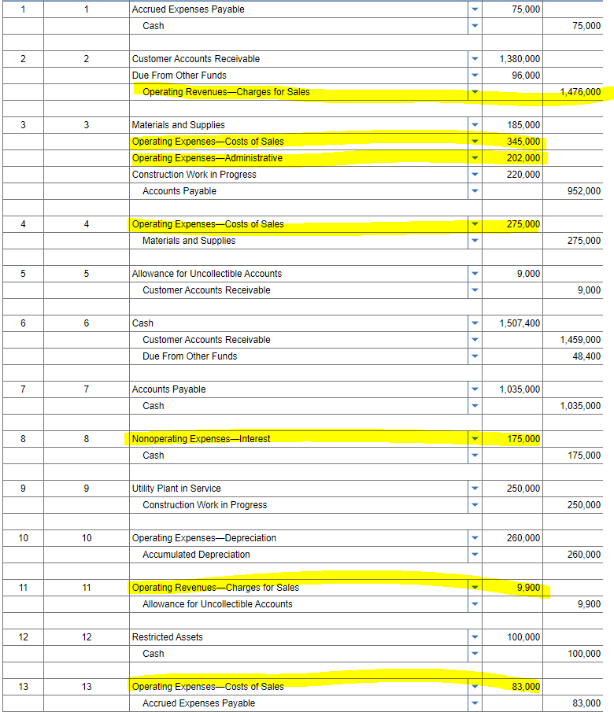
14. Nominal accounts for the year were closed.

Slide 39
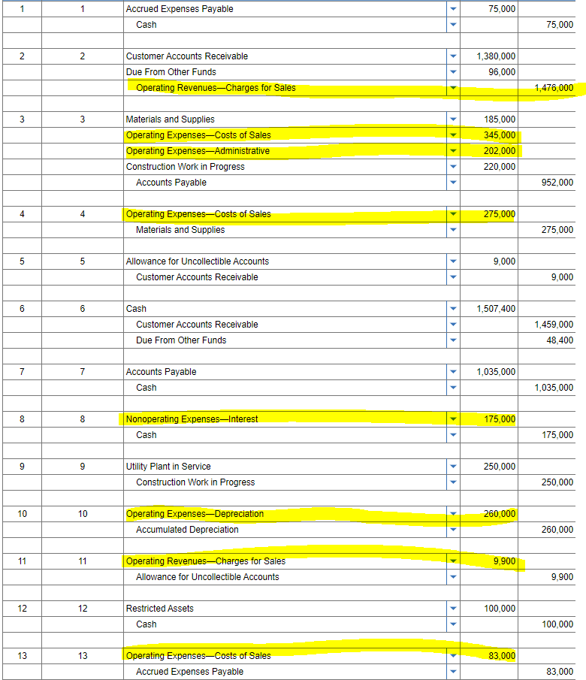
14. Nominal accounts for the year were closed.

Slide 40
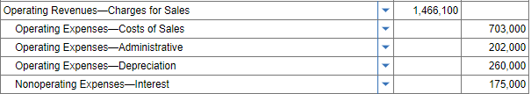
14. Nominal accounts for the year were closed.

Slide 41
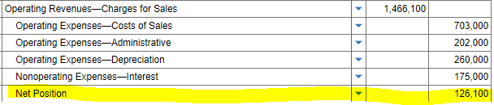
14. Nominal accounts for the year were closed.

Slide 42
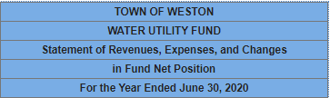
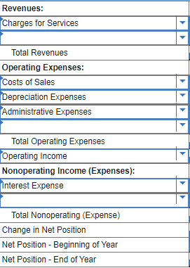
14. Nominal accounts for the year were closed.

Slide 43
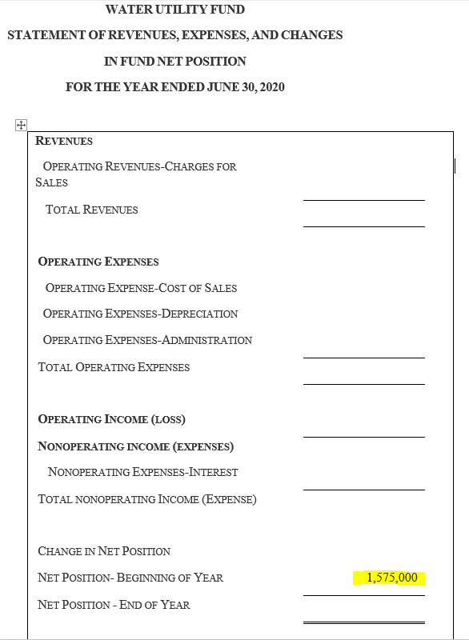
14. Nominal accounts for the year were closed.

Slide 44
14. Nominal accounts for the year were closed.

Slide 45
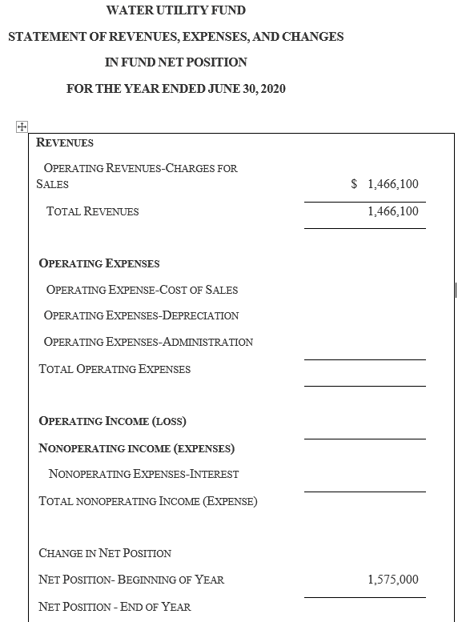
14. Nominal accounts for the year were closed.

Slide 46
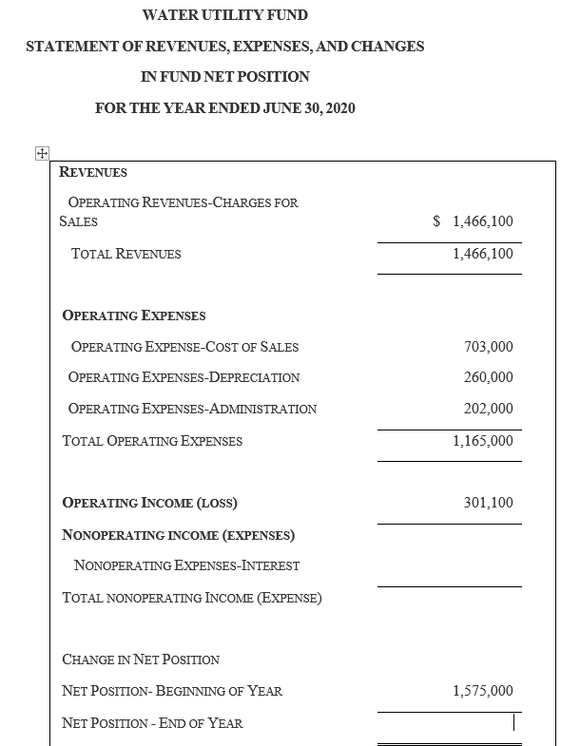
14. Nominal accounts for the year were closed.

Slide 47
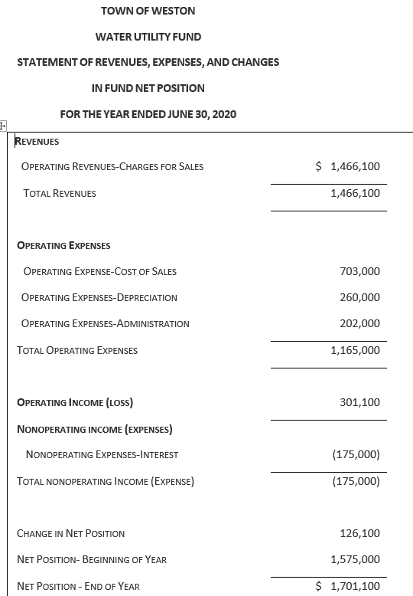
14. Nominal accounts for the year were closed.

Slide 48
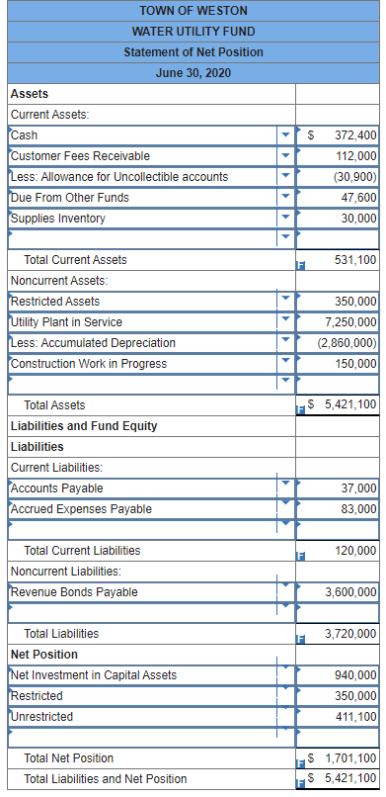
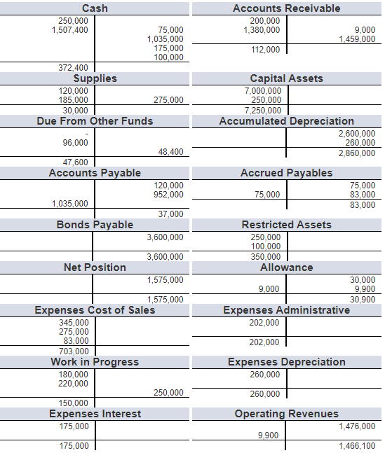

Slide 63
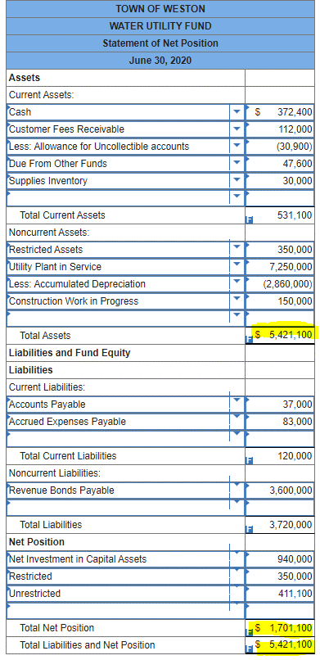
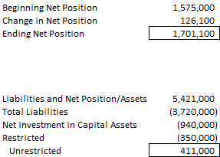


Slide 64
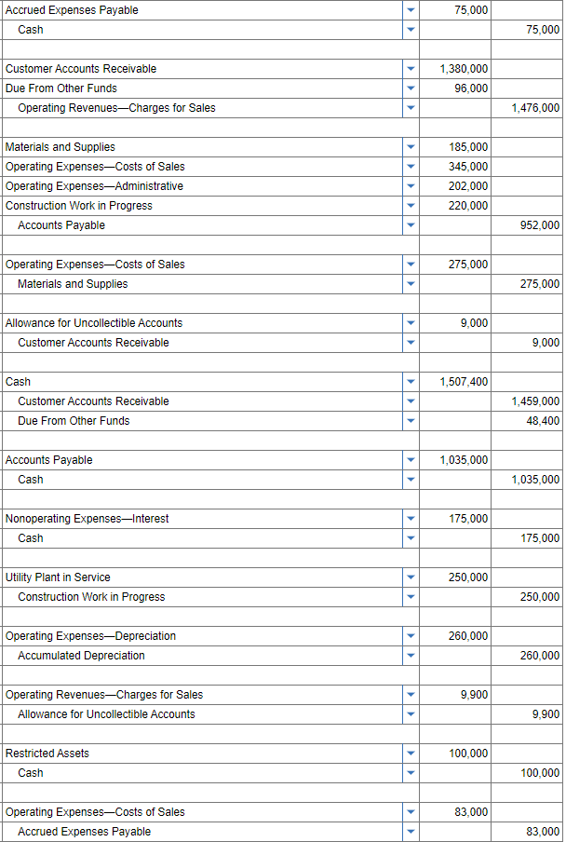
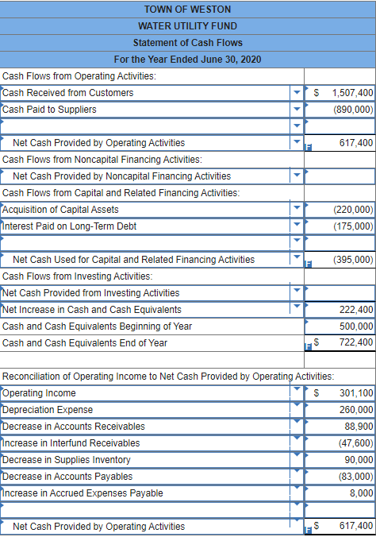

Slide 65
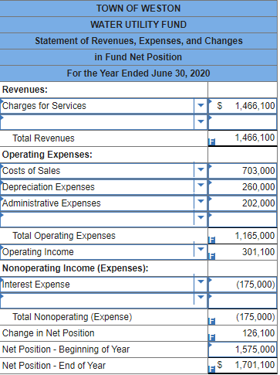

Slide 67
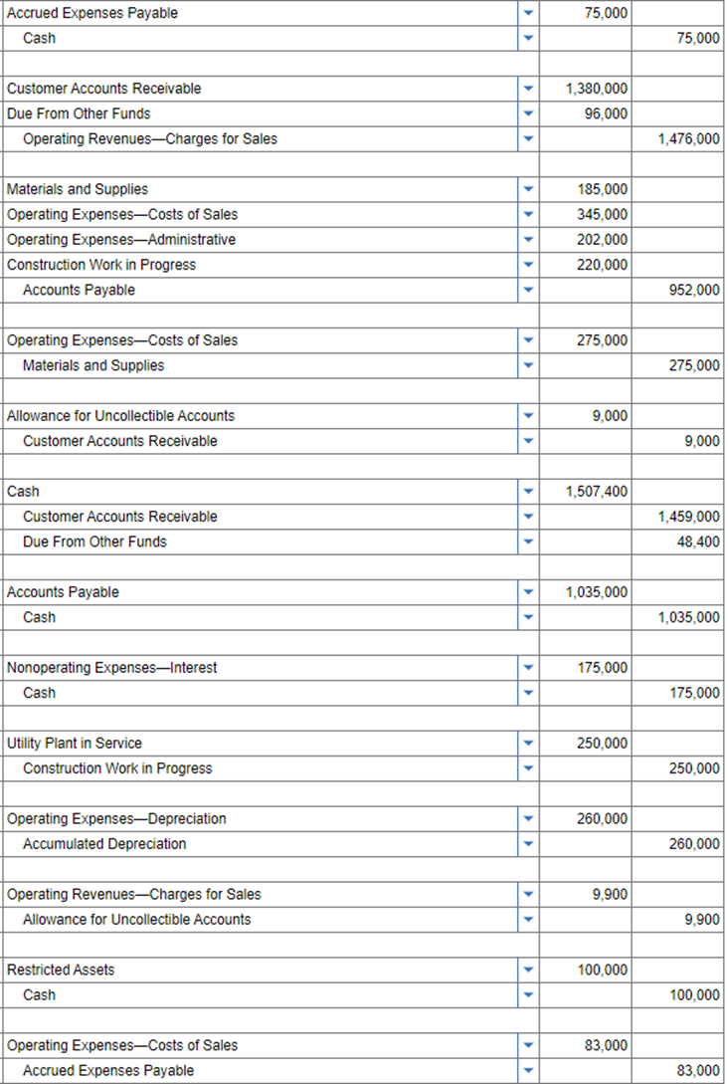

Slide 68
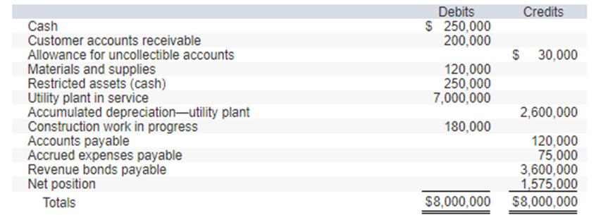

Slide 69
