Slide 1
Essentials of Accounting for Governmental and Not-for-Profit Organizations
Chapter 6
Proprietary Funds -- Internal Service and Enterprise Funds
McGraw-Hill/Irwin
Copyright © 2016 by The McGraw-Hill Companies, Inc. All rights reserved.

Slide 2
Chapter 6 - Objectives
Apply the accrual basis of accounting in the recording of typical transactions of internal service and enterprise funds
Prepare the fund-basis financial statements for proprietary funds
Identify when an activity is required to be reported as an enterprise fund
Contrast statements of cash flow prepared under GASB and FASB guidelines

Slide 3
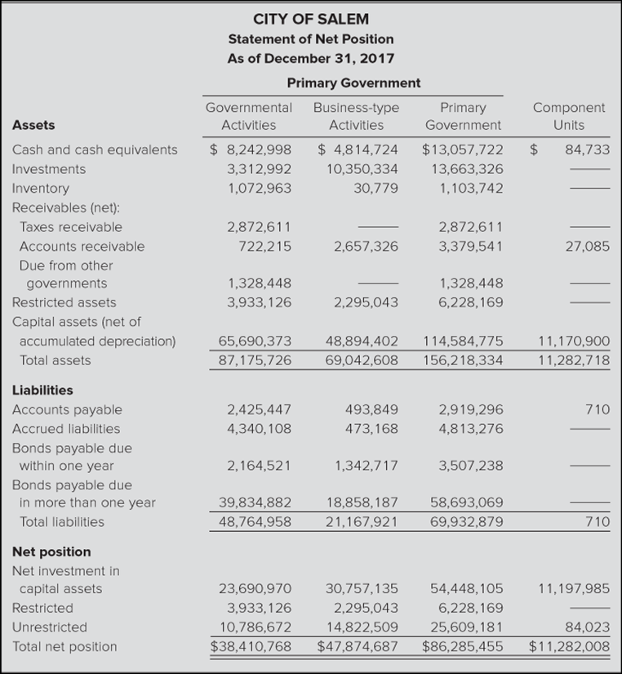
Proprietary Fund Presentation
Governmental activities include internal service funds
Business-type activities include all enterprise funds

Slide 4
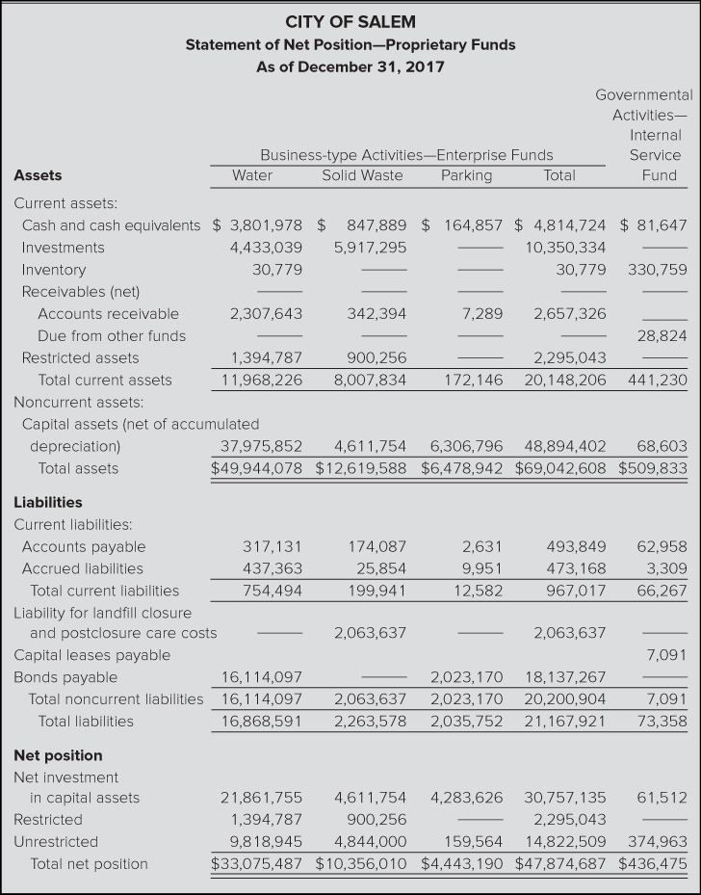
Proprietary Funds - Presentation
There will be a separate column for all major enterprise funds and a total for all non-major enterprise fund (if any).

Slide 5
Primary Govt Funds

Slide 6
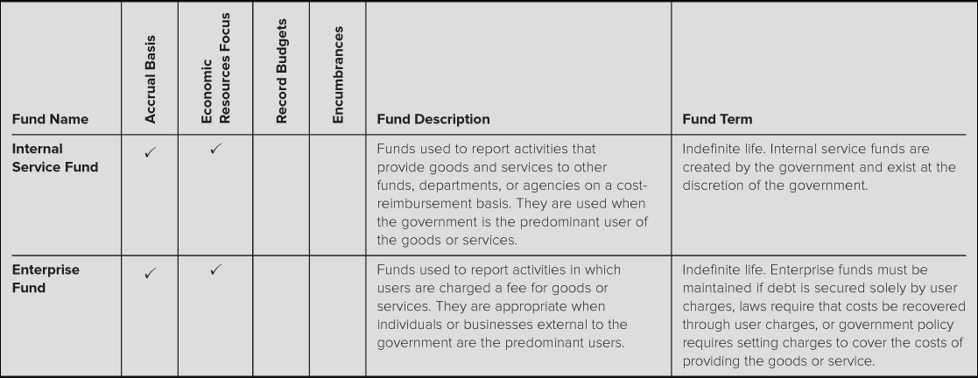
Proprietary Funds Meant to be self- supporting and cover the cost of providing services

Slide 7
Use of Enterprise Fund
Permitted if:
None of the three mandatory requirements are met, but management would like to see the activity’s “net cost” after depreciation expense
Implication—some services charging fees (recreational facilities or civic centers) can be handled in either a governmental or proprietary type funds – depending on the wishes of the government
Examples
Water utilities
Gas or electric utilities
Airports
Bus systems
Swimming pools, golf courses, libraries
Lotteries
Hospitals, parking garage, toll roads, public housing
Sports stadiums

Slide 8
Use of Internal Service Funds
Used for sales of service primarily to other departments within the government unit (typically on a cost reimbursement basis)
Established by legislative approval but not required by GASB
The purpose is to pool resources for more efficient operations
Do not use the term revenues but rather charges for services
Often it is more efficient to have a single (separate) department responsible for these types of services and charge their costs back to other departments
Examples of internal service fund uses:
Motor pool,
Telecommunications,
Maintenance,
Purchasing /supplies/central stores,
Insurance/risk management
Computer service department

Slide 9
Review of Proprietary Type Funds
Accrual basis means there is a matching of revenues and expenses, including depreciation
Emphasis is on income measurement
Typically do not record budgets or encumbrances
Uses the allowance method. Bad debt expense is not used. Amounts are directly debited to charges for sales (COGS).
Report related capital asset acquisition and debt service activities within the proprietary funds
Construction of enterprise fund capital assets are reported in the proprietary fund, not in a capital project fund
Payments for interest and principal are made from the proprietary fund, not a debt service fund
Both the capital assets and long-term liabilities are found in the government-wide financial statements

Slide 10
Proprietary Fund Closing Entries
All revenue and expense type accounts, as well as transfers, are closed to Net Position
Net Position is reported within three categories:
Net Investment in Capital Assets
Is calculated as [capital assets – accumulated depreciation] - outstanding balance of debt incurred to acquire capital assets.
Restricted
Restricted means restricted by external parties or by legislation, including legislation enacted by the government’s governing body Examples: creditors, grantors, laws, constitutional laws, legislation, or regulations of other govt
Unrestricted for the remainder

Slide 11
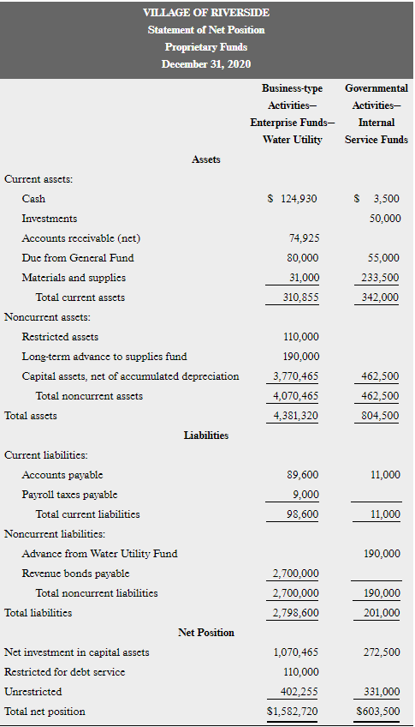
Basic financial statements – both presented

Slide 12
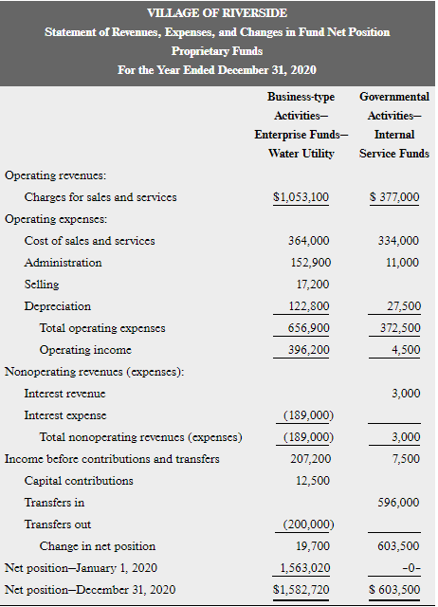

Slide 13
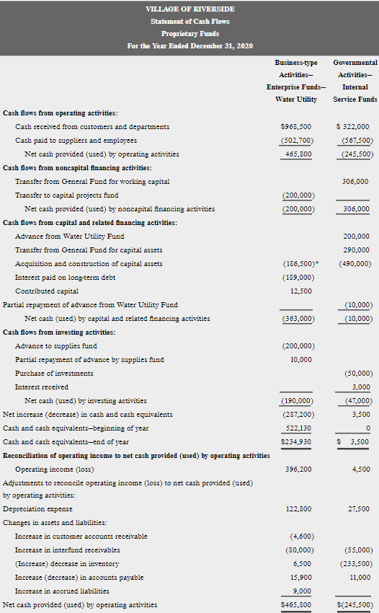

Slide 14
Bonds in Enterprise Funds
General obligation bonds:
These are backed by the full faith and credit of the government (i.e. the taxing authority of the government).
Purpose:
This may be done to get a lower interest cost due to govt’s credit rating
Reporting:
If this is just a formality, the bonds are still listed as a liability in the Enterprise Fund
Bonds are omitted from Enterprise Funds only if the government agrees and fully intends to pay the bonds from other resources
Revenue Bonds: Revenue bonds promise bondholders that enterprise revenues will be used to make payments. These are listed as Bonds Payable in the enterprise funds.

Slide 15
Self-Insurance and Risk Management
Governments have a choice of using the General Fund or an Internal Service fund (ISF) for self-insurance activities
If an internal service fund is used, the interfund premium is treated as charges for services (revenue) to the ISF and as an Expense or Expenditure to other funds (provided that the amount paid is a reasonable amount calculated in a manner that will yield an amount roughly equal to the amount of average long-term claims).
Claims paid or accrued by the ISF would be considered an operating expense of the ISF

Slide 16
Solid Waste Landfills Enterprise Fund
Accrual basis – treatment of post-closure costs
Costs of complying with environmental protection laws after closure should be estimated and accrued as a cost of operating the landfill during its life.
The purpose of this accounting treatment is to match the estimated costs with revenue during the time period when the waste is accepted.
Accrued costs include equipment needed, cost of covering landfill, and caring for the site for 30 years. All at current cost
Each year accrue:
Post-closure expenses XXX
Liability for post-closure care XXX
(units of production method used to determine $)
After closure, as maintenance costs are incurred:
Liability for post-closure care XX
Cash XX

Slide 17
Solid Waste Landfills – Governmental Activities
Alternatively, some governments may operate landfills within the Governmental Activities.
In this case, the long-term portion of any liability for closure and post-closure care costs will appear in the government-wide statement of net position and the periodic expense in the government-wide statement of activities.

Slide 18
Four Categories of Cash Flows
1. Operating
Interest and dividend revenue as well as interest expense is not in this section (in contrast to Statements of Cash Flows prepared following FASB standards).
Direct method required.
2. Capital and Related Financing
FASB’s Statement of Cash Flows show only principal payments on debt in financing, GASB’s approach includes principal and interest payments here. Purchases of long-term assets are included here not in investing as it would be for FASB Statements of Cash Flows.
3. Noncapital Related Financing
Short term loans and repayments including interest not related to capital assets
Grants received from or payable to other governments not related to capital assets
Transfers to and from other funds
4. Investing
Investments and their associated revenues. Does not include purchase and sale of other long-term assets.

Slide 19
Comparison of Cash Flow Statements
Commercial Statements
May use Direct or Indirect Methods for Cash Flows from Operating Activities
Interest and dividends received are reported in operating section
Interest payments are reported in operating section
Purchases or sales of long-term assets are reported in investing
The reconciliation of income and cash flows from operations starts with Net Income
Proprietary Fund Statements
Direct Method is required for Cash Flows from Operating Activities
Interest and dividend revenue is reported in investing section
Interest Payments can be reported in capital or noncapital related financing section
Fixed asset transactions are reported in capital and related financing
The reconciliation of income and cash flows from operations starts with operating Income. Required to present a reconciliation between these two stmts

Slide 20
Enterprise funds appear in the business activities column of the government-wide statements.
Internal service funds are most commonly included in the Governmental Activities column.
Government-wide
Statement of Net Position and Statement of Activities
Fiduciary Funds are not included in government-wide

