Slide 1
Survey of Accounting
Second Edition
Kimmel ● Weygandt
Chapter 4
Accrual Accounting Concepts
This slide deck contains animations. Please disable animations if they cause issues with your device.
Copyright ©2020 John Wiley & Sons, Inc.

Slide 2
Chapter Outline
  Learning Objectives
  LO 1 Explain the accrual basis of accounting and the reasons for adjustments.
  LO 2 Prepare adjustments for deferrals.
  LO 3 Prepare adjustments for accruals.
  LO 4 Prepare financial statements from adjusting amounts.

Slide 3
Learning Objective 1
Explain the Accrual Basis of Accounting and the Reasons for Adjustments
L O 1

Slide 4
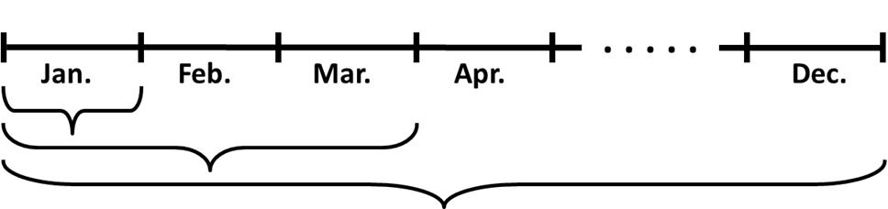
Accrual-Basis and Adjusting Entries
Accountants divide the economic life of a business into artificial time periods (Periodicity Assumption).
Generally a
  month,
  quarter, or
  year.
HELPFUL HINT
An accounting time period that is one year long is called a fiscal year.
L O 1

Slide 5
Accrual-Basis and Adjusting Entries
Calendar Year or Fiscal Year
    Most large companies are required to prepare quarterly and annual financial statements to stockholders.
    Companies often report using the calendar year (i.e., January 1 to December 31).
    Some companies choose a different 12-month period (e.g., August 1 to July 31), referred to as a fiscal year.
L O 1

Slide 6
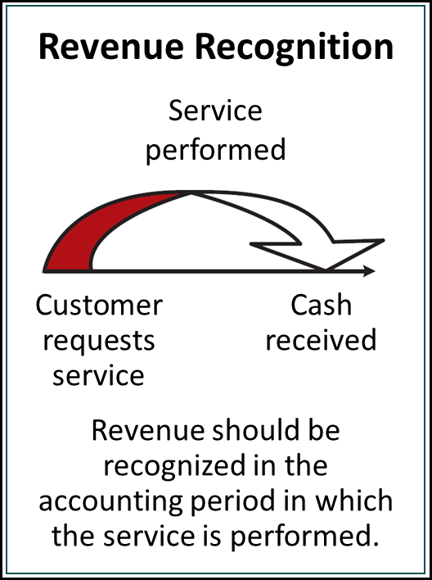
Accrual-Basis and Adjusting Entries
Revenue Recognition Principle
    Recognize revenue in the accounting period in which the services or goods have been exchanged for either cash or a promise to pay—accounts receivable. In other words, the performance obligation is satisfied. The company has a legal right to expect payment.
L O 1

Slide 7
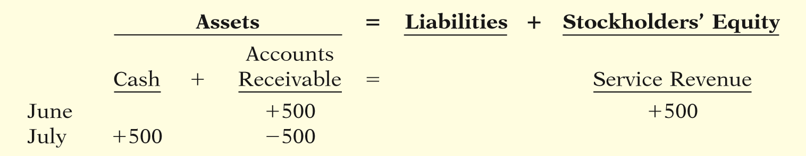
Revenue Recognition Principle
Illustration
Assume Conrad Dry Cleaners cleans clothing on June 30 for $500, but customers do not claim and pay for their clothes until the first week of July. The effect on the accounting equation for the June and July transactions would be as follows.
L O 1

Slide 8
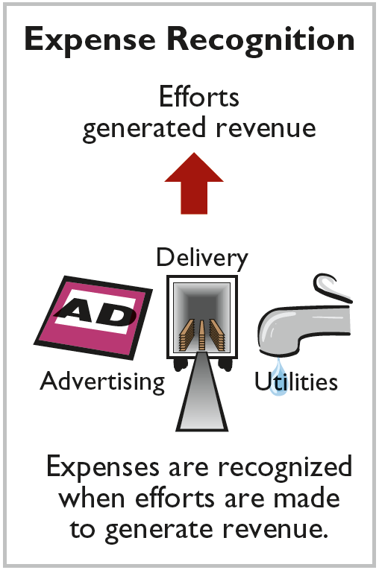
Accrual-Basis and Adjusting Entries
Expense Recognition Principle
    Companies recognize expenses in the period in which they incur these expenses to generate revenue. Expenses are paid either in cash or incur a liability (promise to pay for expenses later). These liabilities are accounts payable.
“Let the expenses follow the revenues.”
L O 1

Slide 9
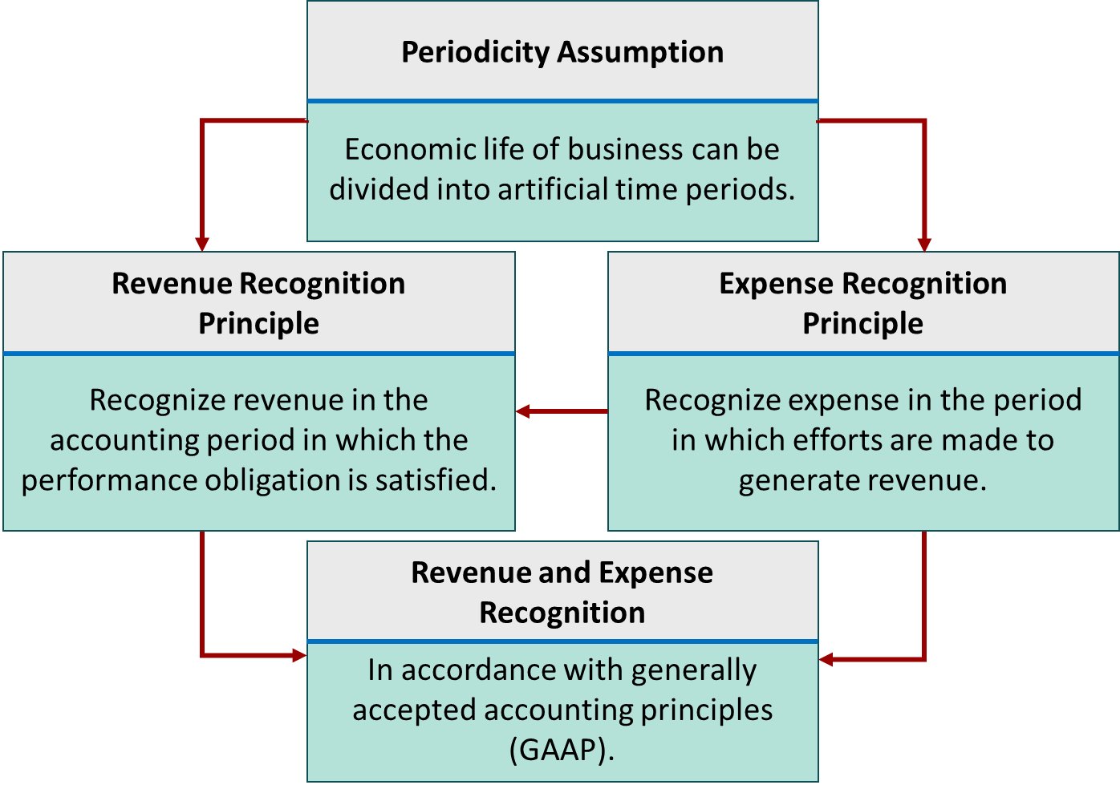
Relationship between revenue recognition principle and expense recognition principle
L O 1

Slide 10
Accrual versus Cash Basis Accounting
Cash-Basis Accounting
    Revenues recognized when cash is received.
    Expenses recognized when cash is paid.
    Cash-basis accounting is not in accordance with generally accepted accounting principles (GAAP).
L O 1

Slide 11
The Need for Adjustments
Adjustments
    Ensure that the revenue recognition and expense recognition principles are followed.
    Required every time a company prepares financial statements.
    Will include one income statement account and one balance sheet account.
L O 1

Slide 12
The Need for Adjustments
  Adjustments are made to ensure that:
  expenses are recognized in the period in which they are incurred.
  revenues are recorded in the period in which services are performed.
  balance sheet and income statement accounts have correct balances at the end of an accounting period.
L O 1

Slide 13
Categories of Adjustments
Deferrals:
Prepaid expenses (Asset): Expenses (future benefits) paid in cash before they are used or consumed. Prepaid insurance, rent, etc. Supplies
Unearned revenues (Liability): Cash received before services are performed. Company is obligated to perform the service.
Accumulated Depreciation and Depreciation Expense: Allocating the cost of assets to future periods as expenses
Accruals:
Accrued revenues (Revenue): Revenues for services performed but not yet received in cash or recorded. Ex, interest on a bank loan pursuant to a loan agreement.
Accrued expenses (Liability): Known expenses incurred but not yet paid in cash or recorded. Ex, utilities, salaries, etc.
L O 1

Slide 14
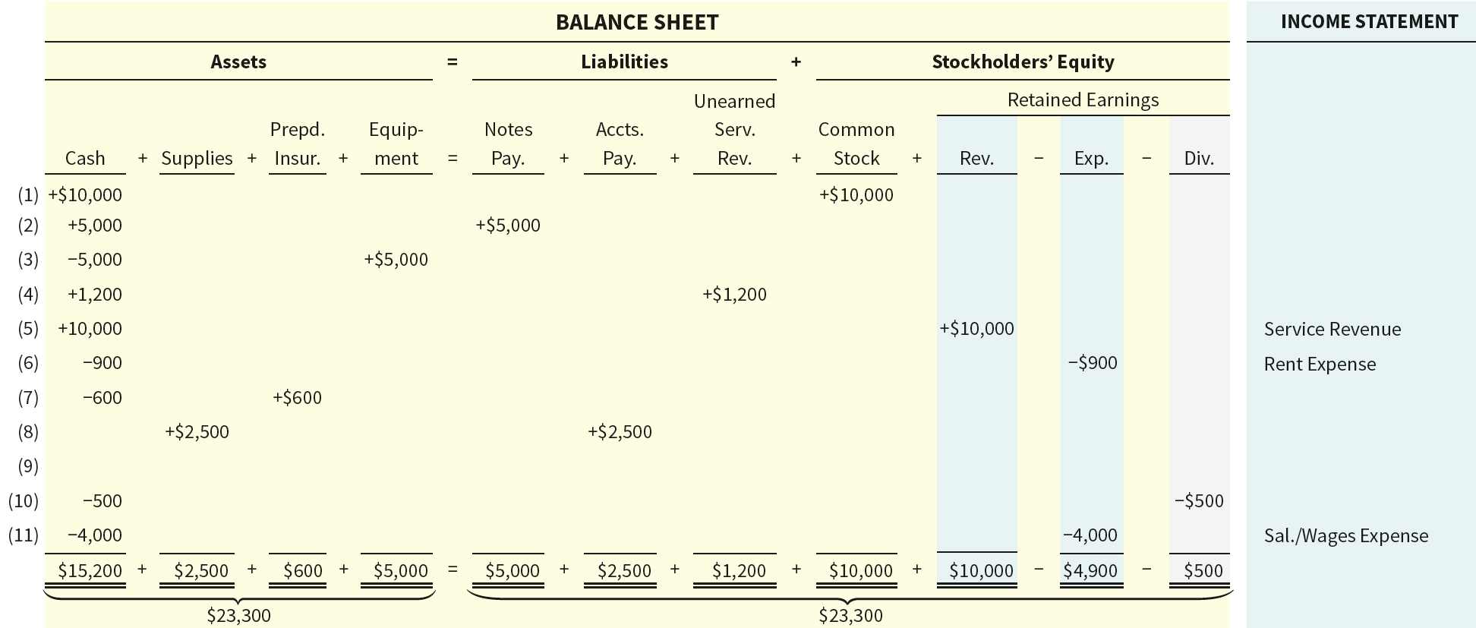
Summary of Transactions Before Adjustment
L O 1

Slide 15
Learning Objective 2
Prepare Adjustments for Deferrals
L O 2

Slide 16
Adjustments for Deferrals
    Two Types of Deferrals:
    Prepaid expenses – Cash paid for future benefits (an asset) used up over time such as prepaid insurance or rent as well as supplies
    Unearned revenues – Cash received for services not yet performed such as concert tickets.
    Prepaid expenses and unearned revenue. In an exchange between two companies, one would have an asset and the other an unearned revenue. Ex, prepaid insurance.
L O 2

Slide 17

Prepaid Expenses
Prepayments of expenses that are recorded as an asset to show the service or benefit the company will receive in the future.
Prepayments often occur for these types of transactions:
  Insurance
  Supplies
  Advertising
  Rent
L O 2

Slide 18
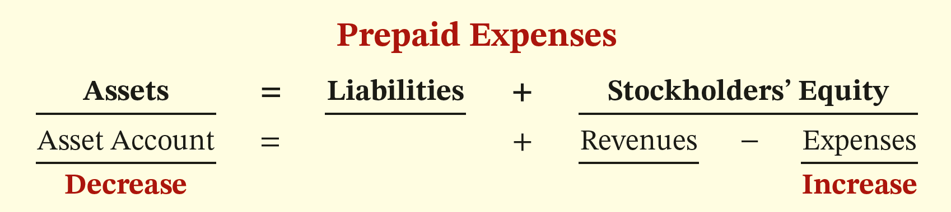
Prepaid Expense Adjusments
    Expire either with the passage of time or through use.
    Adjustment results in an increase to an expense account and a decrease to an asset account.
    Migrates from the balance sheet (prepaid asset) to income statement (expense)
    One balance sheet account; one income statement account
L O 2

Slide 19
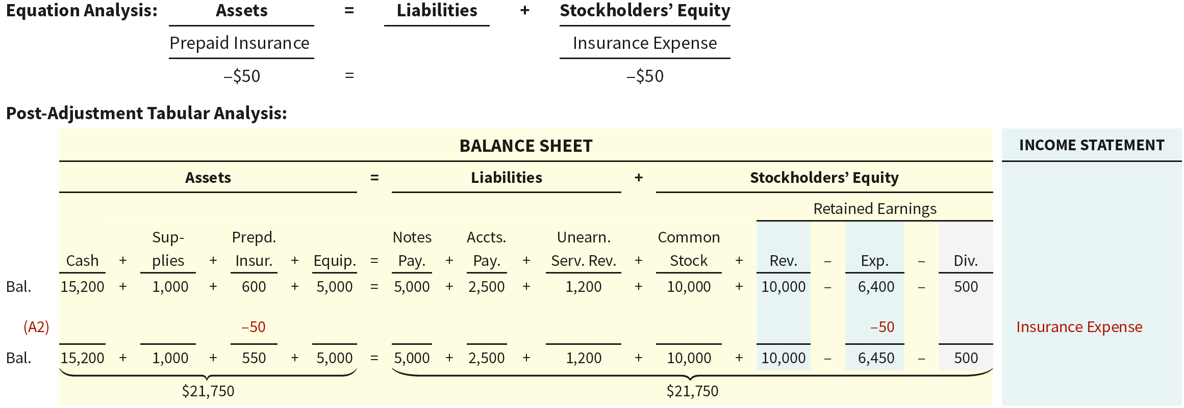
Prepaid Insurance Adjustment
Illustration: On October 4, Sierra Corporation paid $600 for a one-year fire insurance policy. Coverage began on October 1. Sierra recorded the payment by increasing Prepaid Insurance. This account shows a balance of $600 in the October 31 trial balance. Insurance of $50 ($600 ÷ 12) expires each month.
Moves from balance sheet to income statement
L O 2

Slide 20
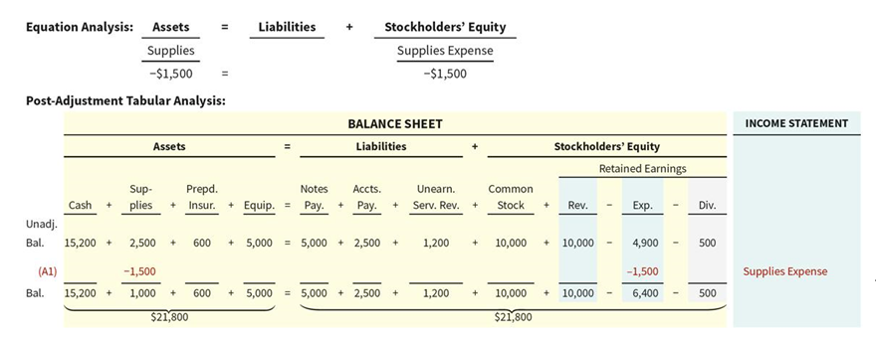
Supplies Adjustment
Illustration: Sierra Corporation purchased supplies costing $2,500 on October 5. Sierra recorded the purchase by increasing the asset Supplies. An inventory count at the close of business on October 31 reveals that $1,000 of supplies are still on hand.
Moves from balance sheet to income statement
L O 2

Slide 21
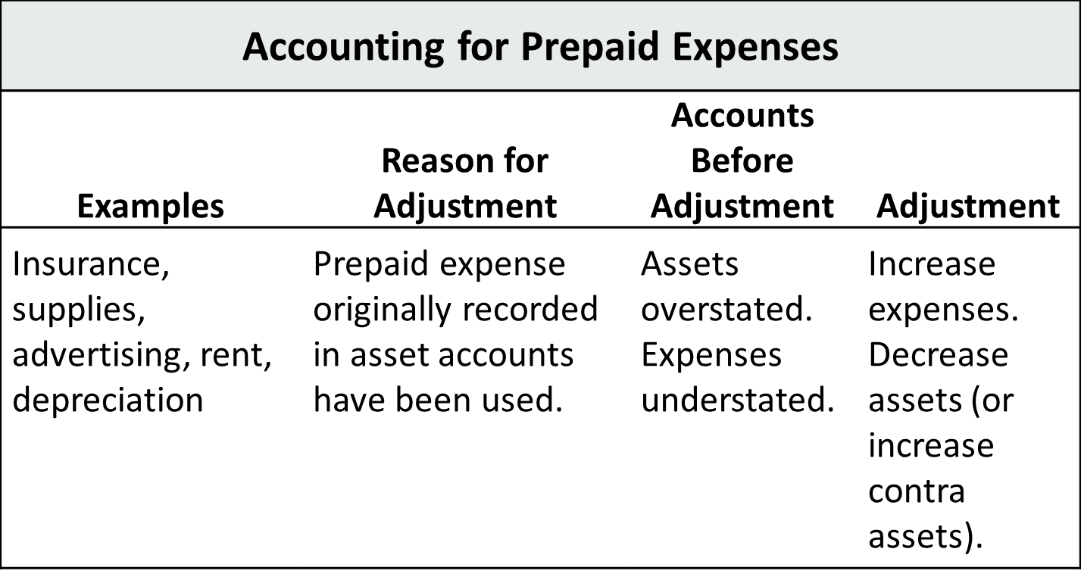
Prepaid Expenses
Summary
L O 2

Slide 22

Unearned Revenues
Receipt of cash that is recorded as a liability because the service has not been performed.
Unearned revenues often occur in regard to:
  Rent
  Airline tickets
  Magazine subscriptions
  Customer deposits
  Concert tickets/NFL games
L O 2

Slide 23

Adjustment for Unearned Revenues
    Adjustment is made to record the revenue for services performed during the period and to show the liability that remains at the end of the period
    Results in a decrease to a liability account and an increase to a revenue account
    Migrates from balance sheet to income statement
L O 2

Slide 24
Unearned Revenues Illustration
    Sierra Corporation received $1,200 on October 2 from R. Knox for guide services for multi-day trips expected to be completed by December 31. From an evaluation of the service Sierra performed for Knox during October, the company determines that it should recognize $400 of revenue in October.
L O 2

Slide 25
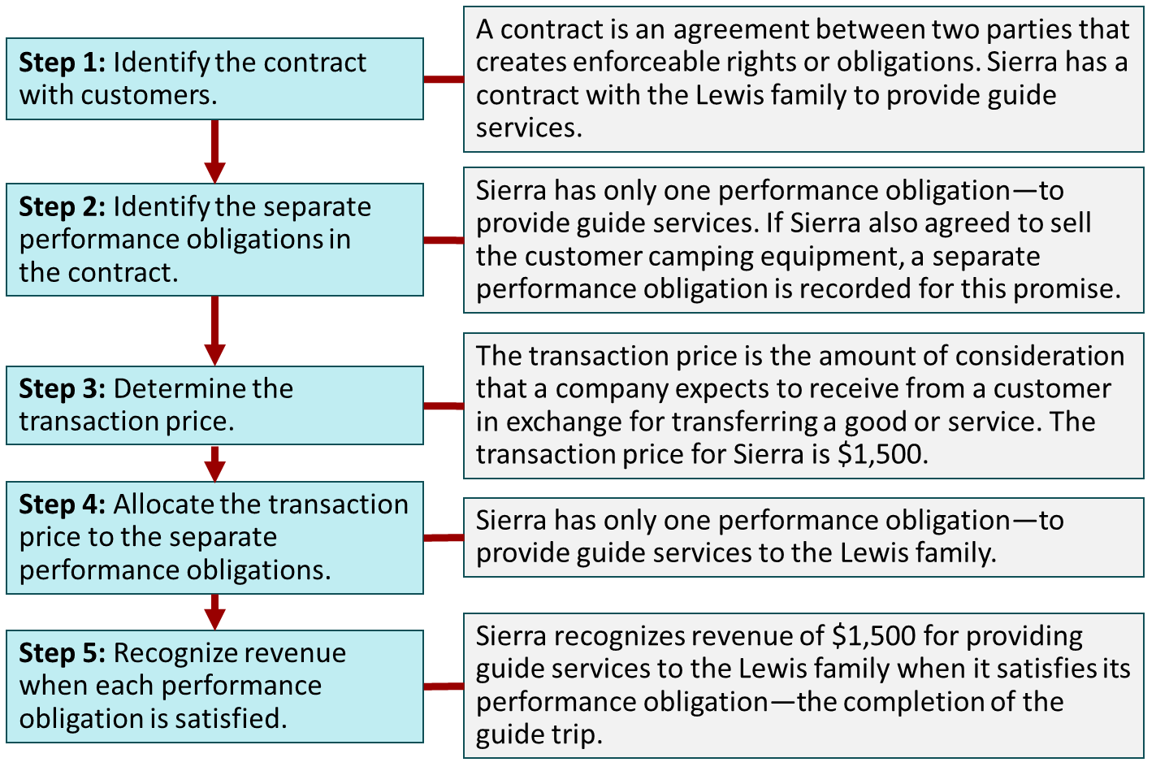
Revenue Recognition
Five-Step Process
L O 1

Slide 26
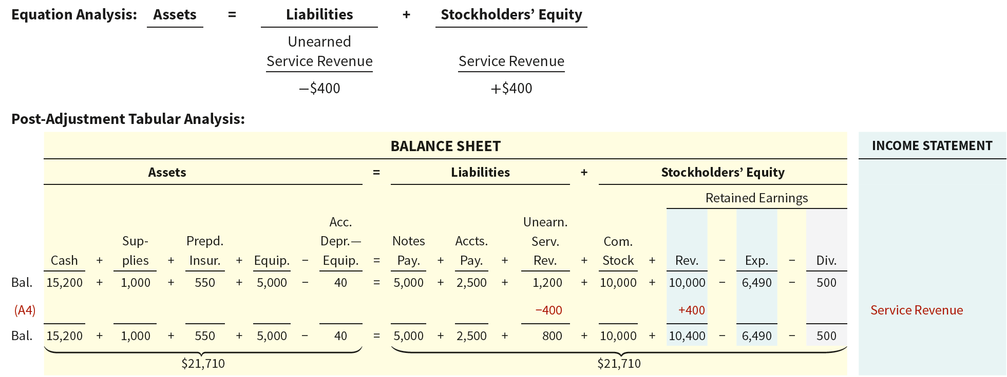
Unearned Revenues
Service Revenue Accounts After Adjustment
    Basic Analysis: The liability Unearned Service Revenue is decreased $400; the revenue Service Revenue is increased $400.
L O 2

Slide 27
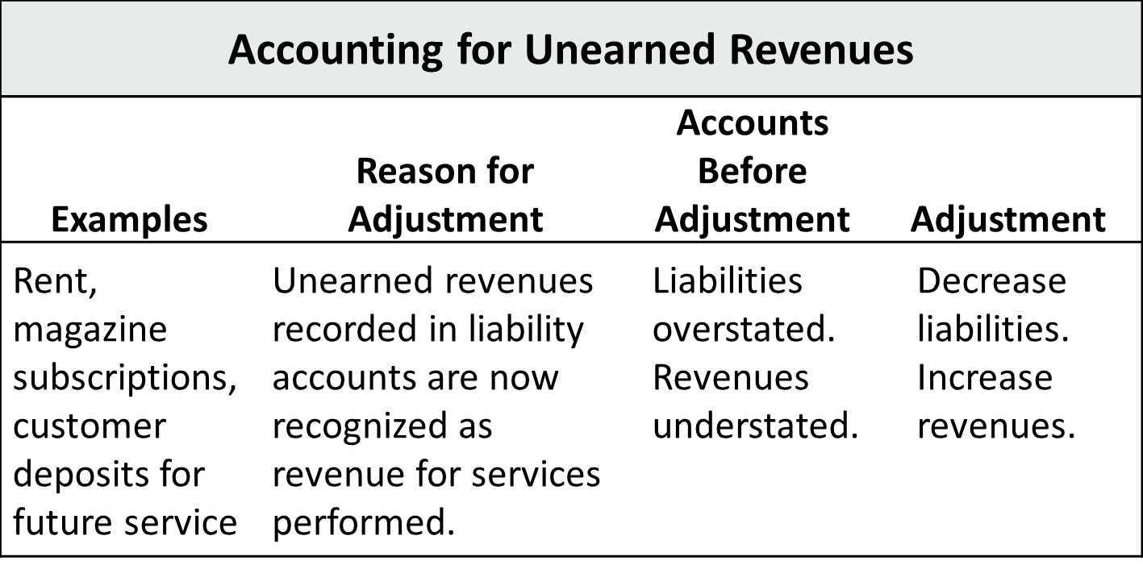
Unearned Revenues
Summary
L O 2

Slide 28
Depreciation Adjusment
    Buildings, equipment, and motor vehicles (assets that provide service for many years) are recorded as assets, rather than an expense, on the date acquired.
    Depreciation is the process of allocating the cost of an asset to expense over its useful life to the periods over which they are used in operations to generate revenue/sales.
      The period of service for which the company plans to use the asset is referred to as the useful life of the asset.
    Depreciation does not attempt to report the actual change in the value of the asset.
      Allocation concept, not a valuation concept.
      Depreciation is the systematic, rational allocation of the cost of the asset over its useful life and is intended to match the cost of the asset to the time it will be used to general revenue.
L O 2

Slide 29
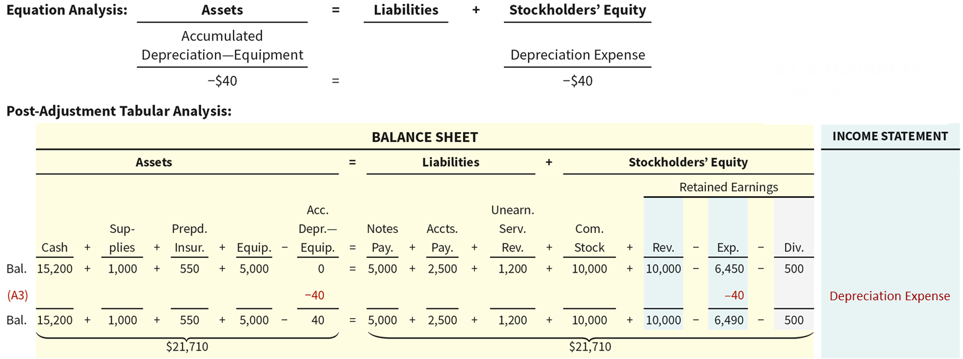
Depreciation
Adjustment for Depreciation
Illustration: For Sierra Corporation, assume that depreciation on the office equipment is $480 a year, or $40 per month.
L O 2

Slide 30
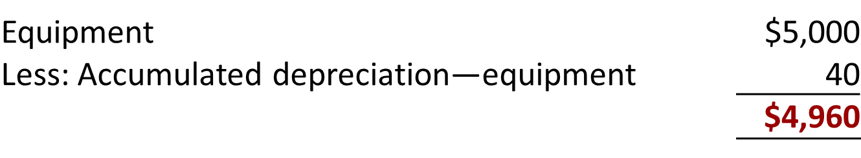
Depreciation
Statement Presentation
    Accumulated Depreciation is a contra asset account. Therefore, it is deduction related to the asset.
    Offsets related asset account on the balance sheet.
    Book value is the difference between the cost of any depreciable asset and its accumulated depreciation.
L O 2

Slide 31
Learning Objective 3
Prepare Adjustments for Accruals
L O 3

Slide 32
Adjusting Entries for Accruals
    The second category of adjustments is accruals.
    Prior to an accrual adjustment, the revenue account (and related asset account) or the expense account (and related liability account) is understated.
    Adjustment for accruals will increase both a balance sheet and an income statement account.
L O 3

Slide 33
Accrued Revenues
Revenues for services performed but not yet received in cash or recorded. Usually pursuant to a contract which binds the parties such as a legally enforceable performance agreement such as loan agreement, rent agreement, etc.
Accrued revenues could occur in regard to:
  Interest
  Rent
L O 3

Slide 34
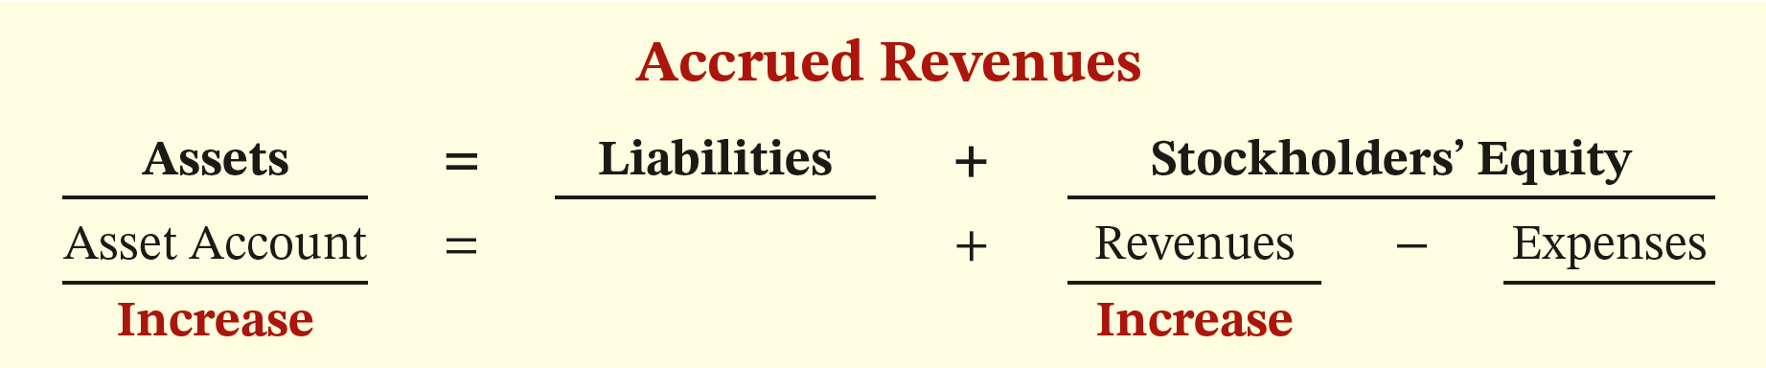
Adjustment for Accrued Revenue
    Adjustment records the receivable that exists and records the revenues for services performed
    Adjustment:
  Increases an asset account (Ex: interest receivable/rent receivable)
  Increases a revenue account (Ex: interest revenue/rent revenue)
L O 3

Slide 35
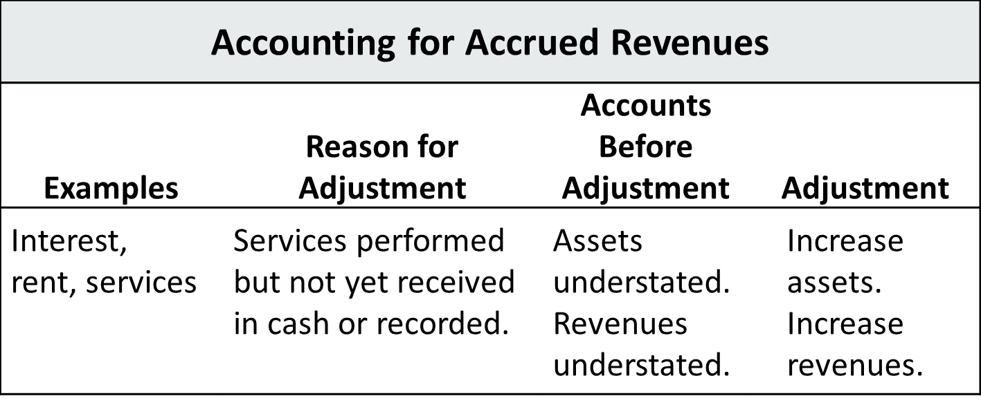
Accrued Revenues
Summary
L O 3

Slide 36
Accrued Expenses
Expenses incurred but not yet paid in cash or recorded.
Accrued expenses often occur related to:
  Rent
  Interest
  Taxes
  Salaries
  Utilities
L O 3

Slide 37
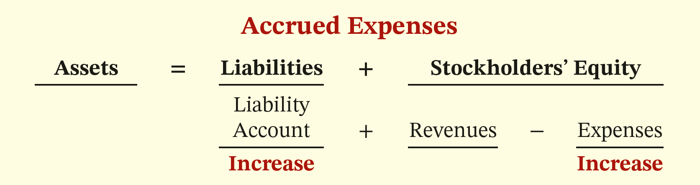
Accrued Expenses
Adjustment for Accrued Expenses
    Adjustment records the obligation and recognizes the expense.
    Adjustment:
  Increase an expense account and
  Increase a liability account.
L O 3

Slide 38
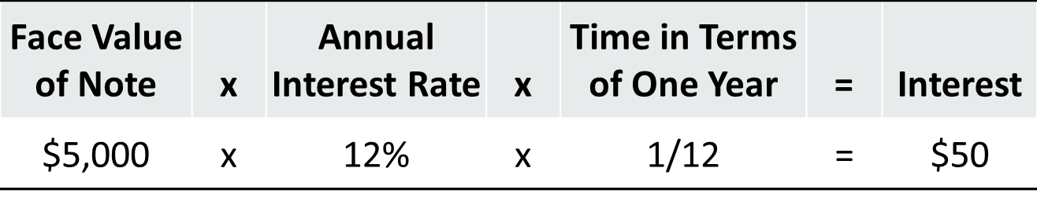
Accrued Expenses Accrued Interest
    Illustration: Sierra Corporation signed a three-month note payable in the amount of $5,000 on October 1. The note requires Sierra to pay interest at an annual rate of 12%.
If Whitney Hancock lent Sierra the money, it would record an interest receivable and interest revenue.
  L O 3

Slide 39
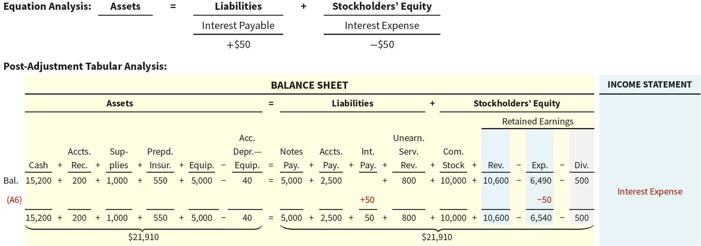
Accrued Interest Basic Analysis
The expense Interest Expense is increased $50. Since it reduces stockholders’ equity, it is entered as a negative. The liability Interest Payable is increased $50. The sum of the positive and negative values keeps the equation in balance.
  L O 3

Slide 40
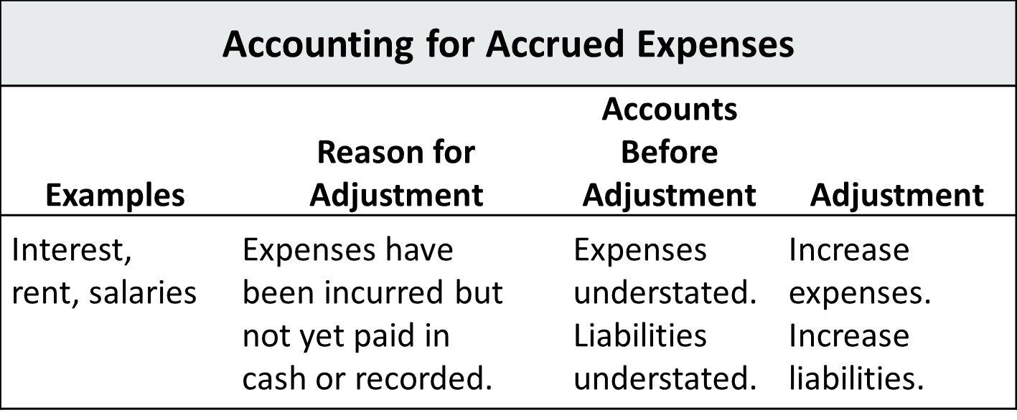
Accrued Expenses
Summary
  L O 3

Slide 41
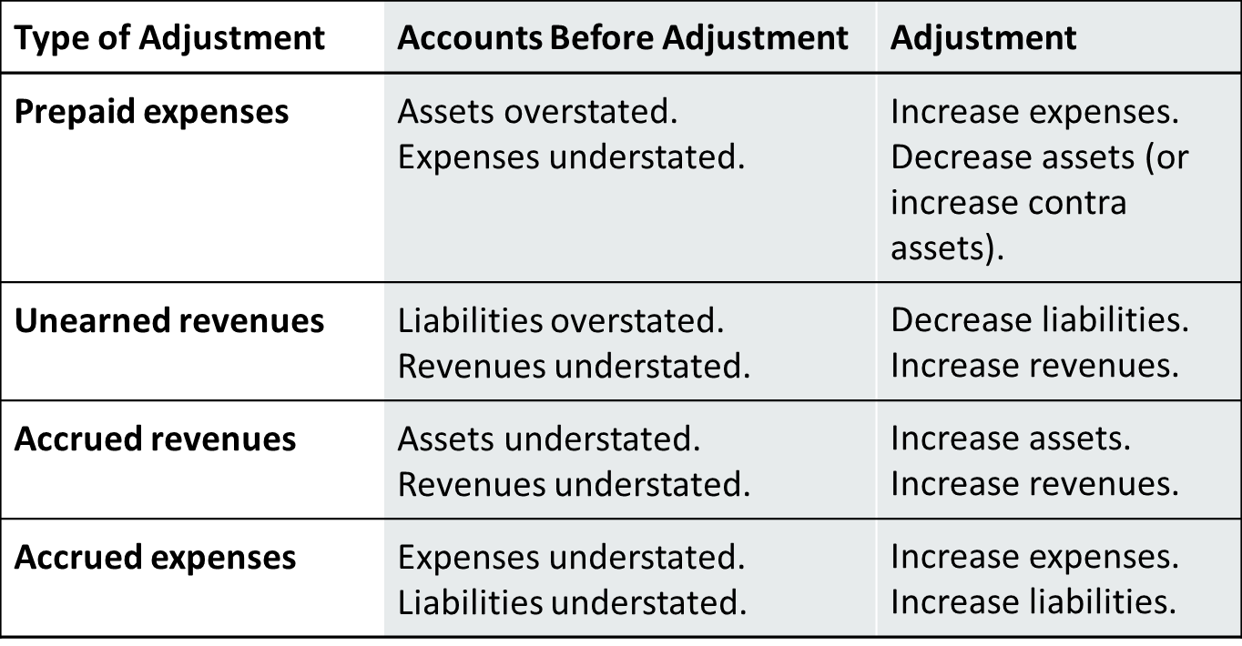
Summary of Basic Relationships
  L O 3

Slide 42
Learning Objective 4
Prepare Financial Statements from Adjusted Amounts
L O 4

Slide 43
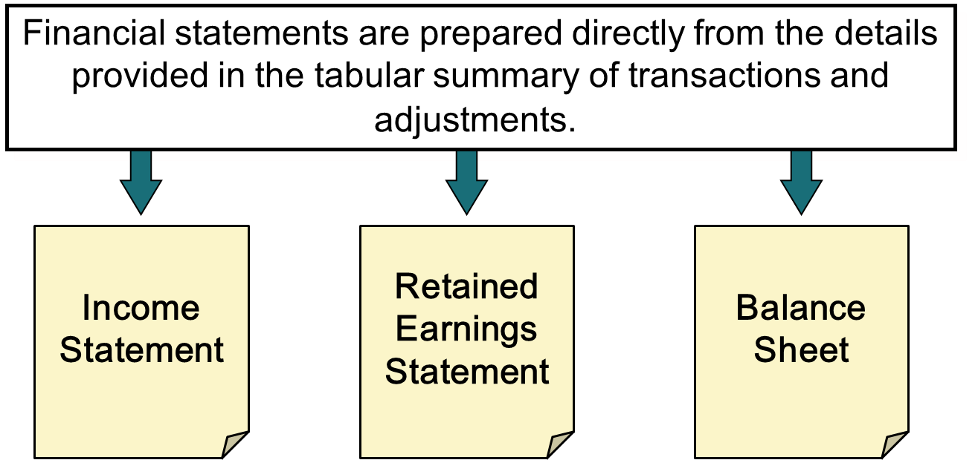
Preparing Financial Statements
  L O 4

