Slide 1
Survey of Accounting
Second Edition
Kimmel ● Weygandt
Chapter 6
Merchandising Operations and the Multiple-Step Income Statement
This slide deck contains animations. Please disable animations if they cause issues with your device.
Copyright ©2020 John Wiley & Sons, Inc.

Slide 2
Learning Objective 1
Describe Inventory Systems and Record Purchases Under a Perpetual Inventory System
L O 1

Slide 3
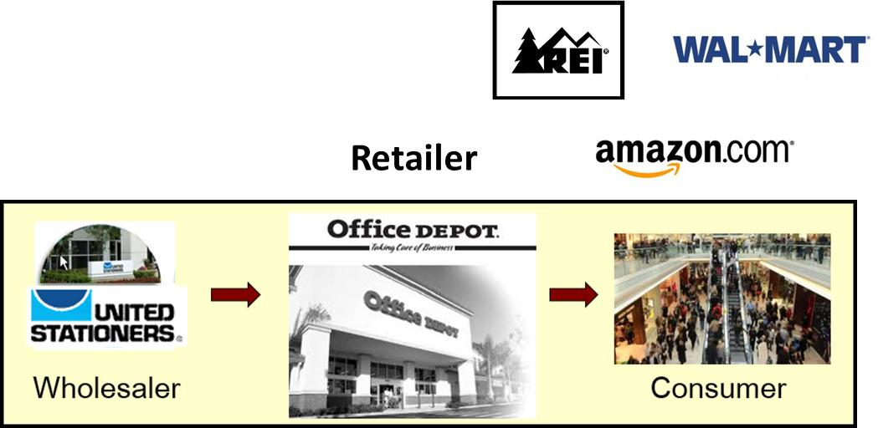
Merchandising Operations and Inventory Purchases
Merchandising Companies
Buy and Sell Goods
The primary source of revenues is referred to as sales revenue or sales. Generally, revenue relates to services.
L O 1

Slide 4
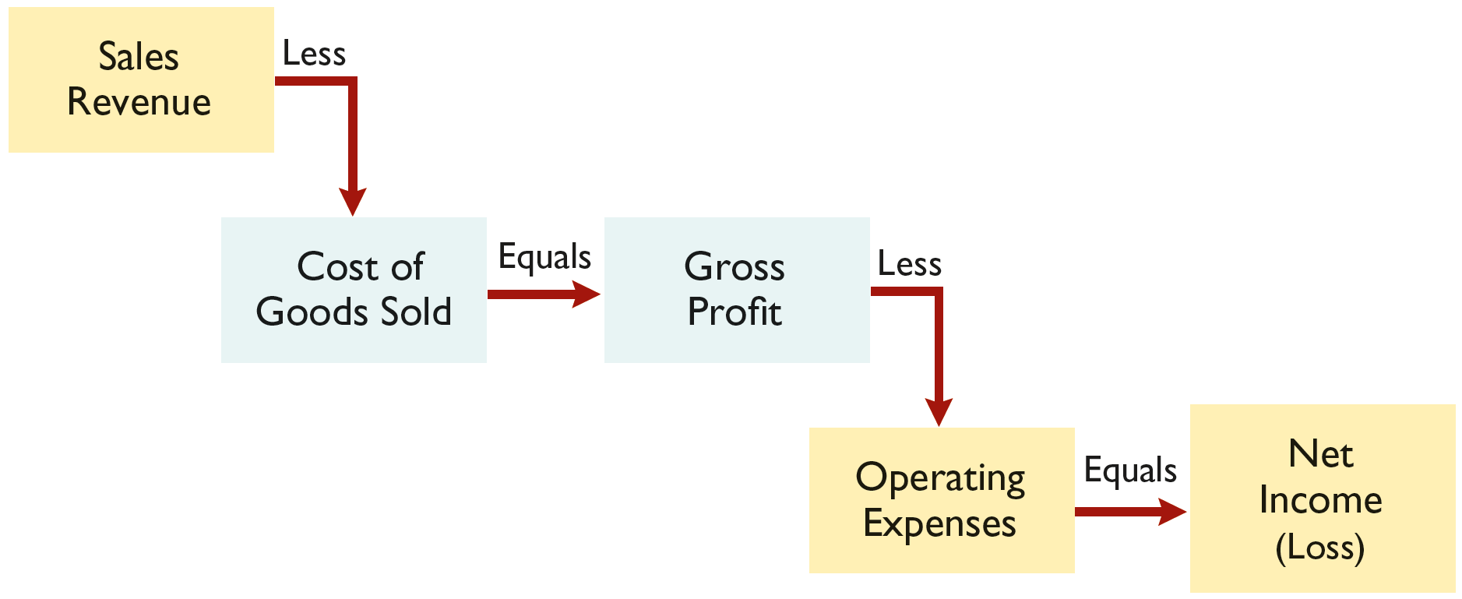
Merchandising Company
Income Measurement
Cost of goods sold is the total cost of merchandise sold during the period. It is an expense account found on the income statement.
L O 1

Slide 5
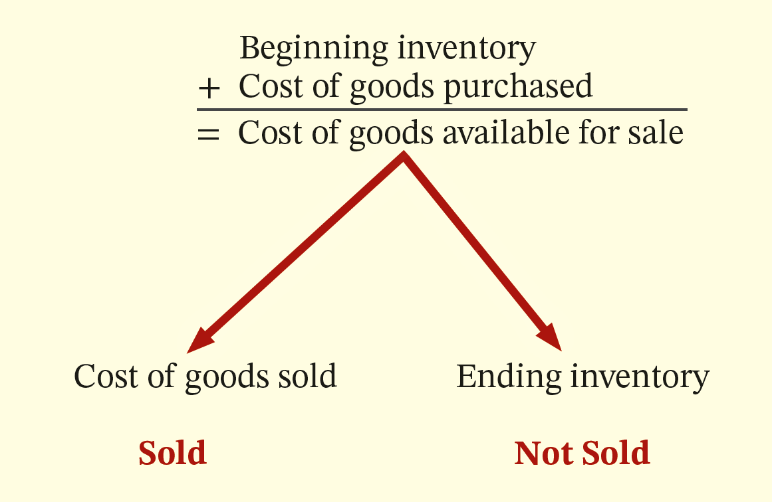
Flow of Costs
An item begins in inventory (an asset).
If sold, transforms in its nature from an asset to an expense through the sales process.
If not sold, it remains an asset on the balance sheet.
Companies use either a perpetual inventory system or a periodic inventory system to account for inventory. All companies take a physical count of their inventory at least once a year.
L O 1

Slide 6
Flow of Costs
Perpetual System
Maintain detailed records of the cost of each inventory purchase and sale.
Records continuously show inventory that should be on hand for every item.
Company determines cost of goods sold each time a sale occurs.
L O 1

Slide 7
Flow of Costs
Periodic System
Does not keep detailed records of goods on hand.
Cost of goods sold determined by count.
Calculation of Cost of Goods Sold:
Beginning inventory | $100,000
Add: Purchases, net | 800,000
Goods available for sale | 900,000
Less: Ending inventory (physical count) | 125,000
Cost of goods sold | $775,000
  L O 1

Slide 8
Recording Purchases Under a Perpetual Inventory System
Made using credit or cash (on account).
  Credit Sales
    Companies record credit purchases by an increase in Inventory and an increase in Accounts Payable
  Cash sales
    Companies record cash purchases by an increase in Inventory and a decrease in Cash
  L O 1

Slide 9
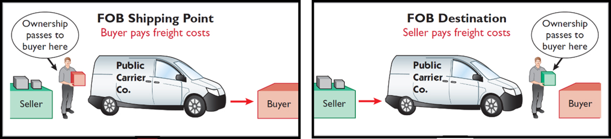
When are inventory purchases recorded?
FOB Shipping Point. Buyer owns when seller places inventory on common carrier. The buyer pays for shipping costs, and this cost is added to the cost of inventory.
The cost of inventory includes all necessary costs to bring the item to the place of business and make it salable.
FOB Destination. The buyer owns when it arrives at their place of business. While on the common carrier, the Seller owns. The seller recognize freight as an expense to record the payment to the carrier.
  L O 1

Slide 10
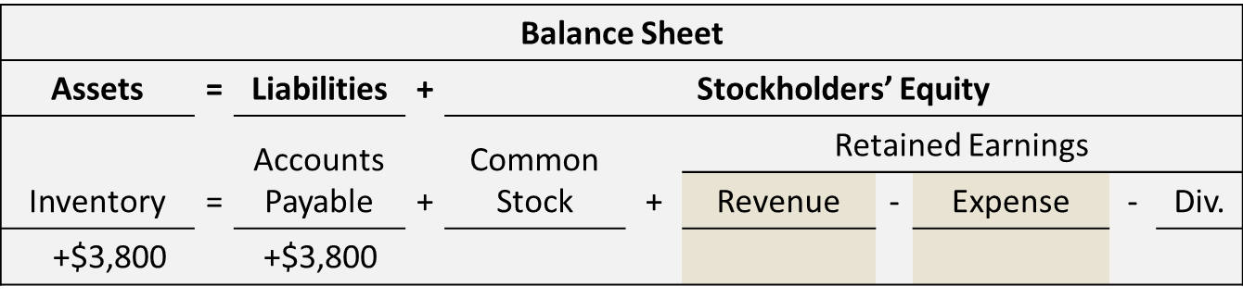
Recording Purchases Under a Perpetual System
Buyer’s Books
Illustration: Suppose Sauk Stereo purchases inventory from PW Audio Supply and received an invoice from for these goods with a purchase price of $3,800. Sauk Stereo increases Inventory and increases Accounts Payable.
L O 1

Slide 11
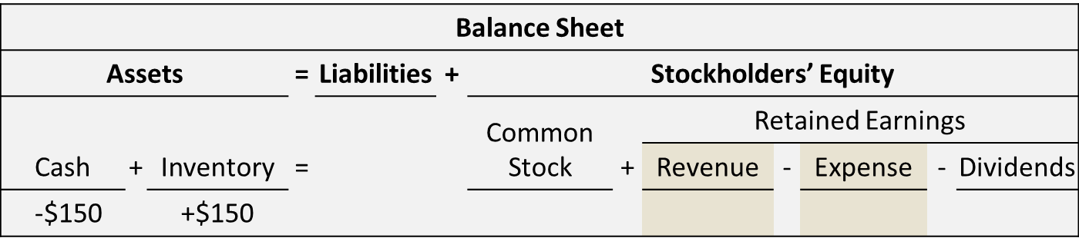
Freight Costs Incurred by the Buyer
When the buyer incurs the transportation costs, these costs are considered part of the cost of purchasing inventory.
Assume Sauk Stereo (the buyer) pays Public Carrier Co. $150 for freight charges on May 6, the event is recorded by Sauk Stereo as follows. IT IS NOT AN EXPENSE.
L O 1

Slide 12
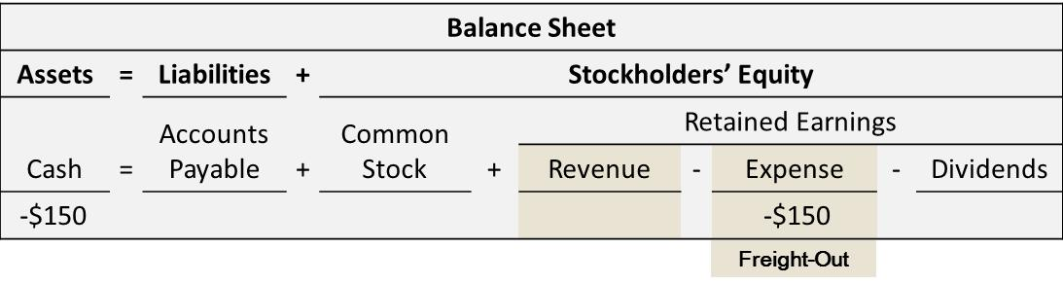
Freight Costs Incurred by the Seller
Freight costs incurred by the seller on outgoing merchandise are an operating expense to the seller (Freight-Out or Delivery Expense).
Assume the seller (PW Audio Supply) pays the $150 freight charges for Sauk Stereo’s purchase, the event is recorded by PW Audio Supply as follows.
L O 1

Slide 13
Sales Returns Versus Sales Allowances on the Seller’s and Buyer’s Books
The buyer may be dissatisfied because goods are damaged or defective, of inferior quality, or do not meet specifications.
Sales Return on a Purchase
Return goods for credit if the sale was made on credit, or for a cash refund if the purchase was for cash.
Sales Allowance on a Purchase
May choose to keep the merchandise if the seller will grant a reduction of the purchase price.
The Buyer will record these transactions as a change in the value of the inventory on hand and reduce accounts payable.
L O 1

Slide 14
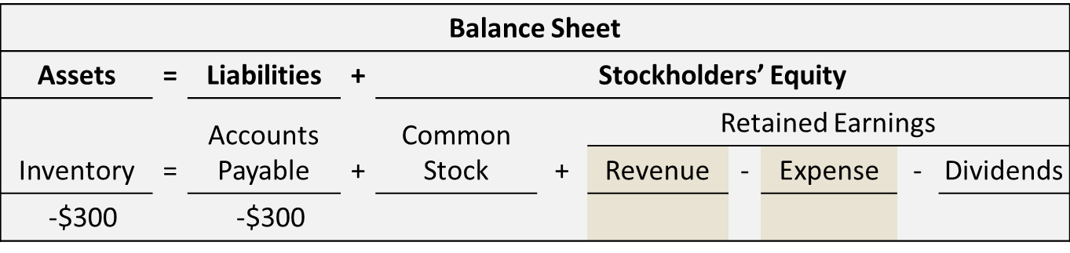
Accounting for a Sales Return on the Buyer’s Books
Illustration: Assume that Sauk Stereo returned goods costing $300 to PW Audio Supply on May 8. Sauk Stereo records the returned merchandise as follows.
If the transaction had resulted in a sales allowance, it would receive the same treatment on the buyer’s books.
L O 1

Slide 15
Negotiating Early Payment—The advantage of Sales Discounts
Credit terms may permit buyer a cash discount for prompt payment.
Advantages:
Buyer saves money.
Seller converts the accounts receivable into cash more quickly.
Example: Credit terms may read 2/10, n/30.
L O 1

Slide 16
Sales Discounts Examples
2/10, n/30
2% discount if paid within 10 days, otherwise net amount due within 30 days.
1/10 EOM
1% discount if paid within first 10 days of next month.
n/10 EOM
Net amount due within the first 10 days of the next month.
L O 1

Slide 17
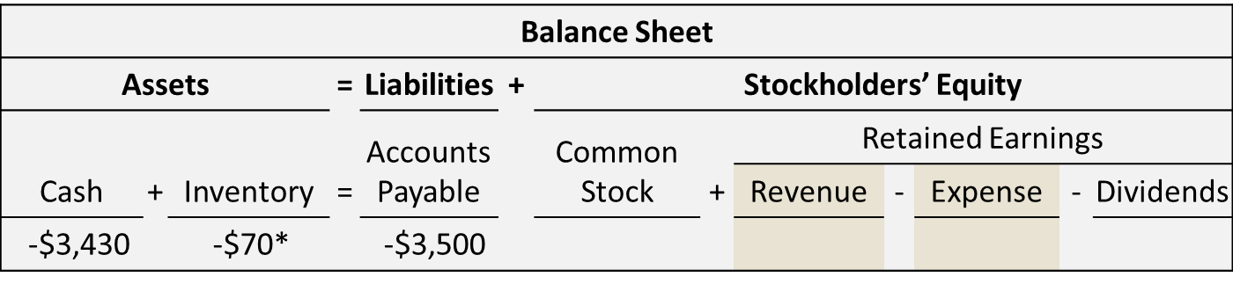
Sales Discounts on Buyer’s books
Payment on May 14
Sauk Stereo pays the balance due of $3,500 (gross invoice price of $3,800 less purchase returns and allowances of $300) on May 14, the last day of the discount period. Sauk Stereo records the payment as follows.
(3,800 minus 300 return = 3,500 × 98% = $3,430
and 3,500 x 2% = $70)
L O 1

Slide 18
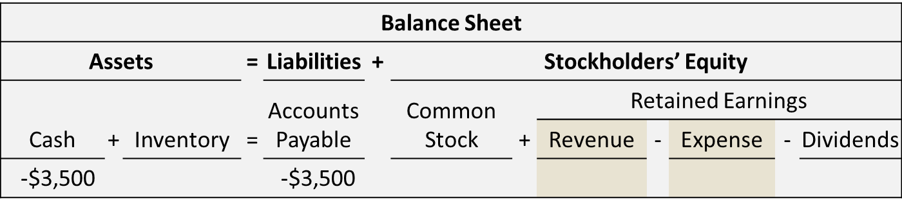
Sales Discounts
Payment on June 3
Sauk Stereo failed to take the discount and instead made full payment of $3,500 on June 3, Sauk would record the transaction as follows.
L O 1

Slide 19
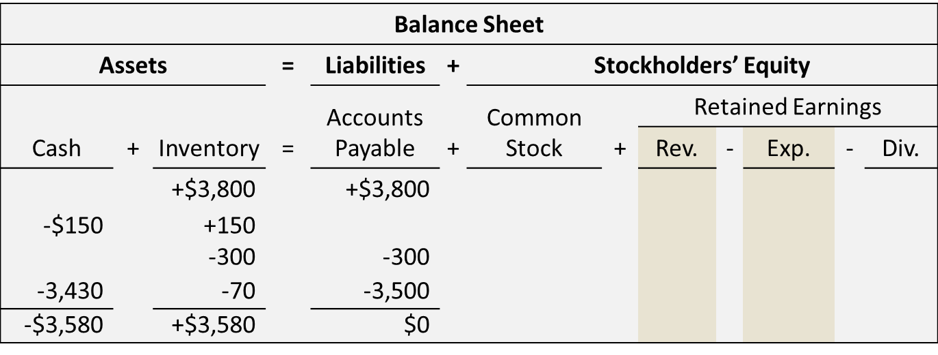
Summary of Purchasing Transactions on the Buyer’s Books
The following tabular summary provides a summary of the effect of the previous transactions on Inventory. This results in a balance in Inventory of $3,580.
L O 1

Slide 20
Learning Objective 2
Record Sales Under a Perpetual Inventory System
L O 2

Slide 21
Recording Sales Under a Perpetual Inventory System
  Sales may be made on credit or for cash.
  Sales revenue, like service revenue, is recorded when the performance obligation is satisfied.
  Performance obligation is satisfied when goods are transferred from seller to buyer.
  Sales invoice should support each sale.
  Invoice shows the date of sale, customer name, total sales price, and other relevant information.
L O 2

Slide 22
Recording Sales
  For each sale, the seller:
  Increases Accounts Receivable or Cash, as well as Sales Revenue.
  Increases Cost of Goods Sold and decreases Inventory.
  Inventory account will show at all times the amount of inventory that should be on hand.
  3. Requires two entries—one to record the sale and how it was paid and the other to record the cost of inventory purchased. The inventory purchased transforms from an asset on the balance sheet to an expense (Cost of Goods Sold) on the income statement.
L O 2

Slide 23
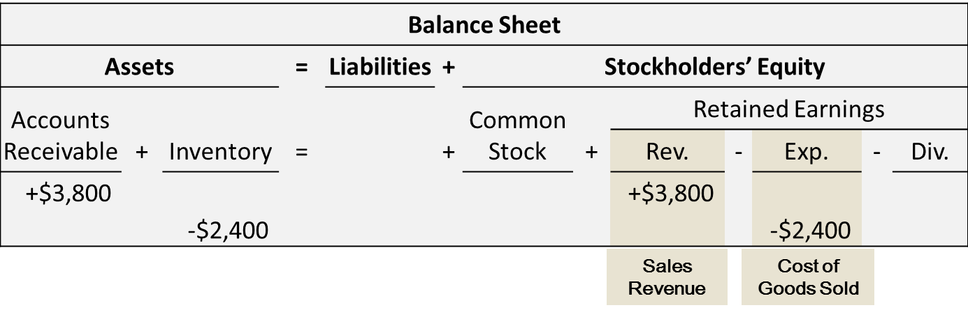
Recording Sales
Cos of Goods Sold
PW Audio Supply sold inventory to Sauk Stereo for $3,800. These goods had a cost to PW Audio Supply of $2,400. PW Audio Supply records the sale to Sauk Stereo as follows.
  L O 2

Slide 24
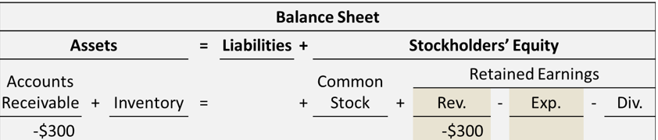
Sales Returns and Allowances
Allowance Given
Illustration: If PW Audio Supply received an allowance on defective goods, it would be recorded as follows.
Sales returns and allowances which is a contra sales account.
  L O 2

Slide 25
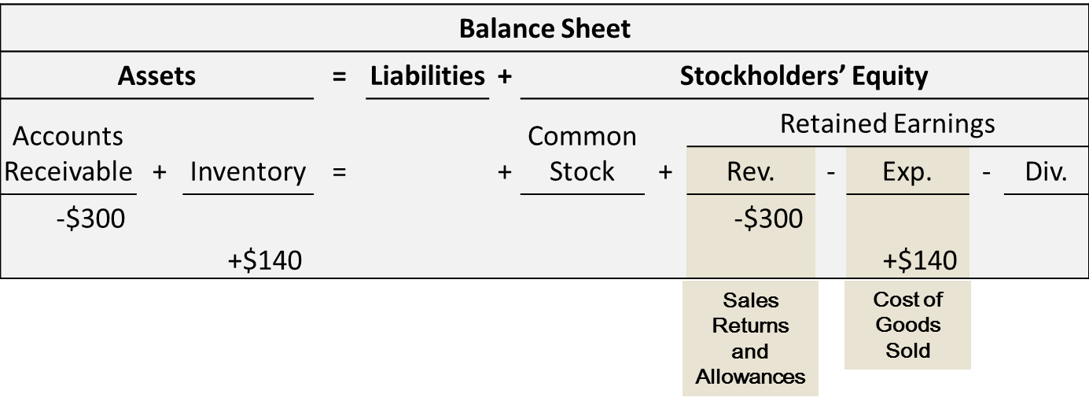
Sales Returns and Allowances
Cost of Goods Returned
Illustration: If PW Audio Supply received returned goods that had a selling price of $300 and a cost of $140, it would be recorded as follows.
Sales returns and allowances which is a contra sales account.
  L O 2

Slide 26
Data Analytics and Credit Sales
  Effectively analyzing data regarding current as well as potential customers can help a company expand its sales base while minimizing the risk of unpaid receivables.
  Companies such as Best Buy, REI, and Costco have all refined their customer return policies as a result of data analytics applied to their data.
  Companies statistically analyze past discount practices to determine how large the discount should be, how long the payment period should be, and other factors.
L O 2

Slide 27
Learning Objective 3
Prepare a Multiple-Step Income Statement
L O 3

Slide 28
Multiple-Step Income Statement
  Highlights the components of net income
  Three important line items:
  Gross profit.
  Income from operations.
  Net income.
L O 3

Slide 29
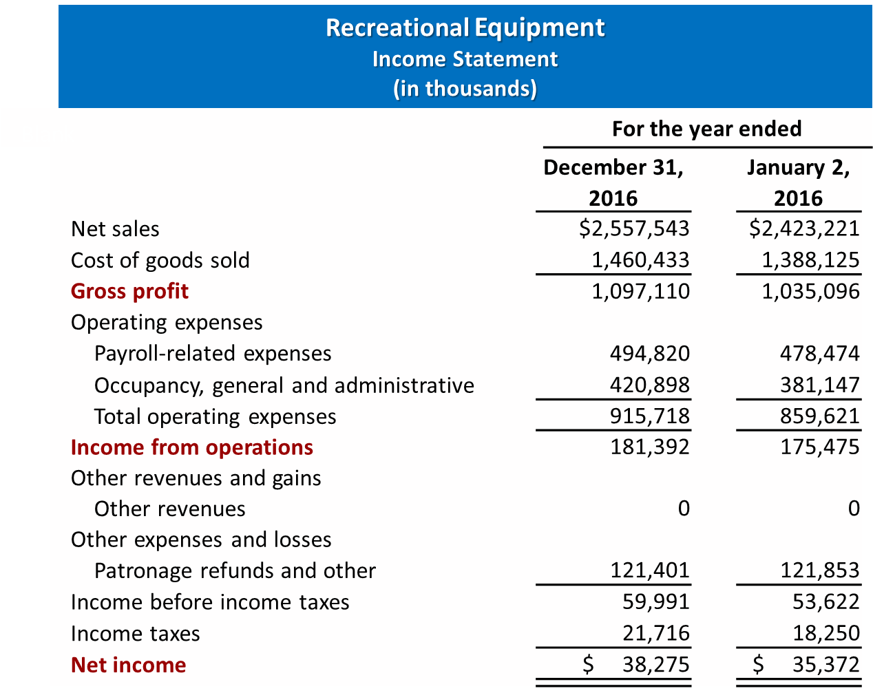
Multiple-Step Income Statement
Example
  L O 3

Slide 30
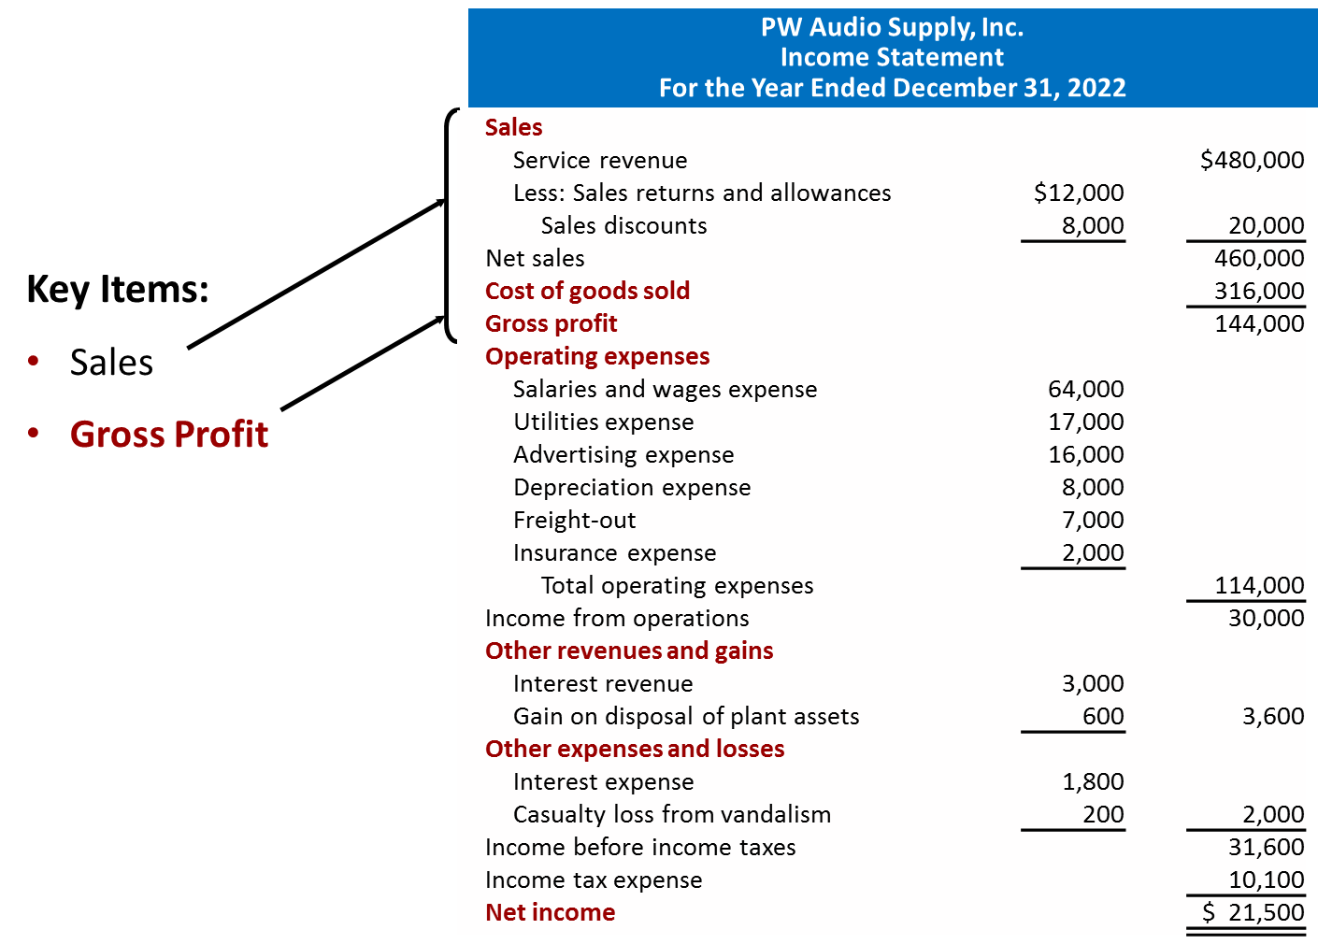
Multiple-Step Income Statement
Gross Profit
  L O 3

Slide 31
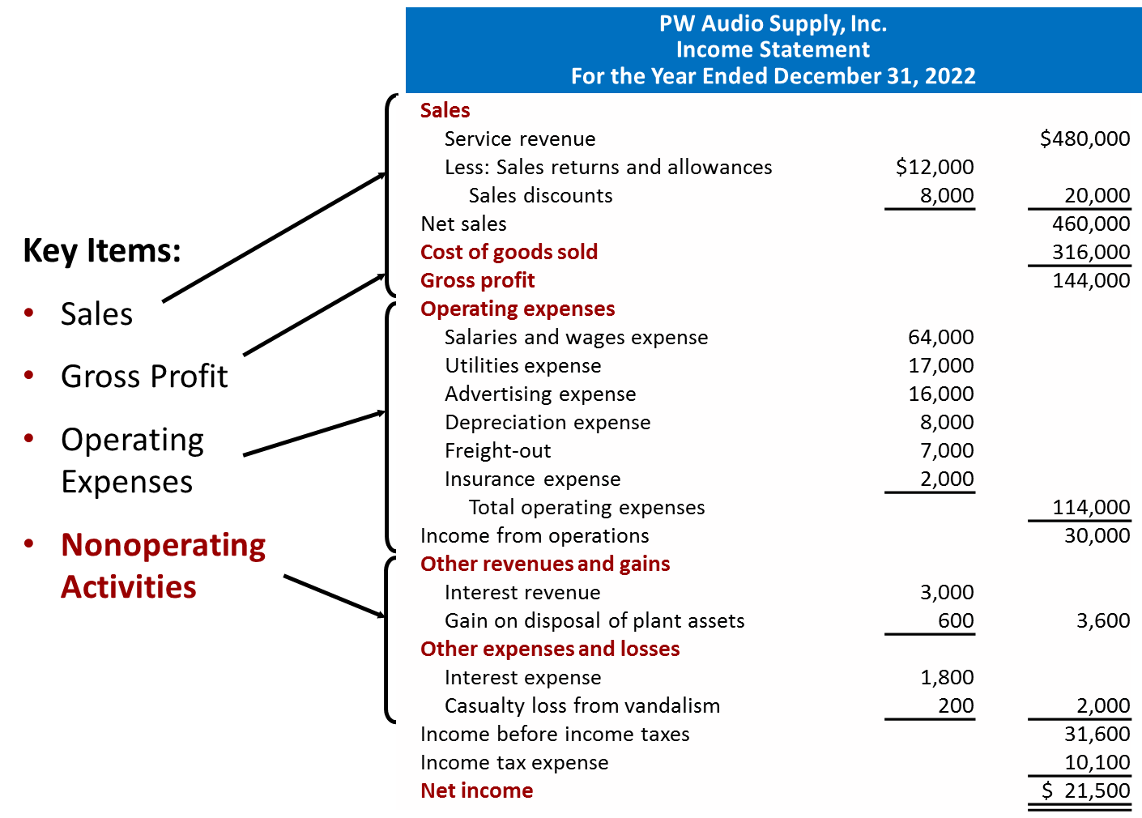
Multiple-Step Income Statement
Nonoperating Activities
  L O 3

Slide 32
Nonoperating Activities
  Revenues and expenses and gains and losses unrelated to company’s main line of operations. Examples include:
  Other Revenues and Gains
  Interest revenue from notes receivable and marketable securities.
  Dividend revenue from investments in capital stock.
  Rent revenue from subleasing a portion of the store.
  Gain from the sale of property, plant, and equipment.
  Other Expenses and Losses
  Interest expense on notes and loans payable.
  Casualty losses from such causes as vandalism and accidents.
  Loss from sale of property, plant, and equipment.
  Loss from strikes by employees and suppliers.
L O 3

Slide 33
Learning Objective 4
Compute and Analyze Gross Profit Rate and Profit Margin
L O 4

Slide 34
Gross Profit Rate
  May be expressed as a percentage by dividing the amount of gross profit by net sales.
  Analysts generally consider the gross profit rate to be more informative than the gross profit amount.
  Helps companies decide if the prices of their goods are in line with changes in the cost of inventory.
L O 4

Slide 35
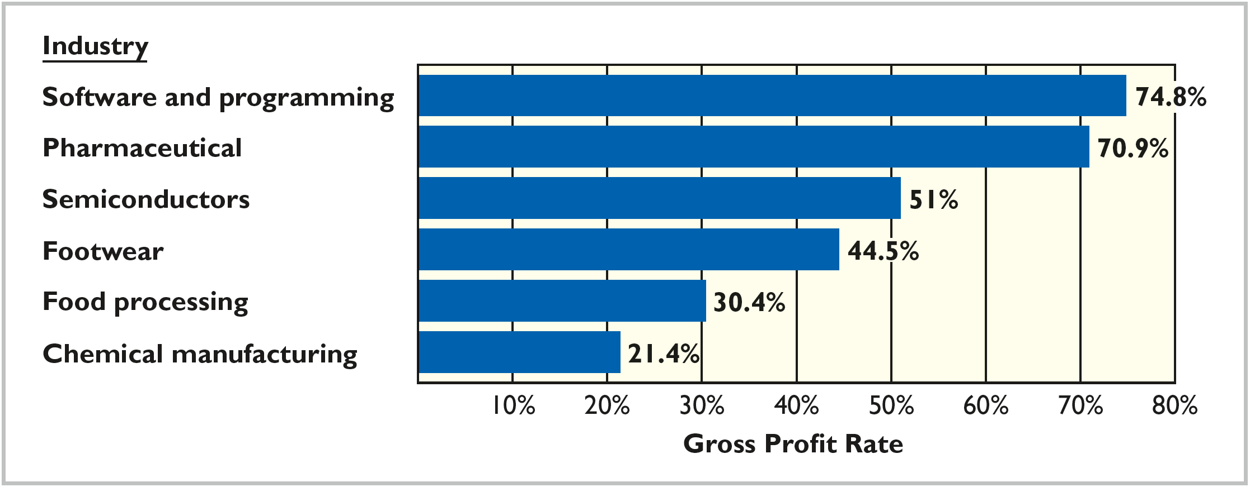
Gross Profit Rate by Industry
  L O 4

Slide 36
Profit Margin
  Measures the percentage of each dollar of sales that results in net income.
  How do the gross profit rate and profit margin ratio differ?
  Gross profit rate measures the margin by which selling price exceeds cost of goods sold.
  Profit margin ratio measures the extent by which selling price covers all expenses (including cost of goods sold).
L O 4

Slide 37
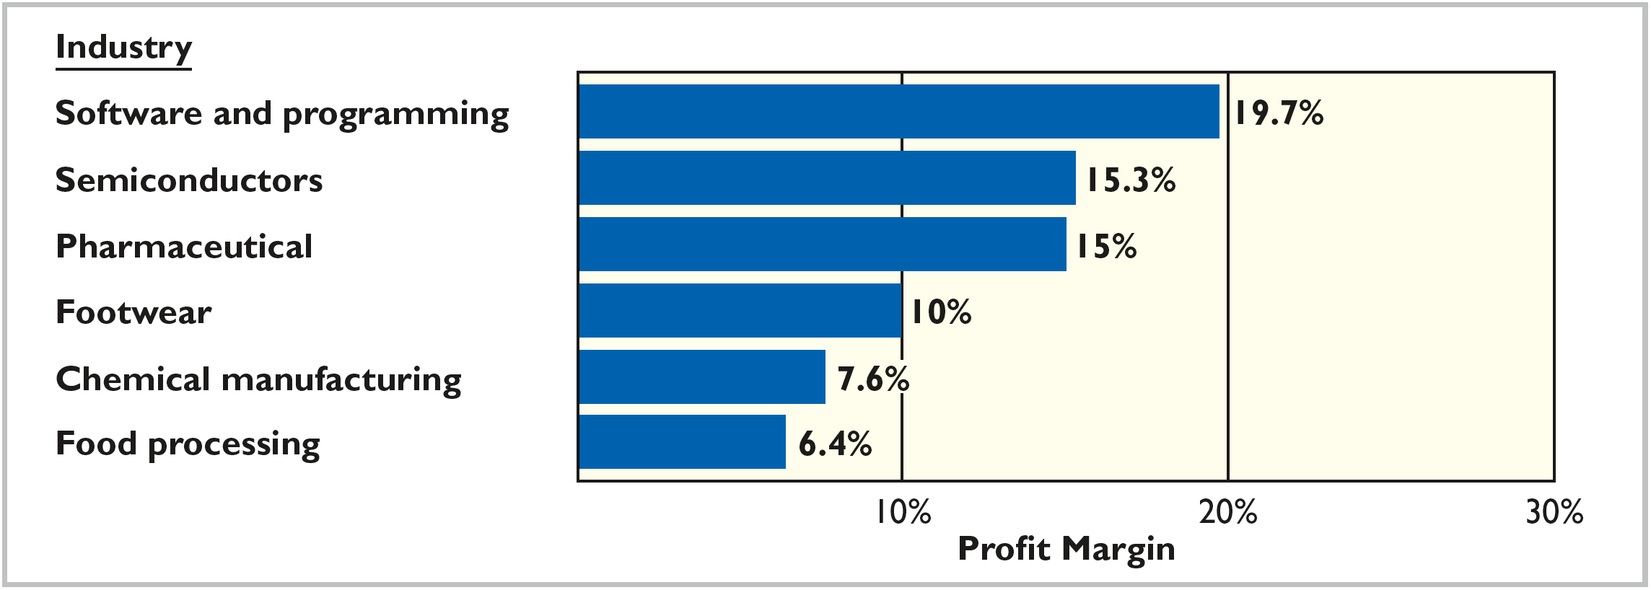
Profit Margins by Industry
  L O 4

