Slide 1
Managerial Accounting and Cost Concepts
Defining Cost as a Concept in a Variety of Scenarios

Slide 5
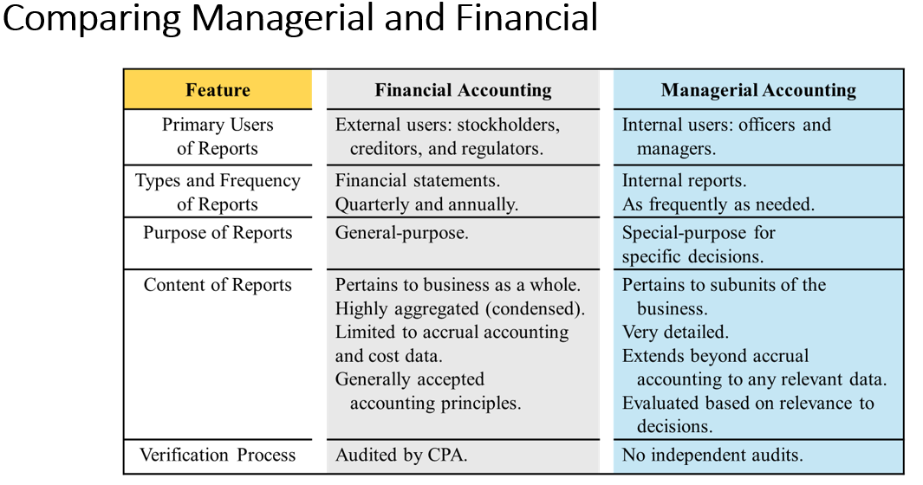

Slide 6
Managerial Accounting
Applies to all types of companies
Responsible for budget preparation
Uses financial information prepared by financial accountants but in a different format and for different purposes
Not responsible to generate revenue—responsible to use information to support revenue generation
Functions at the segment (subunits) level as well as the entire company

Slide 7
Identify distinguishing features of managerial accounting.
E11.1 (LO 1), C Justin Bleeber has prepared the following list of statements about managerial accounting, financial accounting, and the functions of management.
Financial accounting focuses on providing information to internal users.
Staff positions are directly involved in the company’s primary revenue-generating activities.
Preparation of budgets is part of financial accounting.
Managerial accounting applies only to merchandising and manufacturing companies.
Both managerial accounting and financial accounting deal with many of the same economic events.
Managerial accounting reports are prepared only quarterly and annually.
Financial accounting reports are general-purpose reports.
Managerial accounting reports pertain to subunits of the business.
Managerial accounting reports must comply with generally accepted accounting principles.
The company treasurer reports directly to the vice president of operations.
Identify each statement as true or false. If false, indicate how to correct the statement.

Slide 8
The term “cost” is used in a variety of ways
Typically, cost refers to future projection of expenditures. Expenses typically refer to past expenditures.
There are many types of costs, and these costs are classified differently according to the immediate needs of management.
For example, managers may want cost data to predict costs, prepare planning budgets, or to make decisions.
Each different use of cost data demands a different classification and definition of costs.
This notion of different costs for different purposes is a critically important aspect of managerial accounting. We will find the same costs grouped in different manners depending upon our audience.

Slide 9
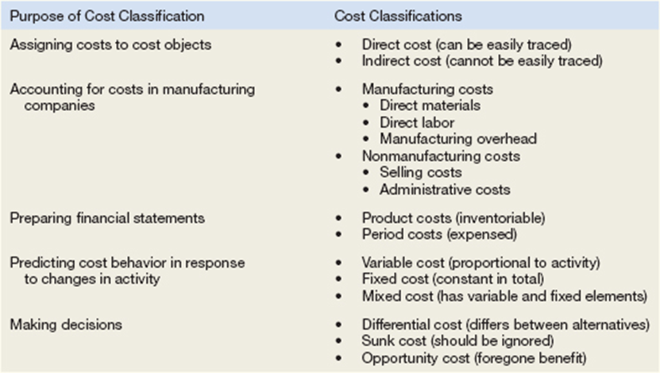
Cost Classifications

Slide 10
Assigning Costs to Cost Objects
Costs are assigned to cost objects for a variety of purposes including pricing, preparing profitability studies, and controlling spending. A cost object is anything for which cost data are desired—including products, customers, jobs, and organizational subunits.
For purposes of assigning costs to cost objects, costs are classified as either direct or indirect.
Direct Cost
A direct cost is a cost that can be easily and conveniently traced to a specified cost object.
If Nike is assigning costs to its various regional and national sales offices, then the salary of the sales manager in its Tokyo office would be a direct cost of that office.
If a printing company made 10,000 brochures for a specific customer, then the cost of the paper used to make the brochures would be a direct cost of that customer.
The caveat is “But for this cost object, would the cost exist?
Indirect Cost
An indirect cost is a cost that cannot be easily and conveniently traced to a specified cost object.
Providing a chapel area in a hospital could not be traced to any one hospital unit. It would a “common cost.” A common cost is incurred to support many cost objects but cannot be traced to any one cost object.
Costs can move between direct and indirect depending upon the cost object.
A manager of a factory would be a direct cost of the factory but would be an indirect cost of induvial product produced in the factory.

Slide 11
Manufacturing costs
Manufacturers have two categories of costs
Manufacturing – called “product” costs on financial stmts
Direct Materials – tangible items large enough and expensive enough to be traced to the product (inventory manufactured by the company)
Direct Labor – personnel who “touch” the product during manufacturing
Manufacturing Overhead – anything factory-related which is not direct materials or direct labor
Non-Manufacturing – called “period” costs on financial stmts
Selling costs – costs incurred between factory and delivery to consumer
Admin costs – costs incurred to oversee both manufacturing and selling

Slide 12
Classify costs into three classes of manufacturing costs.
E11.2 (LO 2), C The following is a list of costs and expenses usually incurred by Barnum Corporation, a manufacturer of furniture, in its factory.
Salaries for product inspectors.
Insurance on factory machines.
Property taxes on the factory building.
Factory repairs.
Upholstery used in manufacturing furniture.
Wages paid to assembly-line workers.
Factory machinery depreciation.
Glue, nails, paint, and other small parts used in production.
Factory supervisors’ salaries.
Wood used in manufacturing furniture.
Classify these items into the following categories: (a) direct materials, (b) direct labor, and (c) manufacturing overhead.

Slide 13
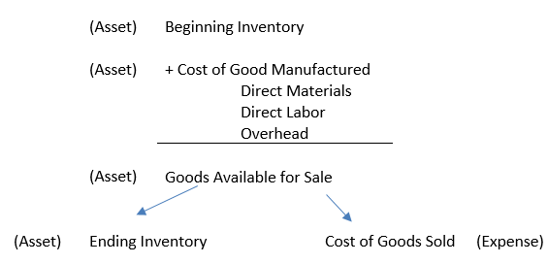
Cost Classifications for Preparing Financial Statements
Product Costs
For financial accounting purposes, product costs include all costs involved in acquiring or making a product. In the case of manufactured goods, these costs consist of direct materials, direct labor, and manufacturing overhead. Product costs “attach” to units of product as the goods are purchased or manufactured, and they remain attached as the goods go into inventory awaiting sale. Product costs are initially assigned to an inventory account on the balance sheet. When the goods are sold, the costs are released from inventory as expenses (typically called cost of goods sold) and matched against sales revenue on the income statement.
The matching principle is based on the accrual concept that costs incurred to generate a particular revenue should be recognized as expenses in the same period that the revenue is recognized. This means that if a cost is incurred to acquire or make something that will eventually be sold (inventory), then the cost should be recognized as an expense only when the sale takes place—that is, when the benefit occurs.

Slide 14
Cost Classifications for Preparing Financial Statements
Period Costs
All costs that are not product costs. All selling and administrative expenses are treated as period costs.
For example, sales commissions, advertising, executive salaries, public relations, and the rental costs of administrative offices are all period costs.
Period costs are not included as part of the cost of either purchased or manufactured goods; instead, period costs are expensed on the income statement in the period in which they are incurred using the usual rules of accrual accounting.
Keep in mind that the period in which a cost is incurred is not necessarily the period in which cash changes hands. For example, costs of prepaid liability insurance are spread across the periods that benefit from the insurance—regardless of the period in which the insurance premium is paid.

Slide 15
BE11.5 (LO 2), C Identify whether each of the following costs should be classified as product costs or period costs.
Manufacturing overhead.
Selling expenses.
Administrative expenses.
Advertising expenses.
Direct labor.
Direct materials.

Slide 16
E11.5 (LO 2), C Gala Company is a manufacturer of laptop computers. Various costs and expenses associated with its operations are as follows.
Property taxes on the factory building.
Production superintendents’ salaries.
Memory boards and chips used in assembling computers.
Depreciation on the factory equipment.
Salaries for quality control inspectors.
Sales commissions paid to sell laptop computers.
Electrical components used in assembling computers.
Wages of workers assembling laptop computers.
Soldering materials used on factory assembly lines.
Salaries for the night security guards for the factory building.
The company intends to classify these costs and expenses into the following categories: (a) direct materials, (b) direct labor, (c) manufacturing overhead, and (d) period costs.

