Slide 1
Survey of Accounting
Second Edition
Kimmel ● Weygandt
Chapter 7
Reporting and Analyzing Inventory and Receivables

Slide 2
Learning Objective 1 Discuss How to Classify and Determine Inventory
L O 1

Slide 3
Classifying and Determining Inventory
Merchandising Company
Manufacturing Company
One Classification:
Merchandise Inventory
Three Classifications:
Raw Materials
Work in Process
Finished Goods
Helpful Hint
Regardless of the classification, companies report all inventories under Current Assets on the balance sheet.
L O 1

Slide 4
Determining Inventory Quantities
Why count physical inventory:
Perpetual System
Check accuracy of inventory records.
Determine amount of inventory lost due to wasted raw materials, shoplifting, or employee theft.
Periodic System
Determine the inventory on hand.
Determine amount of inventory lost due to wasted raw materials, shoplifting, or employee theft.
Determine the cost of goods sold for the period.
L O 1

Slide 5
Taking a Physical Inventory
Involves counting, weighing, or measuring each kind of inventory on hand.
Taken,
when the business is closed or
business is slow.
Companies who depend upon Christmas sales as their busiest season often count inventory on January 31
L O 1

Slide 6
Determining Ownership of Goods
Goods In Transit
Purchased goods not yet received.
Sold goods not yet delivered.
Goods in transit should be included in the inventory of the company that has legal title to the goods.
Legal title is determined by the terms of sale—FOB Shipping Point or FOB Destination. (FOB = Free on Board)
L O 1

Slide 7
Freight Costs
Ownership of the goods passes to the buyer when the public carrier accepts the goods from the seller.
Ownership of the goods remains with the seller until the goods reach the buyer.
L O 1

Slide 8
Determining Ownership of Goods Consigned Goods
One entity holds the goods of another entity and attempts to sell the goods “consigned” to them on behalf of the other entity. Ownership has not passed to the company attempting to sell the costs.
Once sold, a fee is kept, and the remainder remitted to the owner of the goods.
Many car, boat, and antique dealers as well as jewelry stores sell goods on consignment.
L O 1

Slide 9
Learning Objective 2 Apply Inventory Cost Flow Methods and Discuss Their Financial Effects
L O 2

Slide 10
Inventory Methods and Financial Effects
Inventory is accounted for at cost.
Cost includes all expenditures necessary to acquire goods and place them in a condition ready for sale including freight, tariff, storage, and refurbishment costs the buyer pays.
Unit costs are applied to quantities to determine the total cost of inventory and cost of goods sold using the following costing methods:
Specific identification—real estate, cars, Rolexes, etc.
Cost flow assumptions (First-In First-Out, Last-In First-Out, Average-cost).
L O 2

Slide 11
Specific Identification
Crivitz TV Company purchases three identical 50-inch TVs on different dates at costs of $700, $750, and $800. During the year Crivitz sold two sets at $1,200 each.
The company would specifically identify which TVs were sold and match that COGS to the Sale.
Purchases
February 3 | 1 TV at $700
March 5 | 1 TV at $750
May 22 | 1 TV at $800
Sales
June 1 | 2 TVs for $2,400 ($1,200 × 2)
L O 2

Slide 12
Specific Identification
If Crivitz sold the TVs it purchased on February 3 and May 22, then its cost of goods sold is $1,500 ($700 + $800), and its ending inventory is $750.
L O 2

Slide 13
Cost Flow Assumptions
These methods assume flows of costs that may be unrelated to the physical flow of goods. Do not have to follow the physical flow of goods. The cost assumption is based on a variety of factors, but the company must be consistent each month.
There are three assumed cost flow methods:
First-in, first-out (FIFO).
Last-in, first-out (LIFO).
Average-cost.
L O 2

Slide 14
Cost Flow Assumptions Use of Cost Flow Methods in Major U.S. Companies
Cost flow assumption does not need to be consistent with the physical movement of goods.
L O 2

Slide 15
Cost Flow Assumptions Given Data
Illustration: Data for Houston Electronics’ Astro condensers.
(Beginning Inventory + Purchases) − Ending Inventory = Cost of Goods Sold
L O 2

Slide 16
First-In, First-Out (FIFO)
Assumes that the first goods purchased are the first to be sold.
Costs of the earliest goods purchased are the first to be recognized in determining cost of goods sold.
Often (but not always) parallels actual physical flow of merchandise.
Oldest units are not necessarily sold first, but that the costs of the oldest units are recognized first.
In a time of rising prices, the costs of goods sold will be lower and the value of inventory still on hand higher.
Higher taxable income and better-looking balance sheet.
L O 2

Slide 17
First-In, First-Out (FIFO) Graphic
$12,000 Goods Available for Sale
L O 2

Slide 18
Last-In, First-Out (LIFO)
Costs of the last goods purchased are the first to be recognized in determining cost of goods sold.
Seldom coincides with actual physical flow of merchandise but may if it is a hardware store, coal pile, etc.
In a time of rising prices, the most recent or higher costs are included in Cost of Goods Sold and the lower, older prices are included in Inventory.
Income Statement shows less profit which may be good if taxation is a concern. Balance sheet assets will be lower which may be good if the company is taxed on inventory.
L O 2

Slide 19
Last-In, First-Out (LIFO) Graphic
L O 2

Slide 20
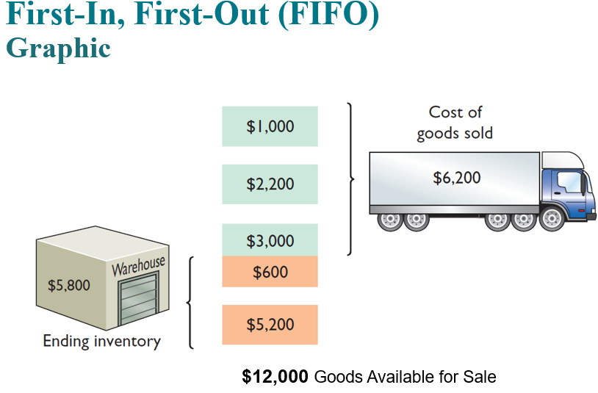
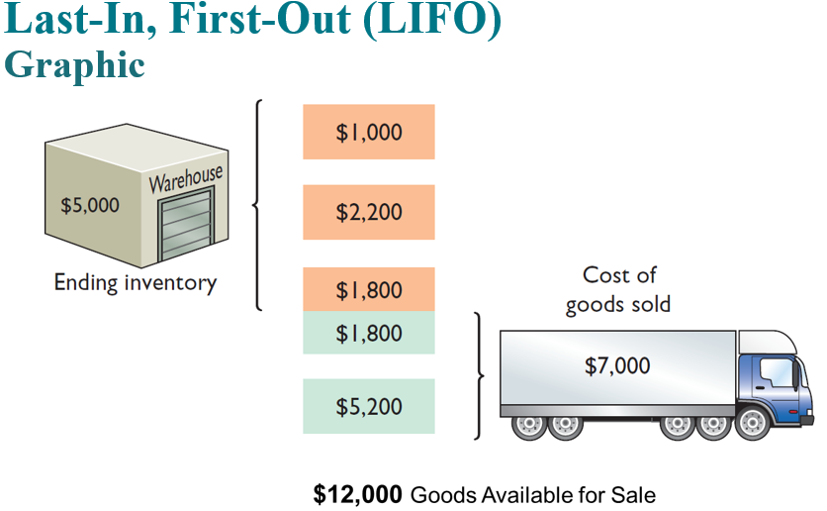

Slide 21
Average-Cost
Allocates cost of goods available for sale on basis of weighted-average unit cost incurred.
Applies weighted-average unit cost to units on hand to determine cost of ending inventory.
L O 2

Slide 22
Average-Cost Graphic
L O 2

Slide 23
Financial Statement and Tax Effects of Cost Flow Methods
The reasons companies adopt different inventory cost flow methods are varied, but they usually involve one of three factors:
Income statement effects.
Balance sheet effects.
Tax effects.
L O 2

Slide 24
Income Statement Effects
In periods of changing prices, the cost flow assumption can have significant impacts both on income and on evaluations of income, such as the following.
In a period of inflation, FIFO produces a higher net income because lower unit costs of the first units purchased are matched against revenue. Ending inventory is higher
In a period of inflation, LIFO produces a lower net income because higher unit costs of the last goods purchased are matched against revenue. Ending inventory is lower
Just the opposite is true if the prices are declining – often seen in the tech industry.
L O 2

Slide 25
Income Statement Effects (continued)
In periods of changing prices, the cost flow assumption can have significant impacts both on income and on evaluations of income, such as the following.
If prices are falling, the results from the use of FIFO and LIFO are reversed. FIFO will report the lowest net income and LIFO the highest.
Regardless of whether prices are rising or falling, average-cost produces net income between FIFO and LIFO.
L O 2

Slide 26
Balance Sheet Effects
A major advantage of the FIFO method is that in a period of inflation, the costs allocated to ending inventory will approximate the inventory's current cost.
Shortcoming of LIFO is that in a period of inflation, the costs allocated to ending inventory may be significantly understated in terms of current cost.
Understatement becomes greater over prolonged periods of inflation if the inventory includes goods purchased in one or more prior accounting periods.
L O 2

Slide 27
Tax Effects
Many companies have selected LIFO. Why?
LIFO results in the lowest income taxes (because of lower net income) during times of rising prices.
Additionally, if the entity is taxed on inventory, ending inventory is lower and the cost lower.
L O 2

Slide 28
Learning Objective 3 Explain How Companies Recognize and Value Receivables
L O 3

Slide 29
Types of Receivables
L O 3

Slide 30
Recognizing Accounts Receivable
Service organization records a receivable when it performs service on account.
Merchandiser records accounts receivable at point of sale of merchandise on account.
Seller may offer a discount to encourage early payment.
Buyer might return goods found to be unacceptable.
Sales returns reduce revenues and receivables.
L O 3

Slide 31
Valuing Accounts Receivable
Companies record receivables in the accounts.
Reported on the balance sheet as an asset.
Reported net of uncollectible accounts.
Uncollectible Accounts
Sales on account raise possibility of accounts not being collected.
Seller records losses that result from extending credit as Bad Debt Expense and in an account entitled “Allowance for Bad Debts or Uncollectible Accounts.” Allowance is a contra asset account related to receivables.
L O 3

Slide 32
Valuing Accounts Receivable Direct Write-Off Method for Uncollectible Accounts
When a company determines receivables to be uncollectible, it charges the loss to Bad Debt Expense.
Bad debt expense will show only actual losses from uncollectibles.
Company reports accounts receivable at its gross amount without any adjustment for estimated losses for bad debts.
Not acceptable for GAAP financial reporting purposes unless the receivable balance are small.
L O 3

Slide 33
Direct Write-Off Method Write-Off of an Account
Illustration: Assume, for example, that Warden Co. writes off M. E. Doran’s $200 balance as uncollectible on December 12. Warden records the write-off as follows.
L O 3

Slide 34
Valuing Accounts Receivable Allowance Method for Uncollectible Accounts
Estimate uncollectible accounts receivable and match them against revenues in the same accounting period in which revenues are recorded.
Record estimated uncollectibles as an increase to Bad Debt Expense and an increase to Allowance for Doubtful Accounts.
Allowance for Doubtful Accounts is a contra asset account to Accounts Receivable.
L O 3

Slide 35
Valuing Accounts Receivable Recording Estimated Uncollectibles
Illustration: Hampson Furniture has credit sales of $1,200,000 in 2022, of which $200,000 remains uncollected on December 31. The credit manager estimates that $12,000 of these sales will prove uncollectible. The adjustment is as follows.
L O 3

Slide 36
Recording Estimated Uncollectibles
L O 3

Slide 37
Allowance Method for Uncollectible Accounts
When a company exhausts all means of collecting a past-due account, the company writes off the account.
Management personnel should formally approve each write-off.
Employee authorized to write off accounts should not have daily responsibilities related to cash or receivables.
L O 3

Slide 38
Allowance Method for Uncollectible Accounts Write-Off of an Uncollectible Account
Illustration: On March 1, 2023, Hampson Furniture writes-off $500 owed by R. A. Ware. The write-off is recorded as follows:
L O 3

Slide 39
Allowance Method for Uncollectible Accounts Balance Sheet Before and After Write-Off
A write-off affects only balance sheet accounts. Cash realizable value in the balance sheet, therefore, remains the same before and after the write-off.
 | Before Write-Off | After Write-Off
Accounts receivable | $200,000 | $199,500
Less: Allowance for doubtful accounts | 12,000 | 11,500
Cash realizable value | $188,000 | $188,000
L O 3

Slide 40
Estimating the Allowance
Companies generally using one of the following two methods:
Percentage-of-Receivables Basis
Management establishes a percentage relationship between amount of receivables and expected losses from uncollectible accounts.
Aging the Accounts Receivable
Is a schedule that classifies customer balances by the length of time they have been unpaid.
L O 3

Slide 41
Estimating the Allowance Aging of Accounts Receivable Method
When the aging of accounts receivable method is used, the company:
Arranges the accounts by age.
Determines the expected bad debt losses by applying percentages, based on past experience and/or the current economic environment, to the totals of each category.
The longer a receivable is past due, the less likely it is to be collected.
L O 3

Slide 42
Estimating the Allowance Aging Schedule
L O 3

Slide 43
Estimating the Allowance Theory
Total estimated uncollectible accounts for Dart Company ($2,228) represent the existing customer claims expected to become uncollectible in the future.
Amount represents the required balance in Allowance for Doubtful Accounts at the balance sheet date.
Amount of bad debt expense that should be recorded is the difference between the required balance and the existing balance in the allowance account.
L O 3

Slide 44
Estimating the Allowance Adjustment
Illustration: If the unadjusted balance in Allowance for Doubtful Accounts is presently $528 but should be $2,228 then a transaction for $1,700 is necessary.
L O 3

Slide 45
Learning Objective 4 Explain the Statement Presentation and Analysis of Inventory
L O 4

Slide 46
Presentation
Inventory is classified in the balance sheet as a current asset immediately below receivables.
In a multiple-step income statement, cost of goods sold is subtracted from net sales.
There also should be disclosure of
Major inventory classifications.
Cost method (FIFO, LIFO, or average-cost).
L O 4

Slide 47
Presentation Footnote Disclosure
L O 4

Slide 48
Analysis Inventory Management
Inventory management is a critical task.
Having too much inventory on hand costs the company money in storage costs, interest costs (on funds tied up in inventory), and costs associated with the obsolescence of technical goods (e.g., computer chips) or shifts in fashion (e.g., clothes).
Having too little inventory on hand results in lost sales.
L O 4

Slide 49
Analysis Data Analytics and Inventory Management
Companies collect massive amounts of data about every inventory item and every customer.
They analyze customer habits, buying patterns, and sales trends.
Using models that incorporate economic variables, weather patterns, and other factors, companies strive to optimize inventory levels to maximize sales while minimizing inventory holding costs.
L O 4

Slide 50
Inventory Turnover
L O 4

Slide 51
Inventory Turnover
Illustration: Data available for WalMart (2x).
(in millions) | 2016 | 2015
Ending inventory | $ 43,046 | $44,469
Cost of goods sold | 361,256
L O 4

