Slide 1
Survey of Accounting
Second Edition
Kimmel ● Weygandt
Liabilities and Stockholders’ Equity
This slide deck contains animations. Please disable animations if they cause issues with your device.
Copyright ©2020 John Wiley & Sons, Inc.

Slide 2
Learning Objective 1
Explain How to Account for Current Liabilities
L O 1

Slide 3
What Is a Current Liability?
A debt that a company expects to pay:
From existing current assets or through the creation of other current liabilities.
Within one year or the operating cycle, whichever is longer.
Current liabilities include notes payable, accounts payable, unearned revenue, and accrued liabilities such as taxes, salaries and wages, and interest.
3. Many liabilities will have a current and a long-term portion.
L O 1

Slide 4
Current Maturities of Long-Term Debt
  Portion of long-term debt that comes due in current year.
  No adjusting entry required. Presentation issue on the Balance Sheet
  Illustration: Wendy Construction issues a five-year, interest-bearing $25,000 note on January 1, 2021. This note specifies that each January 1, starting January 1, 2022, Wendy should pay $5,000 of the note. When the company prepares financial statements on December 31, 2021, what amount should be reported as a:
  Current liability? $5,000
  Long-term liability? $20,000
L O 1

Slide 5
Identify whether obligations are current liabilities.
BE9.1 Busch Company has these obligations at December 31:
a note payable for $100,000 due in 2 years,
(b) a 10-year mortgage payable of $200,000 payable in ten $20,000 annual payments
(c) interest payable of $15,000 on the mortgage
(d) accounts payable of $60,000.
For each obligation, indicate whether it should be classified as a current liability, long-term liability, or both.

Slide 6
Notes Payable
  Written documentation of obligation. Easier to adjudicate in court.
  Usually requires borrower to pay interest.
  Frequently issued to meet short-term financing needs.
  Issued for varying periods of time but typically less than a year
  Usually classified as current liability if due for payment within one year of balance sheet date.
L O 1

Slide 7
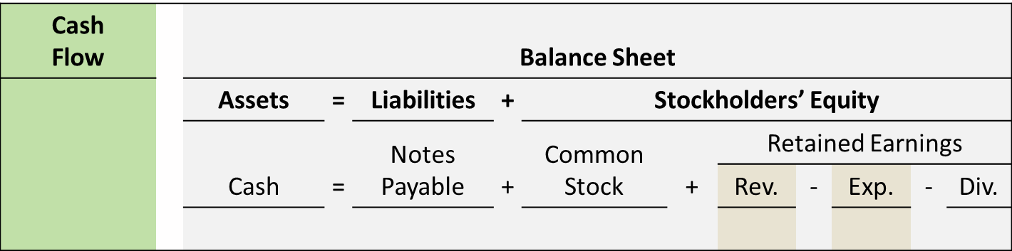
Notes Payable Issuance of Note
On September 1, 2022, Cole Williams Co. signs a $100,000, 12%, four-month note maturing on January 1 with First National Bank.
When a company issues an interest-bearing note, the amount of cash generally equals the note’s face value.
Cole Williams Col therefore will receive $100,000 cash.
L O 1

Slide 8
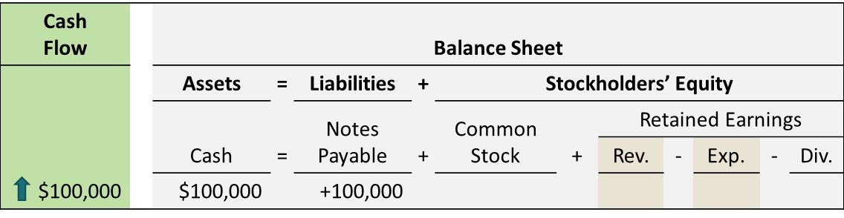
Notes Payable -Recording Issuance of Note
On September 1, 2022, Cole Williams Co. signs a $100,000, 12%, four-month note maturing on January 1 with First National Bank.
When a company issues an interest-bearing note, the amount of cash generally equals the note’s face value.
Cole Williams Col therefore will receive $100,000 cash.
L O 1

Slide 9
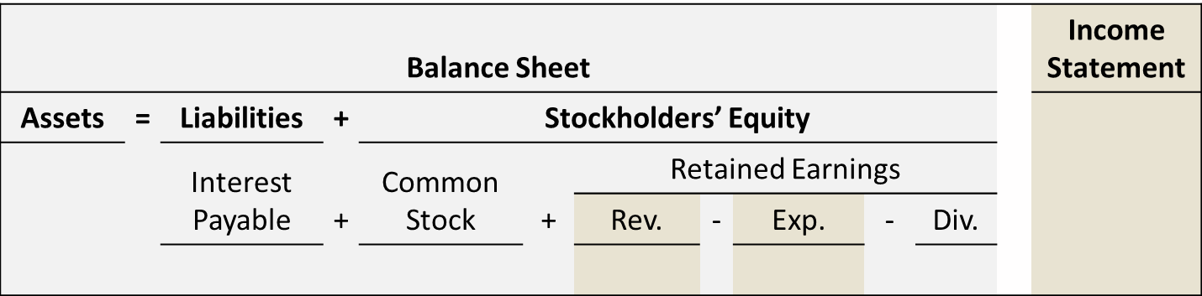
Notes Payable - Adjustment for Interest
If Cole Williams Co. prepares financial statements annually, it makes an adjustment at December 31 to recognize four months of interest expense and interest payable of $4,000 ($100,000 × 12% × 4/12). (Loan was consummated on September 1.
L O 1

Slide 10
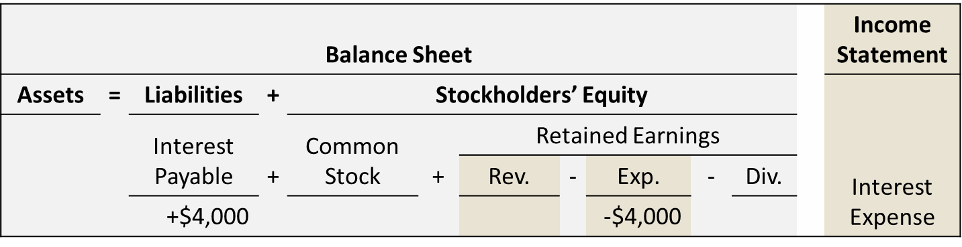
Notes Payable Recording Adjustment for Interest
If Cole Williams Co. prepares financial statements annually, it makes an adjustment at December 31 to recognize four months of interest expense and interest payable of $4,000 ($100,000 × 12% × 4/12) as follows.
L O 1

Slide 11
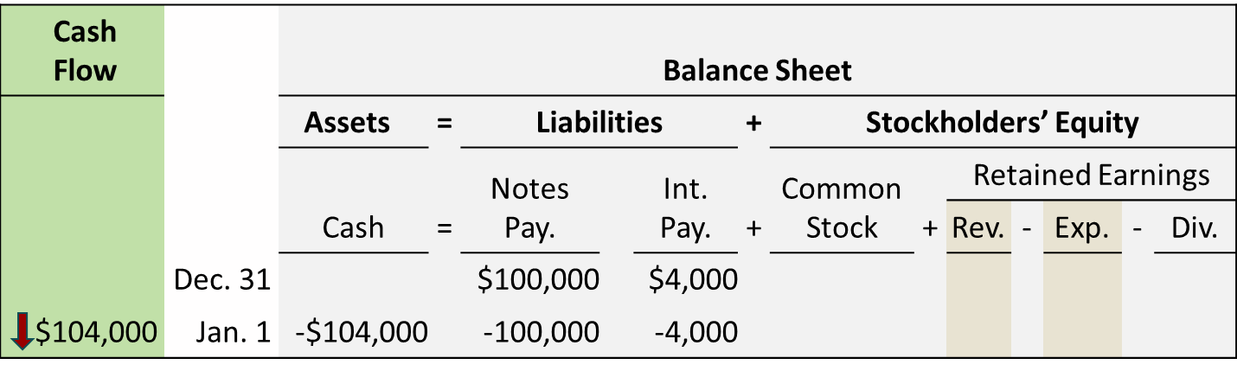
Notes Payable
Recording Payment of Note at Maturity
At maturity on January 1, Cole Williams Co. must pay the face value of the note ($100,000) plus $4,000 interest. The following illustration shows the December 31 balances and then the payment on January 1 for the note and accrued interest.
L O 1

Slide 12
BE9.2 Hive Company borrows $90,000 on July 1 from the bank by signing a $90,000, 7%, 1-year note payable. Prepare a tabular summary to record
the proceeds of the note
(b) accrued interest at December 31, assuming adjustments are made only at the end of the year.

Slide 13
Sales Taxes Payable
  Sales taxes are expressed as a stated percentage of the sales price.
  Selling company:
    Collects tax from customer on behalf of governmental entities. (Quasi-governmental function.
    Periodically (usually monthly) remits collections to state’s department of revenue.
L O 1

Slide 14
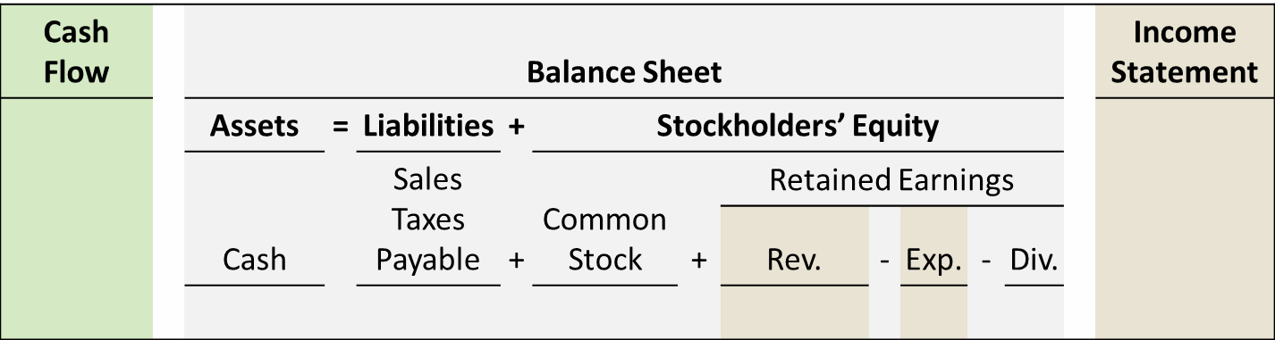
Sales Taxes Payable
Calculation of Sales Taxes
The March 25 cash register readings for Coley Grocery show sales of $10,000 and sales taxes of $600 (sales tax rate of 6%).
L O 1

Slide 15
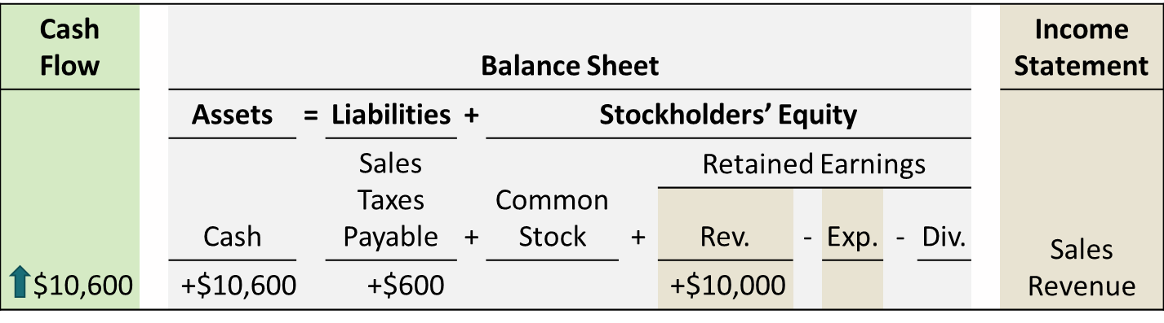
Sales Taxes Payable
Recording Sales Taxes Payable
The March 25 cash register readings for Cooley Grocery show sales of $10,000 and sales taxes of $600 (sales tax rate of 6%), its accounting records show the following.
L O 1

Slide 16
Learning Objective 3
Explain How to Account for the Issuance of Common and Preferred Stock, and the Purchase of Treasury Stock
L O 3

Slide 17
A corporation is created by law.
As a legal entity, a corporation has most of the rights and privileges of a person.
Major exceptions relate to privileges that can be exercised only by a living person, such as right to vote or to hold public office.
Corporation must abide by the law, and it must pay taxes.
It has a continuous life.
L O 3

Slide 18
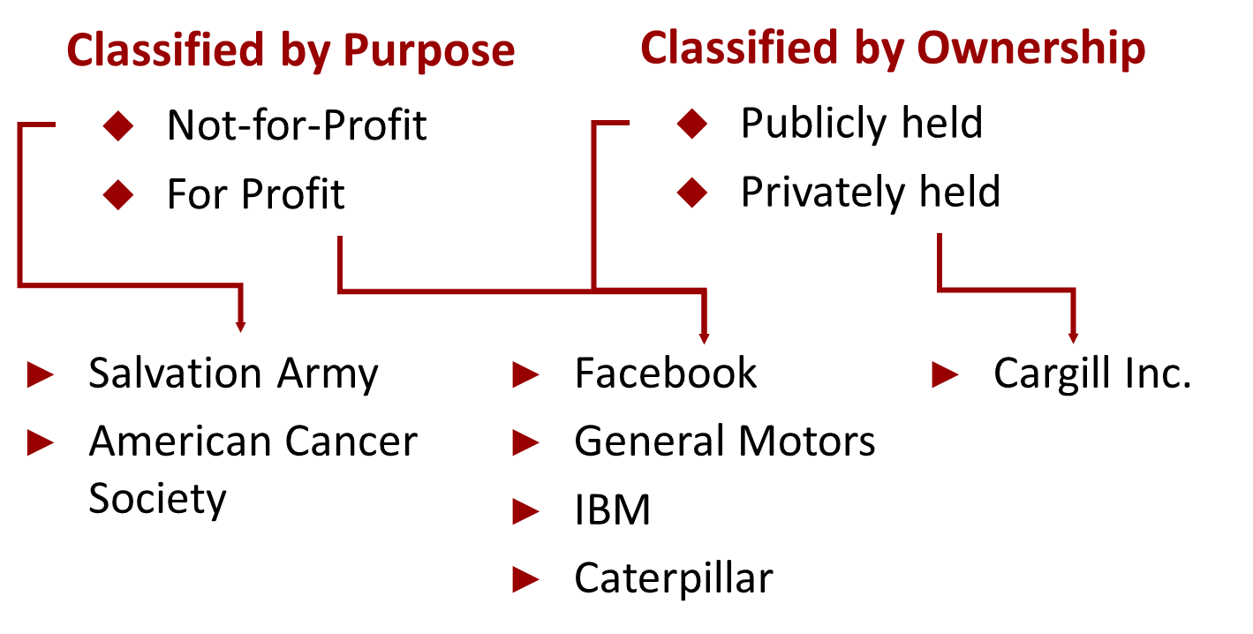
L O 3

Slide 19
A corporation is formed by grant of a state charter. The charter is a document that describes the:
Name and purpose of the corporation.
Types and number of shares of stock that are authorized to be issued.
Names of the individuals that formed the corporation.
Once a corporation becomes public is not managed by the founder but is managed and run by the Board of Directors.
L O 3

Slide 20

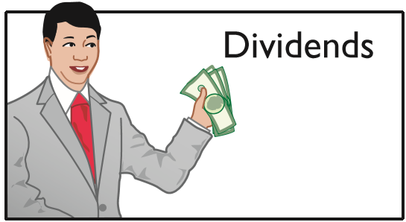
Stockholder Rights
Vote in election of board of directors at annual meeting and vote on any action that require stockholder approval. Although they own the corp, they do not manage it. They elect of Board of Directors who hire/fire upper management.
Share the corporate earnings through receipt of dividends if declared by Board of Directors.
L O 3

Slide 21
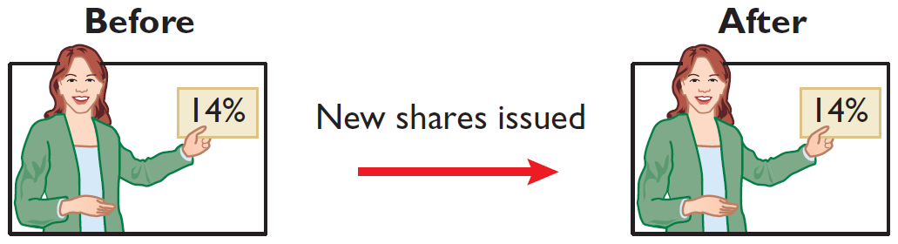
Stockholder Rights (continued)
Keep the same percentage ownership when new shares of stock are issued (preemptive right¹).
¹A number of companies have eliminated the preemptive right because they believe it places an unnecessary and cumbersome demand on management.
  L O 3

Slide 22
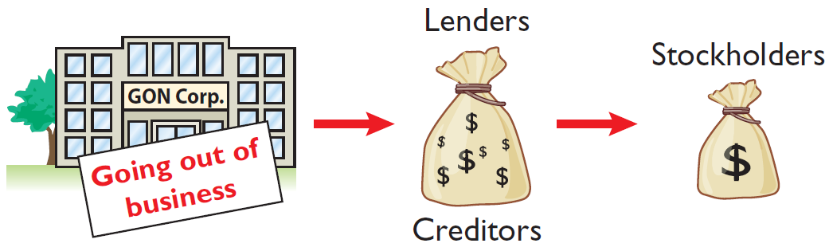
Stockholder Rights (concluded)
Share in assets upon liquidation in proportion to their holdings. This is called a residual claim because owners are paid with assets that remain after all other claims have been paid. Creditors are paid first and come before stockholders in the accounting equation.
L O 3

Slide 23
Stockholders
Have limited liability when the corporation is sued, the only loss they suffer is the loss of the value of the stock (Cannot be sued individually).
They can easily buy and sell stock. (Ownership rights are easily transferrable).
Pay taxes on any cash dividends. (The corporation pays taxes on its own behalf).

Slide 24
Authorized Stock
Charter indicates the amount of stock that a corporation is authorized to sell.
If the corporation has sold all its authorized stock, then it must obtain permission from the state to change its charter before it can issue additional shares.
Therefore, corporations generally begin with a substantial number of authorized shares.
L O 3

Slide 25
Issuance of Stock
Corporation can issue common stock:
Directly to investors.
Indirectly through an investment banking firm.
Direct issue is typical in closely held companies.
Indirect issue is customary for a publicly held corporation.
L O 3

Slide 26
Par and No-Par Value Stocks
Par and No-Par Value Stocks
Par value stock has been assigned a value per share.
Years ago, par value determined the legal capital per share that a company must retain in the business for the protection of corporate creditors.
Many states do not require a par value.
No-par value stock is becoming common.
In many states the board of directors assigns a stated value to no-par shares.
L O 3

Slide 27
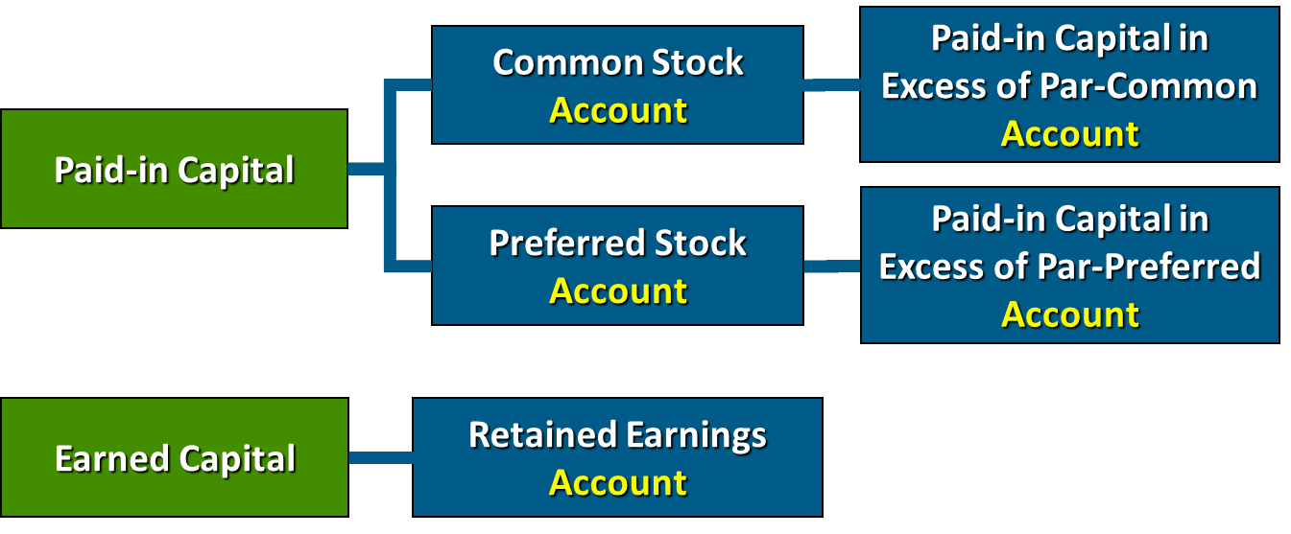
Corporate Capital
Paid-in Capital
Paid-in capital is the total amount of cash and other assets paid into the corporation by stockholders in exchange for capital stock.
L O 3

Slide 28
Corporate Capital
Retained Earnings
Retained earnings is net income that a corporation retains in the business.
L O 3

Slide 29
Accounting for Common Stock
Primary Objectives:
  Identify the specific sources of paid-in capital.
  Maintain the distinction between paid-in capital and retained earnings.
  Other than consideration received, the issuance of stock often affects paid-in capital accounts.
L O 3

Slide 30
Issuing Par Value Common Stock for Cash
Par value does not indicate a stock’s market price. It can be as low as a penny.
Cash proceeds from issuing par value stock may be equal to, greater than, or less than par value.
When a company issues common stock for cash, it records:
The par value of the shares in Common Stock.
The portion of the proceeds that is above or below par value in a separate paid-in capital account.
L O 3

Slide 31
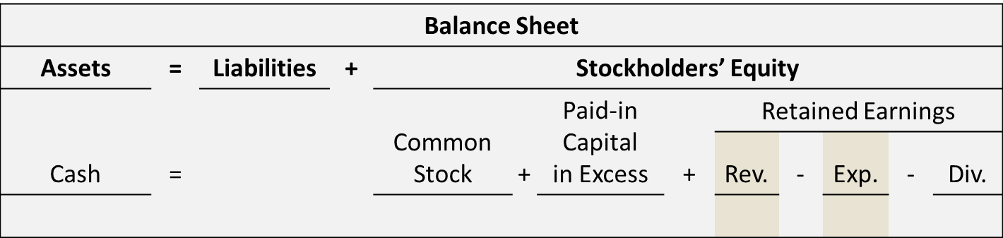
Issuing Par Value Common Stock for Cash
Issuance of Common Stock at Par Value
Hydro-Slide, Inc. issues 1,000 shares of $1 par value common stock for cash.
L O 3

Slide 32
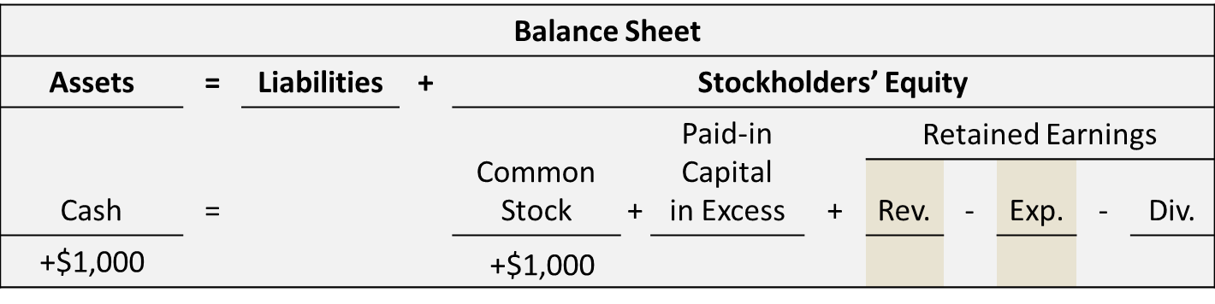
Issuing Par Value Common Stock for Cash
Recording Issuance of Common Stock at Par Value
Hydro-Slide, Inc. issues 1,000 shares of $1 par value common stock for cash.
This transaction increases cash flow by $1,000 and has no effect on net income.
  L O 3

Slide 33
Issuing Par Value Common Stock for Cash
Issuance of Common Stock Above Par Value
Assume Hydro-Slide, Inc. issues an additional 1,000 shares of the $1 par value common stock for cash at $5 per share.
L O 3

Slide 34
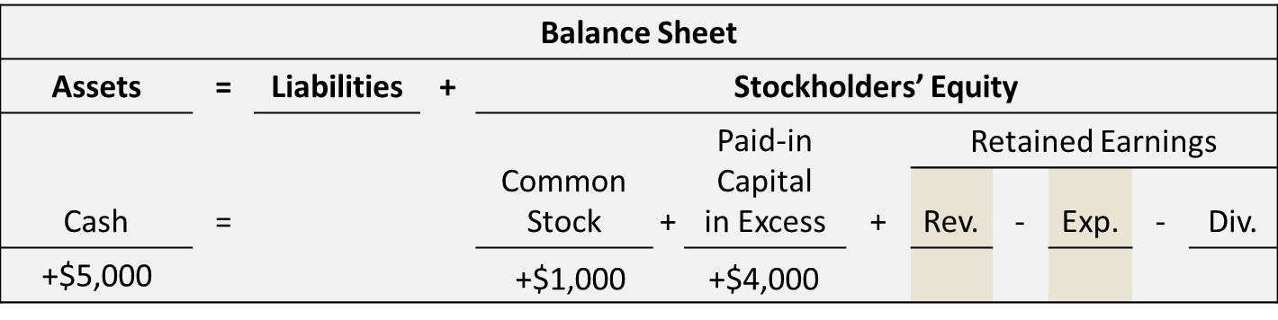
Issuing Par Value Common Stock for Cash
Recording Issuance of Common Stock Above Par Value
Assume Hydro-Slide, Inc. issues an additional 1,000 shares of the $1 par value common stock for cash at $5 per share.
This transaction increases cash flow by $5,000 and has no effect on net income.
  L O 3

Slide 35
BE9.14 On June 1, Forrest Inc. issues 3,000 shares of no-par common stock at a cash price of $7 per share.
Prepare a tabular summary to record the issuance of the shares.

Slide 36
BE9.13 On May 10, Pilar Corporation issues 2,500 shares of $5 par value common stock for cash at $13 per share.
Prepare a tabular summary to record the issuance of the stock.

Slide 37
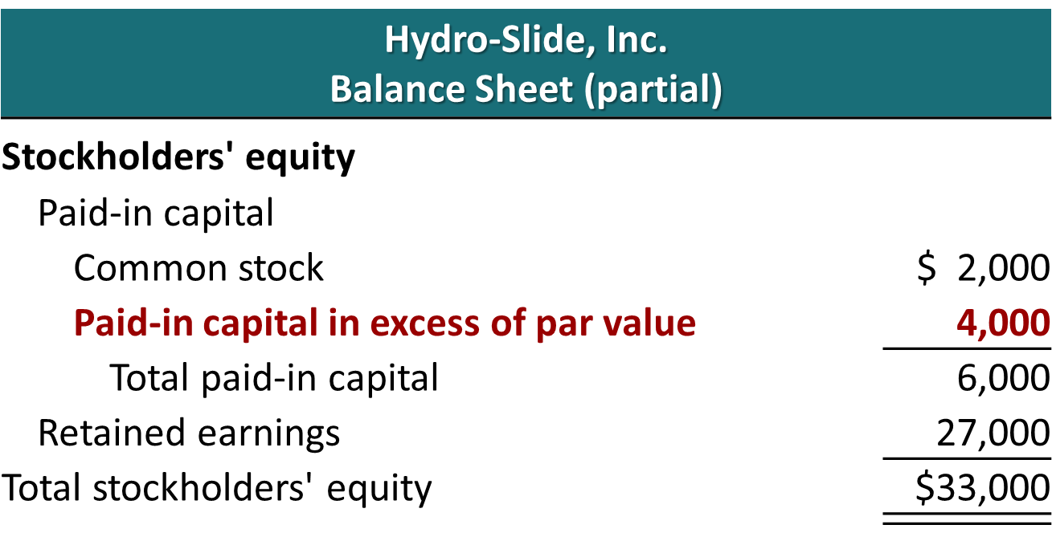
Issuing Par Value Common Stock for Cash
Presentation
L O 3

Slide 38
Accounting for Preferred Stock (1 of 3)
Typically, preferred stockholders have a priority as to:
Dividends.
Assets in the event of liquidation.
However, they sometimes do not have voting rights.
When a corporation has more than one class of stock, each paid-in capital account title should identify the stock to which it relates:
Paid-in Capital in Excess of Par Value—Preferred Stock
Paid-in Capital in Excess of Par Value—Common Stock
L O 3

Slide 39
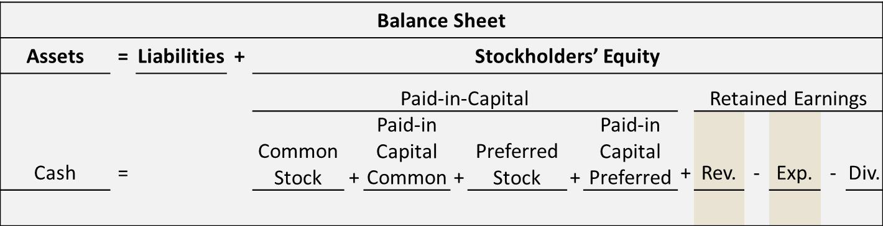
Accounting for Preferred Stock
Issuance of Preferred Stock Above Par Value
Stine Corporation issues 10,000 shares of $10 par value preferred stock for $12 cash per share.
L O 3

Slide 40
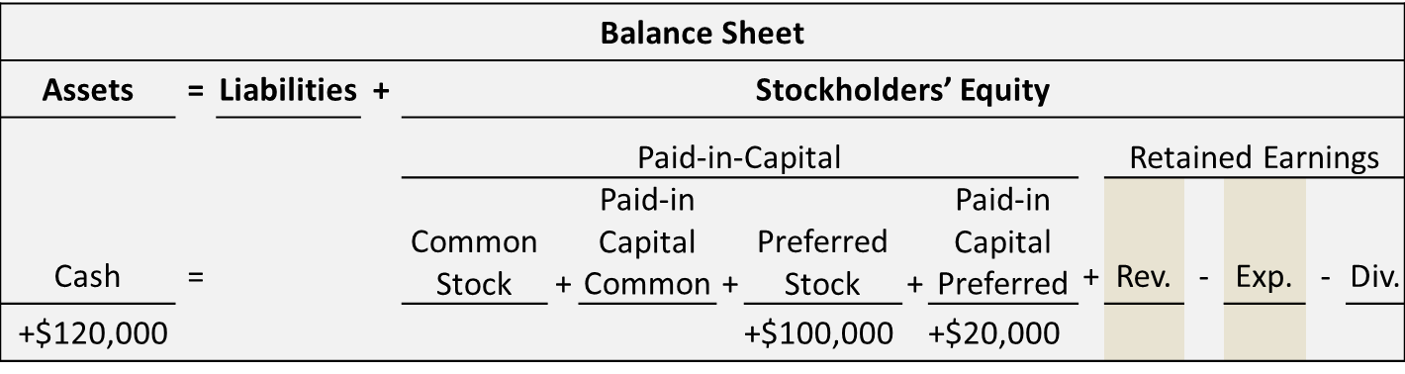
Accounting for Preferred Stock
Recording Issuance of Preferred Stock Above Par Value
Stine Corporation issues 10,000 shares of $10 par value preferred stock for $12 cash per share.
This transaction increases cash flow by $120,000 and has no effect on net income.
  L O 3

Slide 41
BE9.15 Layes Inc. issues 8,000 shares of $100 par value preferred stock for cash at $106 per share.
Prepare a tabular summary to record the issuance of the preferred stock.

Slide 42
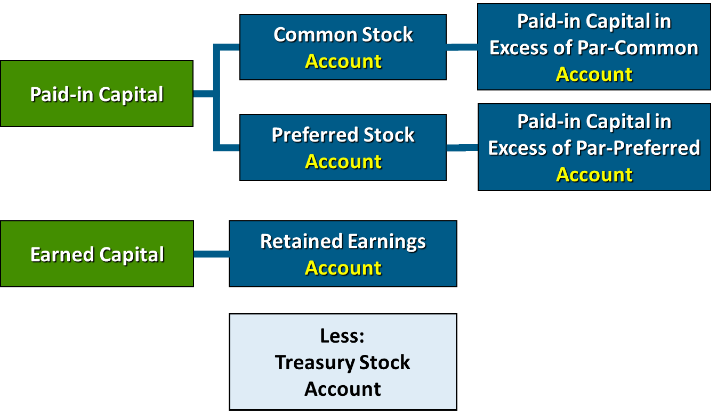
Accounting for Treasury Stock
L O 3

Slide 43
Accounting for Treasury Stock
Treasury stock is a corporation’s own stock that has been reacquired by the corporation and is being held for future use.
Corporations purchase their outstanding stock:
To reissue shares to officers and employees under bonus and stock compensation plans.
To increase trading of the company’s stock in the securities market.
To have additional shares available for use in acquiring other companies.
To increase earnings per share by reducing the number of shares outstanding.
Another infrequent reason is to eliminate hostile shareholders.
L O 3

Slide 44
Purchase of Treasury Stock
Generally accounted for by the cost method.
Increase Treasury Stock for the price paid.
Treasury stock is a contra stockholders’ equity account, not an asset.
Treasury Stock will be decreased by the same re-acquired amount per share if the company later sells the shares.
L O 3

Slide 45
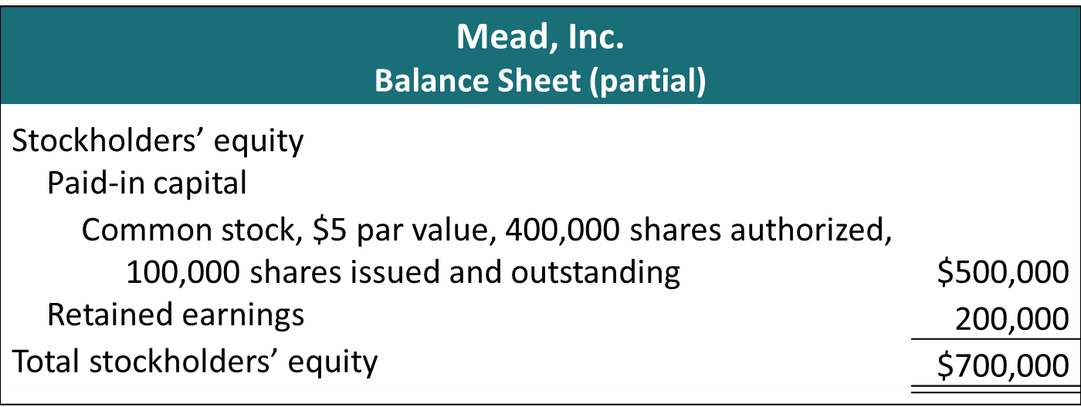
Purchase of Treasury Stock
This illustration shows the stockholders’ equity section of the balance sheet before the purchase of treasury stock.
Authorized share can be found in the corporation’s charter. Issued and outstanding are those shares held by investors.
L O 3

Slide 46
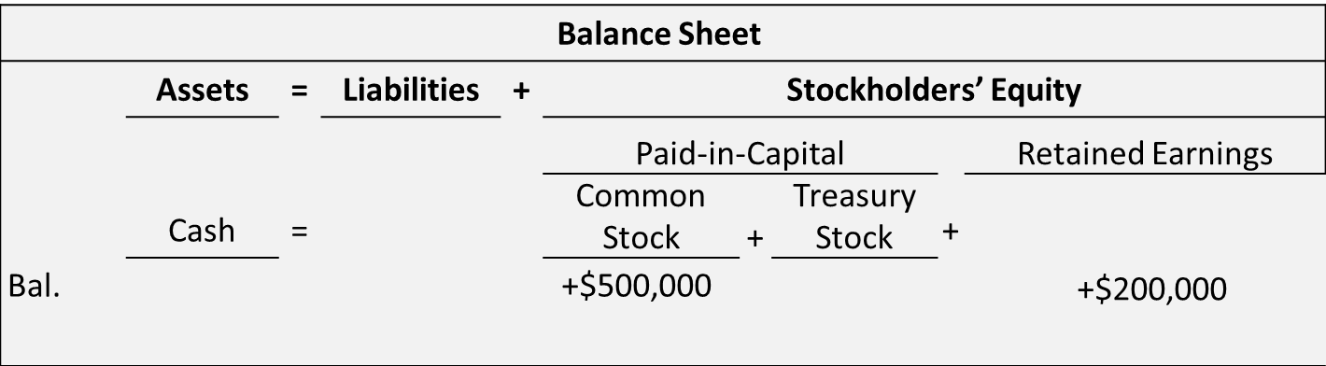
Purchase of Treasury Stock
Example
On February 1, 2022, Mead acquires 4,000 shares of its stock at $8 per share.
L O 3

Slide 47
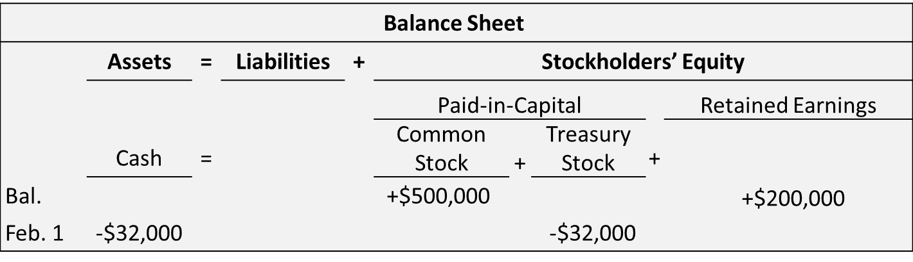
Purchase of Treasury Stock
Recording Purchase of Treasury Stock
On February 1, 2022, Mead acquires 4,000 shares of its stock at $8 per share. It is recorded as follows.
This transaction decreases cash flow by $32,000 and has no effect on net income.
  L O 3

Slide 48
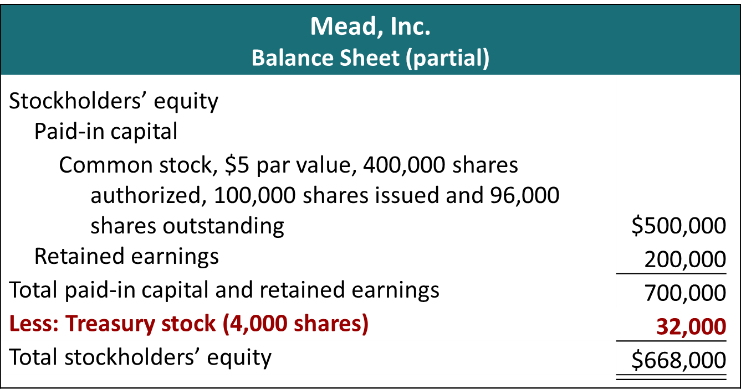
Authorized share can be found in the corporation’s charter. Issued shares equal all shares that were ever issued, and outstanding shares represent the number of shares held by investors. The difference between issued and outstanding represent treasury shares.
L O 3

Slide 49
E9.13 (LO 3), AP Sagan Co. had these transactions during the current period.
June | 12 | Issued 80,000 shares of $1 par value common stock for cash of $300,000.
July | 11 | Issued 3,000 shares of $100 par value preferred stock for cash at $106 per share.
Nov. | 28 | Purchased 2,000 shares of treasury stock for $9,000.

Slide 50
Learning Objective 4
Explain How to Account for Cash Dividends
L O 4

Slide 51
Accounting for Cash Dividends
Distribution by a corporation to stockholders on a pro rata (proportional to ownership) basis.
Types of Dividends:
Cash
Property
Stock
Scrip (cash promissory note)
Dividends are generally reported quarterly as a dollar amount per share.
L O 4

Slide 52
Cash Dividends
Recording Cash Dividends
Three dates are important in connection with dividends:
Declaration date. The corporation now has an obligation to pay.
Record date. Usually, the end of business on a specific day. Defines the population of those who will receive the dividend.
Payment date. The date when the obligation is satisfied.
Companies record transactions on the declaration date and the payment date.
L O 4

Slide 53
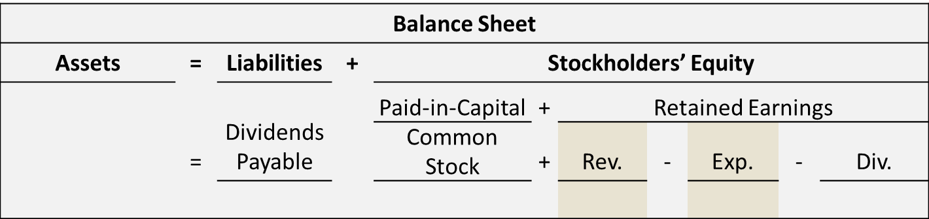
Recording Cash Dividends
Declaration of a Cash Dividend
On December 1, 2022, the directors of Media General declare a $0.50 per share cash dividend on 100,000 shares of $10 par value common stock. The dividend is $50,000.
L O 4

Slide 54
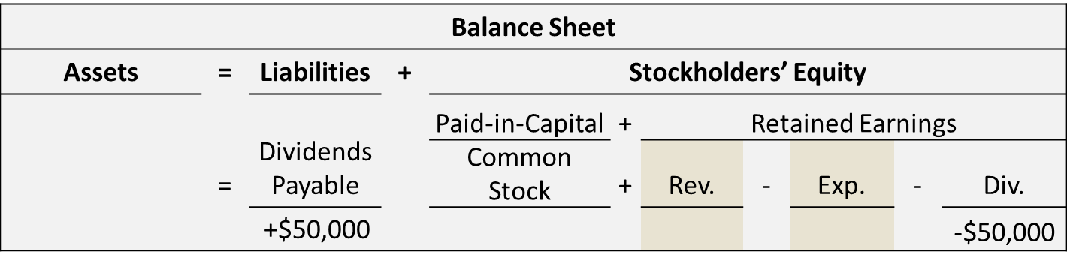
Recording Cash Dividends
Recording the Declaration of a Cash Dividend
On December 1, 2022, the directors of Media General declare a $0.50 per share cash dividend on 100,000 shares of $10 par value common stock. The dividend is $50,000.
This transaction has no effect on net income or cash flow.
  L O 4

Slide 55
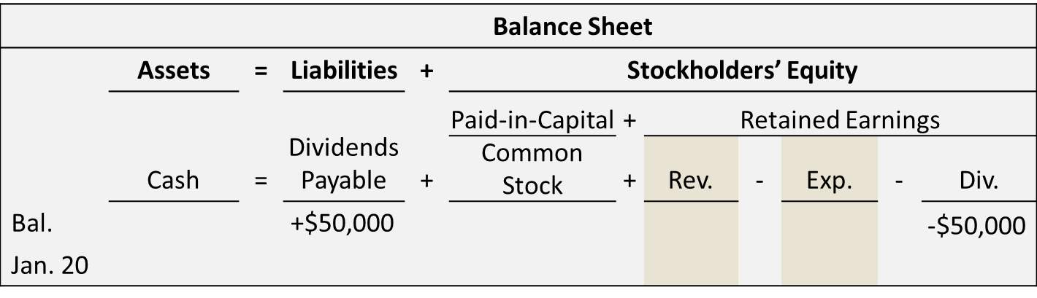
Recording Cash Dividends
Payment of a Cash Dividend
Assume January 20 is the payment date for the dividend.
L O 4

Slide 56
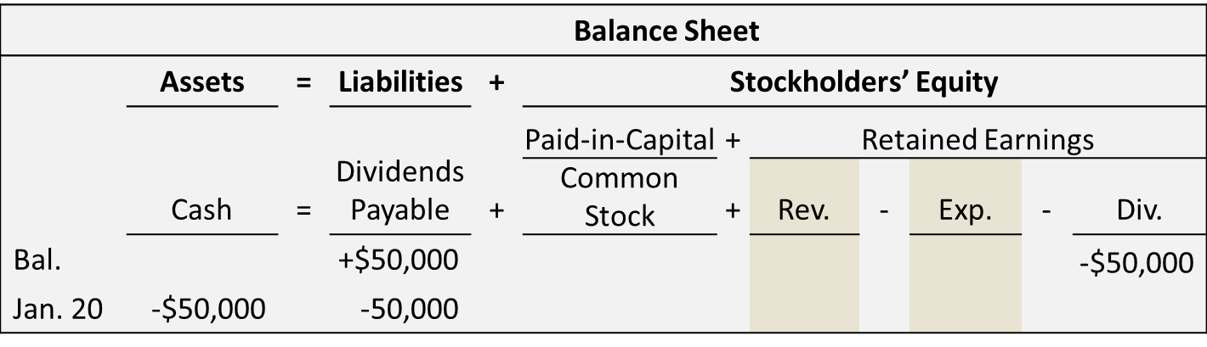
Recording Cash Dividends
Recording Payment of a Cash Dividend
If January 20 is the payment date for dividend, the payment is recorded as follows.
This transaction decreases cash flow by $50,000 and has no effect on net income.
  L O 4

Slide 57
Dividend Preferred Stockholders
Right to receive dividends before common stockholders.
Per share dividend is stated as a percentage of the preferred stock’s par value or as a specified amount.
Cumulative Dividend preferred stockholders must be paid current-year dividends and any unpaid prior-year dividends before common stockholders receive their dividends. The right springs from any dividend that should have been declared but was not. It is not an obligation if the Board of Directors did not declare a dividend because they were unable to do so. The amounts in arrears are declared in the footnotes.
L O 4

Slide 58
BE9.16 Basse Corporation has 7,000 shares of common stock outstanding.
It declares a $1 per share cash dividend on November 1 to stockholders of record on December 1.
The dividend is paid on December 31.
Prepare a tabular summary to record the declaration and payment of the cash dividend.

Slide 59
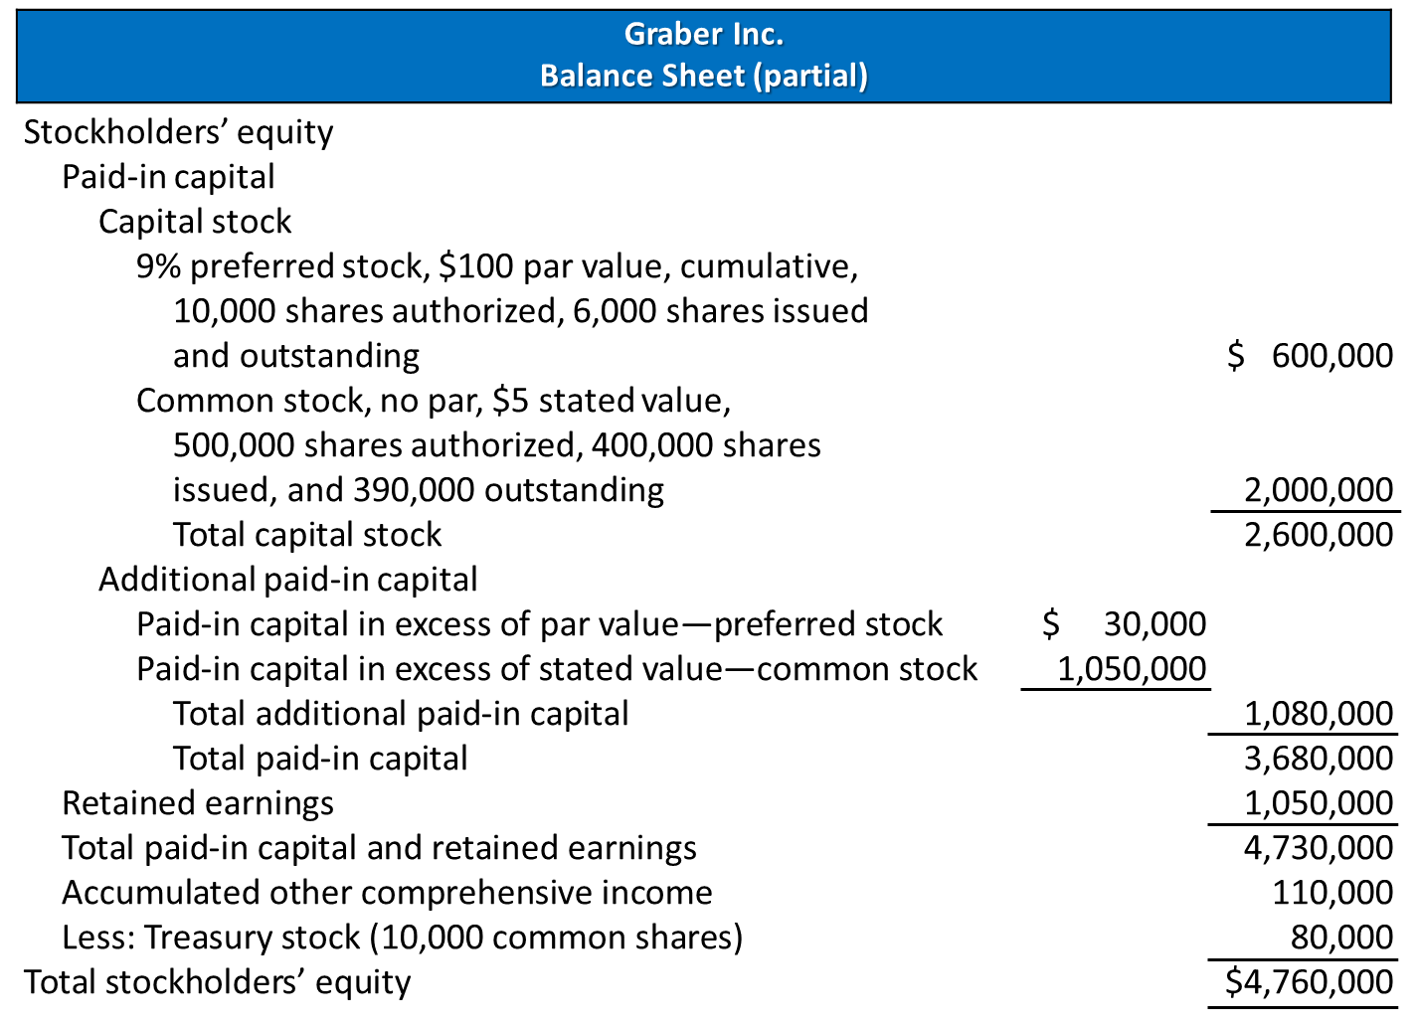
Stockholders’ Equity Section of Balance Sheet
L O 5

Slide 60
Learning Objective 5
Discuss How Stockholders’ Equity is Reported and Analyzed
L O 5

Slide 61
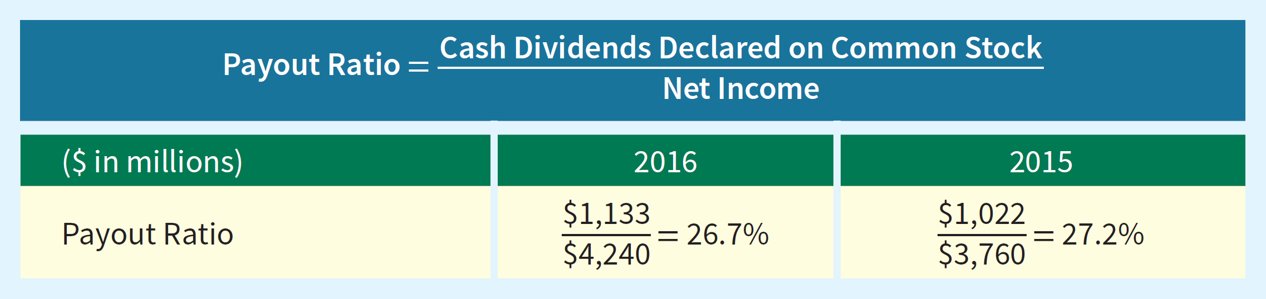
Analysis of Stockholders’ Equity
Dividend Record
Illustration: Payout ratio for Nike in 2016 and 2015.
 | 2016 | 2015
Dividends (in millions) | $ 1,133 | $ 1,022
Nel income (in millions) | 2,440 | 3,760
L O 5

Slide 62
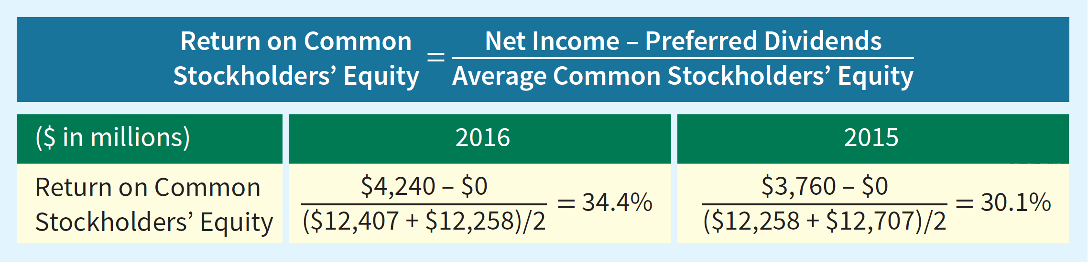
Analysis of Stockholders’ Equity
Earnings Performance
Illustration: Return on common stockholders’ equity ratio for Nike in 2016 and 2015.
(in millions) | 2016 | 2015 | 2014
Preferred dividends | $ -0- | $ -0- | $ -0-
Common stockholders' equity | 12,407 | 12,258 | 12,707
L O 5

Slide 63
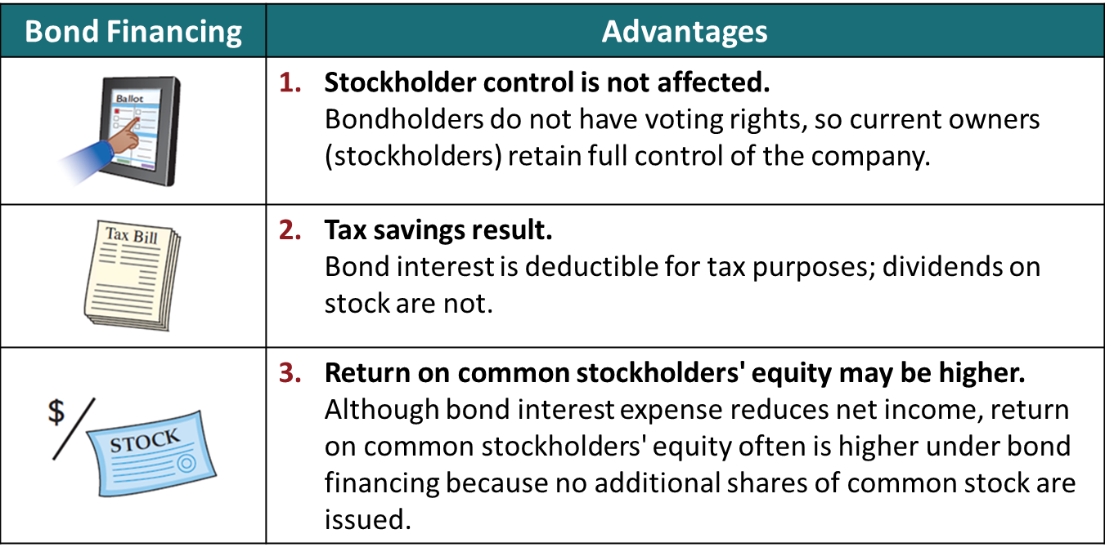
Debt Versus Equity Decision
L O 5

Slide 64
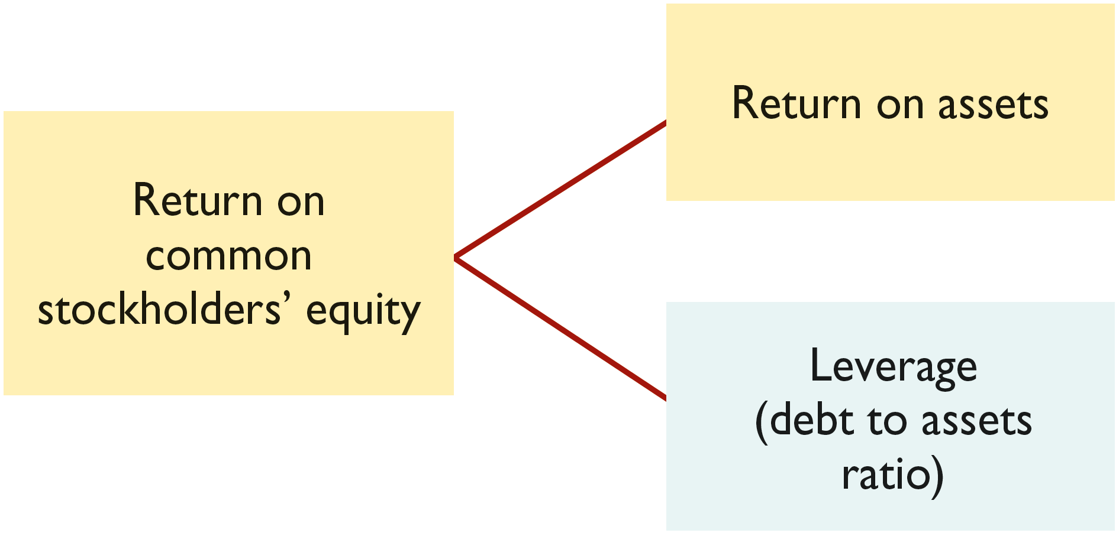
Debt Versus Equity Decision
Components of Return on Common Stockholders’ Equity
If a company wants to increase its return on common stockholders’ equity, it can either increase its return on assets or increase its reliance on debt financing.
L O 5

Slide 65
Debt Versus Equity Decision
Plan A Versus Plan B
Illustration: Microsystems Inc. currently has 100,000 shares of common stock outstanding issued at $25 per share and no debt. It is considering two alternatives for raising an additional $5 million:
Plan A involves issuing 200,000 shares of common stock at the current market price of $25 per share.
Plan B involves issuing $5 million of 12% bonds at face value. Income before interest and taxes will be $1.5 million; income taxes are expected to be 30%.
The alternative effects on the return on common stockholders’ equity are shown in the next Illustration.
L O 5

Slide 66
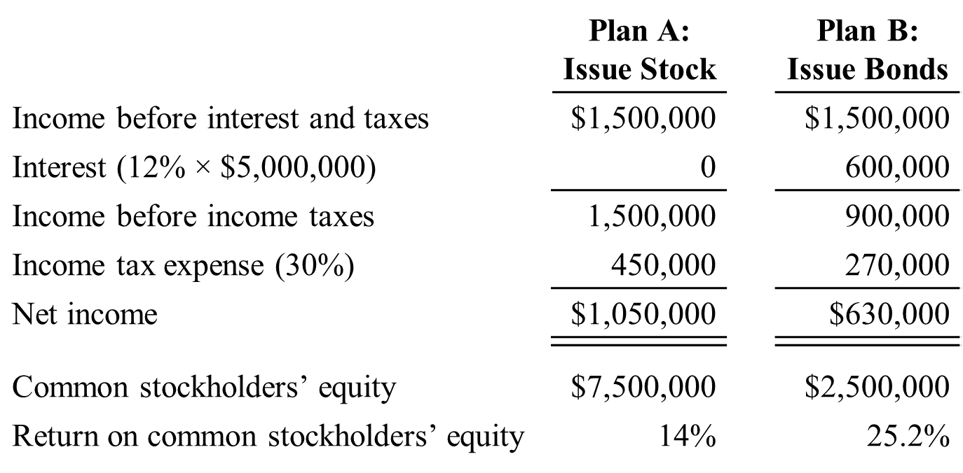
Debt Versus Equity Decision
Plan A Versus Plan B Solution
Even though net income is less with Plan B the return on common stockholders’ equity increases from 14% for Plan A (issuing stock) to 25.2% for Plan B (issuing bonds) because net income is spread over a smaller amount of common stockholders’ equity.
L O 5

Slide 67
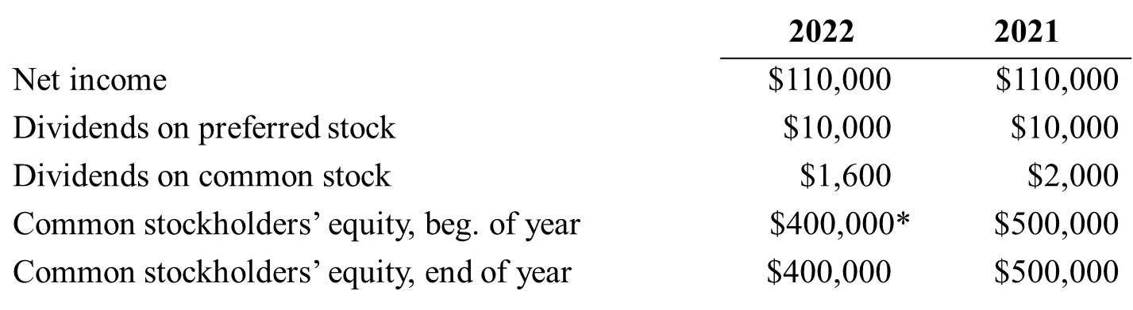
DO IT! 5: Analyzing Stockholders’ Equity
On January 1, 2022, Siena Corporation purchased 2,000 shares of treasury stock. Other information is provided below.
*Adjusted for purchase of treasury stock.
Compute the return on common stockholders’ equity for each year.
  L O 5

